Slide 1

Training resources from NDA
Postponed
Workshop on the EU Accessibility Act
May (TBC)
Public sector bodies and digital agencies
Previous trainings and webinars
http://universaldesign.ie
Public bodies subject to monitoring
Deque University Licence
http://EUWAD.nda.ie
webaccessmonitor@nda.ie

Slide 2

Accessibility for Developers
ARIA and the Accessibility Tree
Will Sutton
Accessibility and Usability Consultant
April 2024

Slide 3
Welcome
Live captions during the online event - toggle on/off
Slides, a transcript and recording will be made available
Please use the Q&A window to ask questions.​
Please use the chat window for general conversation.
There will be a link to feedback at the end.

Slide 4


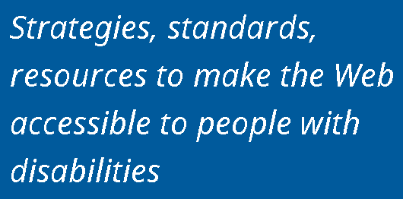

About AbilityNet

Slide 5
Free Webinar
There is a free webinar available that gives an Introduction to Accessibility
Definitions
Moral, Legal, Business and Universal Reasons
Web Content Accessibility Guidelines (WCAG)
abilitynet.org.uk/training

Slide 6
Outline
We’re going to cover:
The Accessibility Tree
What is ARIA
Name, Role, Value
Labelling Inputs and Basic Errors
Grouping Controls
Hiding Content
We will take pauses to answer questions throughout

Slide 7
Poll
How confident are you with accessibility?
Not at all confident
Somewhat confident
Moderately confident
Very confident

Slide 8
The Accessibility Tree

Slide 9
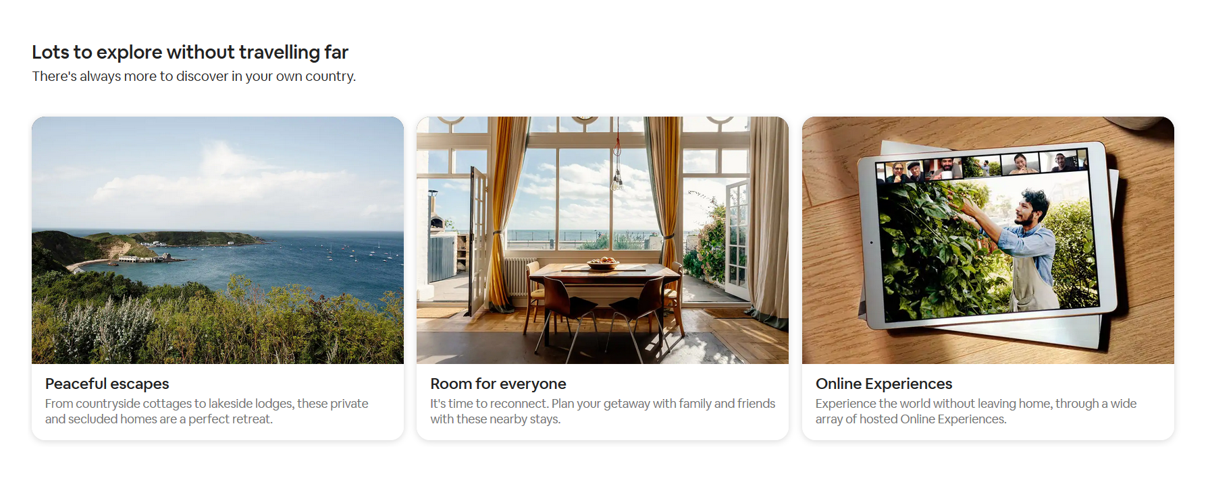
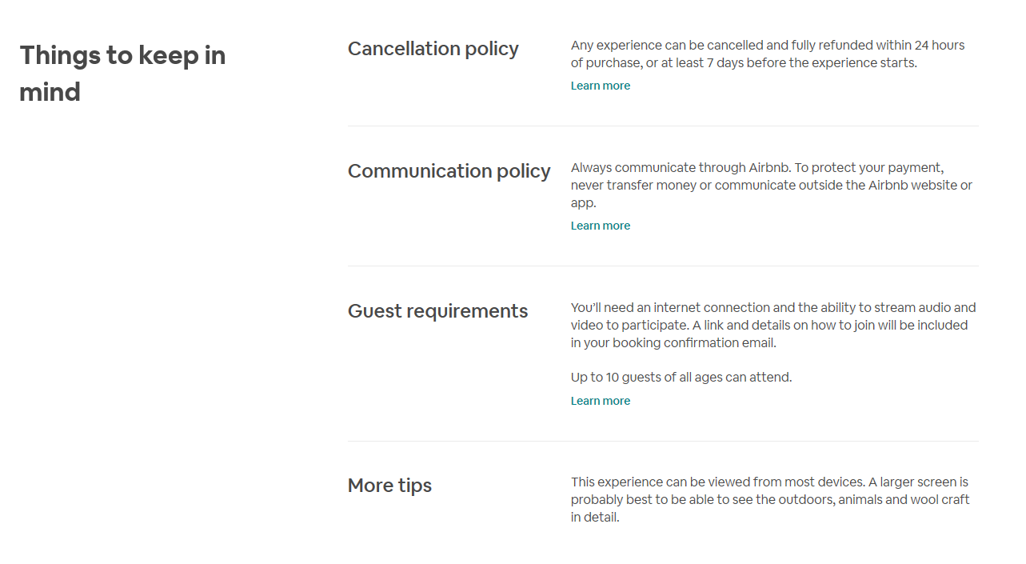
Structure and Design

Slide 10

Screen Readers
A software program that enables a blind or visually impaired user to read text
Also useful for people who are illiterate or have a learning disability
JAWS, NVDA, VoiceOver, Talkback
WebAim Screen Reader Survey

Slide 11
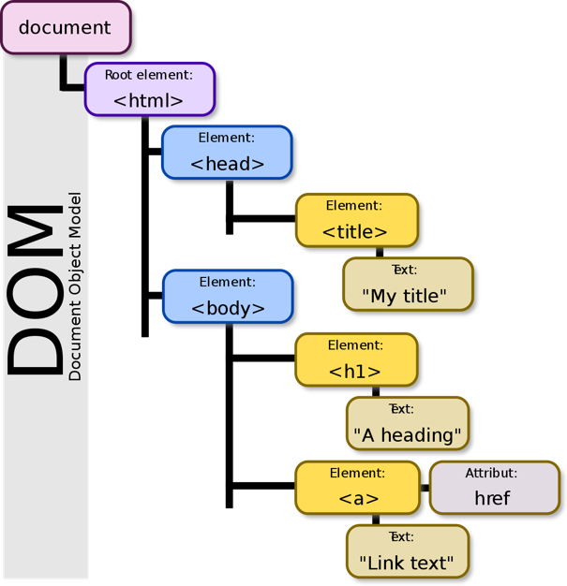
The Accessibility Tree Explained
Browser reads files from server
Browser builds DOM
Browser builds the accessibility tree
Assistive technology interact with the accessibility tree
A List Apart - Semantics to Screen Readers and Google - The Accessibility Tree

Slide 12
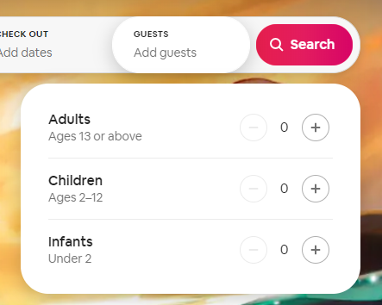
It matters how the code is written!
Semantics are important to convey meaning
CSS can make an element look like anything!
Button Example (codepen.io)

Slide 13
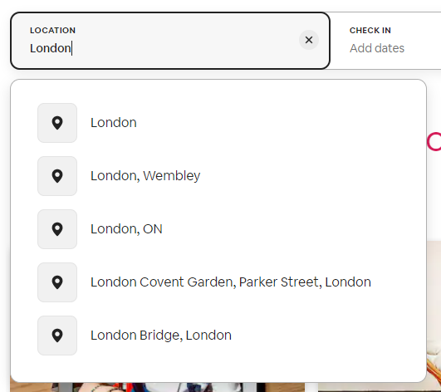
What about custom components?
Native HTML only provide so much information
Accordions/Tabs/Modals
ARIA can add extra meaning

Slide 14
What is ARIA?

Slide 15
Poll
Do you use ARIA on your website?
Yes
Yes, but I’m not sure if I’m using it correctly
No
I’m not sure

Slide 16
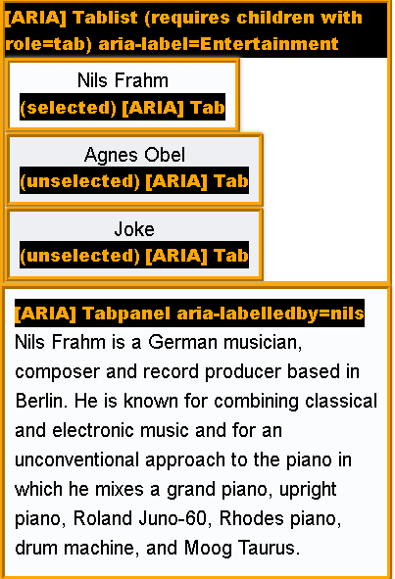
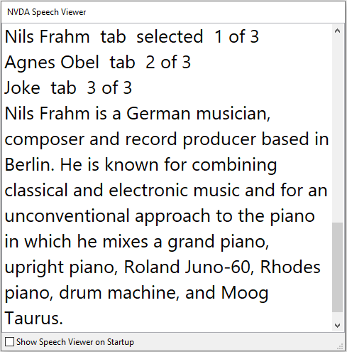
ARIA
The ARIA specification has rules such as “if you can use a native HTML element ... then do so.”.
Patterns such as accordions and tab panels are not available.
ARIA can fill in the gaps. CSS Tricks - aria is spackle not rebar.
ARIA Authoring Practices Guide (w3.org)

Slide 17
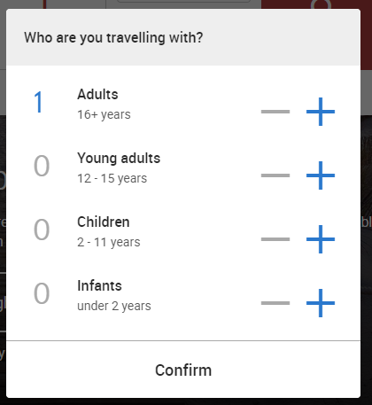
ARIA does…
Add additional content only for assistive technologies
Show a relationship between parent/child elements
Make part of the page ‘live ’ to inform users of a change
ARIA doesn’t…
Add any keyboard functionality
Make an element focusable

Slide 18

Questions?

Slide 19
Name, Role, Value

Slide 20
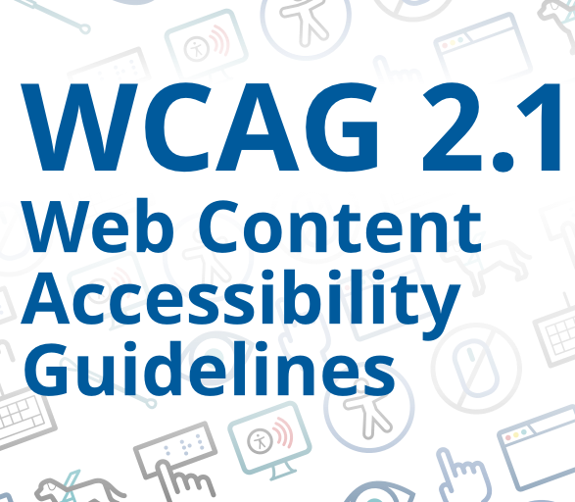
WCAG in a nutshell
WCAG is the Web Content Accessibility Guidelines and is a W3C Recommendation.
It has three levels—A, AA, and AAA. We target AA which includes A and AA.
It has four principles—Perceivable, Operable, Understandable and Robust.
WCAG Quick Reference and Wuhcag.

Slide 21


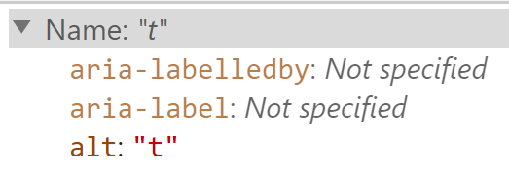
Example Success Criteria
The first success criteria Non-Text Content requires that “non-text content … has a text alternative that serves the equivalent purpose”. This means images, icons, and graphs.
The example on this slide has the text alternative is “t” and does not serve an equivalent purpose.
When in doubt, check the techniques.

Slide 22
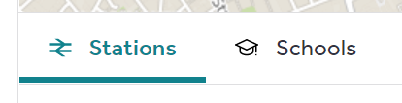

Name, role, value - WCAG
‘For all user interface components… the name and role can be programmatically determined; states, properties, and values that can be set by the user can be programmatically set; and notification of changes to these items is available to user agents, including assistive technologies.’ (Level A)
Can expose an objects name, role and value
Conventions exist on how users should interact with components

Slide 23
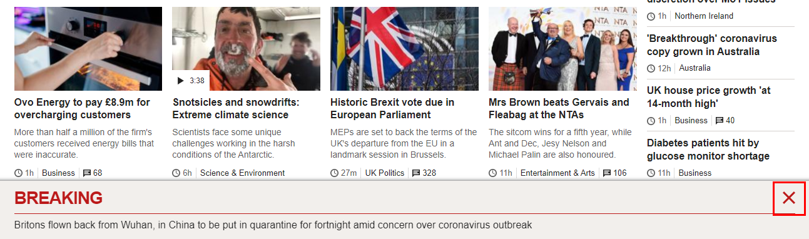
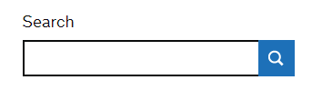
Name
Elements contents
An attribute on the element
An element associated with an element

Slide 24
Name – contents
<button type=“button”>Search</button>
Search, button
<div class=“button”>Search</div>

Slide 25
Name – aria-label
String of text that labels an element
Icon Button Example (codepen.io)
aria-label overwrites any content wrapped by the section
<button type=“button” aria-label=“Close banner”>X</button>
Close banner, button

Slide 26
Name – aria-labelledby
Visible text is linked with a component
<span id=“title”>Search</span>
<button type=“button” aria-labelledby=“title”></button>
Search, button

Slide 27
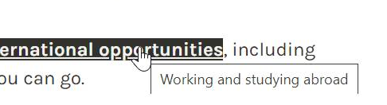
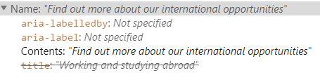
Name – title
Support for title is varied
Can be problematic to use

Slide 28
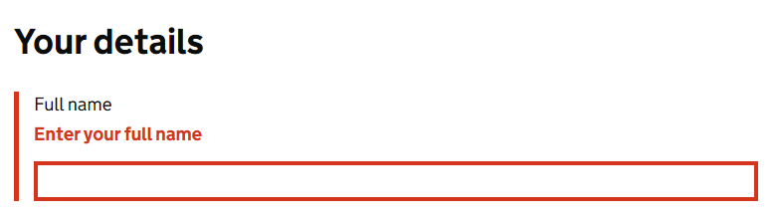
Name – description
aria-describedby provides a description for an element
<label for=“full-name">Full Name</label>
<span>Enter your full name</span>
<input type="text" id=“full-name” name=“name”>
<label for=“full-name">Full Name</label>
<span id=“error”>Enter your full name</span>
<input type="text" id=“full-name" name=“name” aria-describedby=“error”>
Full name, edit text
Full name, enter your full name, edit text

Slide 29
Role
Defines what an element is or does.
HTML elements have implicit roles
ARIA can be used to add roles
HTML is preferred
<button> | role=“button"
<header> | role=“banner"
none | role=“tab"

Slide 30
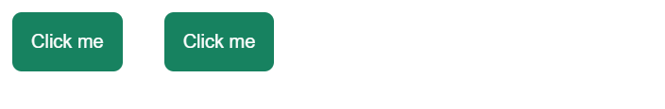
Role – keyboard behaviour
It is important to ensure keyboard behaviour also matches the given role
<button type=“button”>Click me</button> ‘Click me, button’
<div role=“button”>Click me</div> ‘’
role=“button” must receive focus, and be activated using ENTER or SPACE

Slide 31
Poll
What is the expected keyboard behaviour for a checkbox?

Slide 32
Don’t change the native semantics!
<h2 role=“button”>Heading</h2>
<h2><div role=“button”>Heading></div></h2>

Slide 33
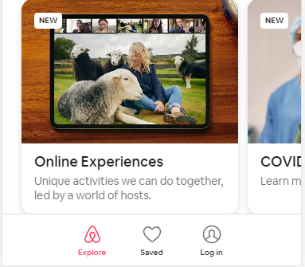

Value
Accordion Button Example (codepen.io)
ARIA Authoring Practices – Role Button

Slide 34
Questions?

Slide 35
Labelling Inputs and Basic Errors

Slide 36
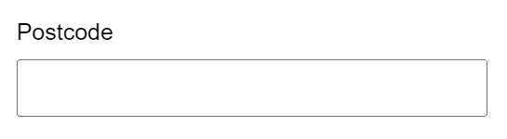
Associating label with input
‘edit text’
<span>Postcode</span>
<input type="text" id=“postcode" name=“postcode">

Slide 37
Native HTML – explicit labelling
‘Postcode, edit text’
<label for=“post-code">Postcode</label>
<input type="text" id=“post-code" name=“postcode">
<p id=“postcode-label">Postcode</p>
<input type="text" aria-labelledby=“postcode-label” name=“postcode">

Slide 38
Native HTML – implicit labelling
‘Postcode, edit text’
<label>
Postcode <br/>
<input type="text" id=“post-code" name=“postcode">
</label>

Slide 39
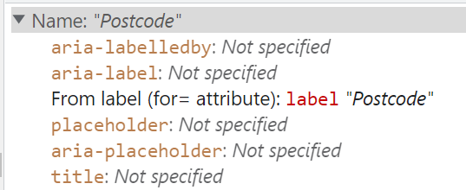
Back to the Accessibility Tree
title
aria-placeholder
placeholder

Slide 40
No visual label
<label for=“search“ style=“display: none;”>Search</label>
<input type="text" id=“search" name="name">
<label for=“search“ style=“display: none;”>Search</label>
<input type="text" id=“search" name="name">
<label for=“search“ class=“sr-only”>Search</label>
<input type="text" id=“search" name="name">

Slide 41
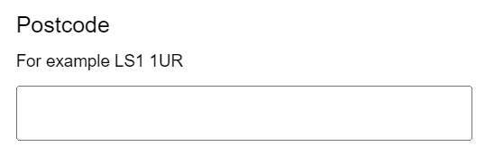
Instructions
‘Postcode, edit text, For example LS1 1UR’
<label for=“post-code”>Postcode</label>
<span id=“instruction”>For example LS1 1UR</span>
<input type="text“ id=“post-code” name=“postcode“ aria-describedby=“instruction”>

Slide 42
Error – associated
<label for=“full-name">Full Name</label>
<span id=“error”>Enter your full name</span>
<input type="text" id=“full-name" name=“name” aria-describedby=“error”>
Full name, edit text, enter your full name

Slide 43
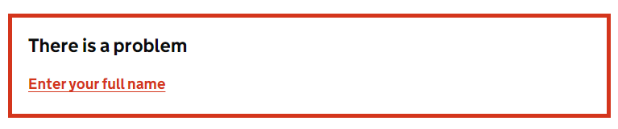
Error summary – associated
<div class=“alert”>
<span id=“error”>Enter your full name</span>
</div>
<label for=“full-name">Full Name</label>
<input type="text" id=“full-name" name=“name” aria-describedby=“error”>

Slide 44
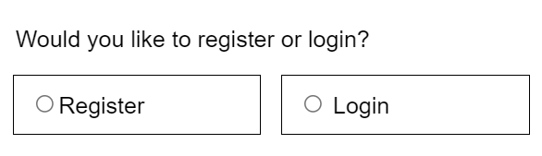
Grouping controls

Slide 45
Grouping multiple inputs
<div>
<input type=”radio" id=“accountType1" value=“register” name=“signup”>
<label for=“accountType1”>Register</label>
</div>
<div>
<input type=”radio" id=“accountType2" value=“login” name=“signup”>
<label for=“accountType2”>Login</label>
</div>
<div>
<input type=”radio" id=“accountType1“ value=“register”>
<label for=“accountType1”>Register</label>
</div>
<div>
<input type=”radio" id=“accountType2” value=“login”>
<label for=“accountType2”>Login</label>
</div>

Slide 46
Grouping multiple inputs - native
<fieldset>
<legend>Would you like to register or login?</legend>
<div>
<input type=”radio" id=“accountType1" value=“register” name=”signup">
<label for=“accountType1”>Register</label>
</div>
<div>
<input type=”radio" id=“accountType2" value=“login” name=”signup">
<label for=“accountType2”>Login</label>
</div>
</fieldset>

Slide 47
Grouping multiple inputs - ARIA
<div role=“radiogroup” aria-labelledby=“radioTitle1”>
<h2 id=“radioTitle1”>Would you like to register or login? </h2>
<div>
<input type=”radio" id=“accountType1" value=“register” name=”signup">
<label for=“accountType1”>Register</label>
</div>
<div>
<input type=”radio" id=“accountType2" value=“login” name=”signup">
<label for=“accountType2”>Login</label>
</div>
</div>

Slide 48
Questions?

Slide 49
Hiding Content

Slide 50
Hiding content from everyone
Content that is revealed when pressing a button
CSS - display: none;
HTML – hidden
height: 0; opacity: 0;
<label for=“full-name“ style=“display: none;”>Full Name</label>
<input type="text" id=“full-name" name="name">

Slide 51
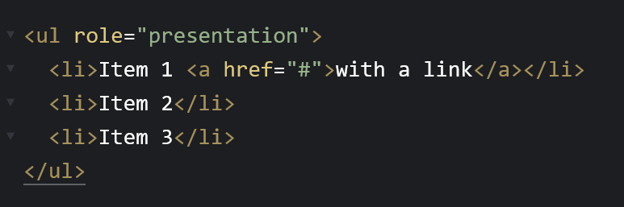
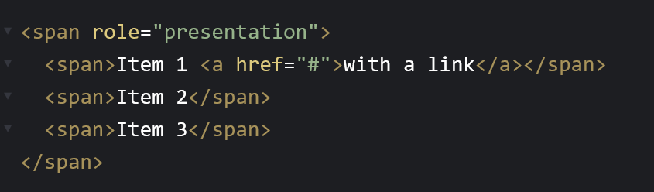
Hiding content from screen readers
Content that is for visual effect – an icon
aria-hidden=“true”
Don’t confuse with role=“presentation” and role=“none”

Slide 52
Don’t hide focusable elements
Don’t use role=“presentation” or aria-hidden=“true” on focusable elements
<button role=“presentation”>Button</button>
The screen reader would focus on nothing

Slide 53
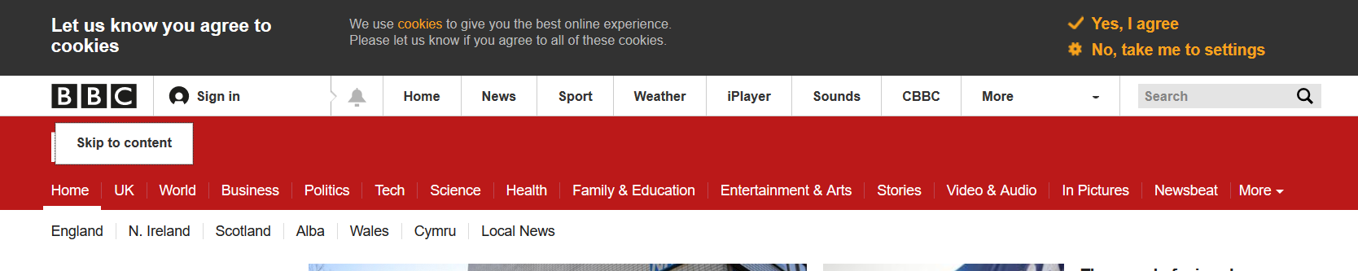
Hiding content from sighted users
Content that might be used to provide context for screen reader users
CSS can be used to hide the information visually
How-to: Hide content - The A11Y Project

Slide 54
Summary

Slide 55
Recap
We’ve covered a lot of ground! We’ve talked about:
The Accessibility Tree
What is ARIA
Name, Role, Value
Labelling Inputs and Basic Errors
Grouping Controls
Hiding Content

Slide 56
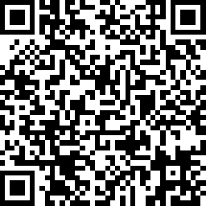


Thank you
Please let us know what you thought: surveymonkey.com/r/L7QTYH5
Scan to leave feedback

Slide 57
Questions?

