Slide 1
From Compliance to Excellence Using accessibility to create great digital services for all
Thursday June 27th, 2024

Slide 2
Agenda
10:00 - Introduction and Opening
10:00-10:10 Dónal Rice. Head of Monitoring – EU Web Accessibility Directive. National Disability Authority
10:10 – 10:30 John Barron. CIO. Revenue Commissioners.
10:30 – 11:00 Brian Dalton. Accessibility Test Lead – A user’s experience of government digital services.
11:00 -11:45 Panel 1 – Public sector perspectives on accessibility
11:45 – 12:00 - Break
12:00-12:40 pm Panel 2 – Building accessibility into the design and development of digital services
12:40 – 13:00 Closing reflections
Trevor Vaugh – Public Service Design Lead, Department of Public Expenditure NDP.
Lunch/networking
13:00
Notes:
https://www.flaticon.com/free-icons/blog
https://www.flaticon.com/free-icons/training

Slide 3
John Barron. CIO. Revenue Commissioners.
Notes:
https://www.flaticon.com/free-icons/blog
https://www.flaticon.com/free-icons/training

Slide 4
Accessibility
Version 1
Driving consistency and change at scale
John Barron, Revenue CIO
June 2024
Notes:
Main slide version 1 - Depends on the audience

Slide 5
One in 5
In Ireland, the number of people who have a disability or disabling condition is increasing.
In Census 2022 1,109,557 people (22% of the population) reported having a long-lasting condition/difficulty or disability to any extent.
This compares with 643,131 people indicated that they had a disability in the 2016 census

Slide 6
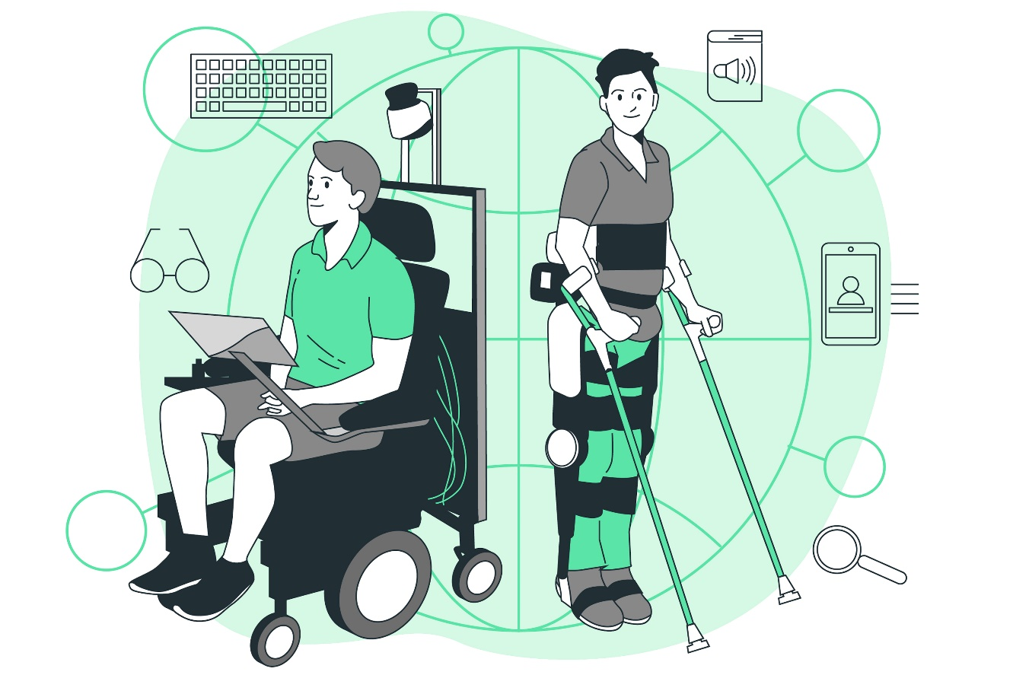
Accessibility is a legal imperative
The Disability Act 2005
The Equal Status Acts 2000-2018
The Official Languages Act 2003
The EU Web Accessibility Directive (Directive (EU) 2016/2102)
The Public Sector Equality and Human Rights Duty
Notes:
The Disability Act 2005 requires public bodies to make their services, information and buildings as accessible as possible to people with disabilities. This includes making reasonable accommodations to ensure accessibility.
The Equal Status Acts 2000-2018 prohibit discrimination against people with disabilities in the provision of goods, services, accommodation etc. Service providers have a duty to provide reasonable accommodations to facilitate access.
The EU Web Accessibility Directive (Directive (EU) 2016/2102) aims to harmonize accessibility standards for websites and mobile apps of public sector bodies across the EU. It requires EU member states to ensure that public sector websites and apps meet Web Content Accessibility Guidelines (WCAG) 2.1 AA accessibility standards.
The Official Languages Act 2003 requires public bodies to ensure that information, services and documents are available in both Irish and English. Any digital services, websites, apps etc. should accommodate both languages.
The Public Sector Equality and Human Rights Duty requires public bodies to eliminate discrimination, promote equality and protect human rights in their public functions. This includes a positive duty to make information, services and buildings accessible.

Slide 7
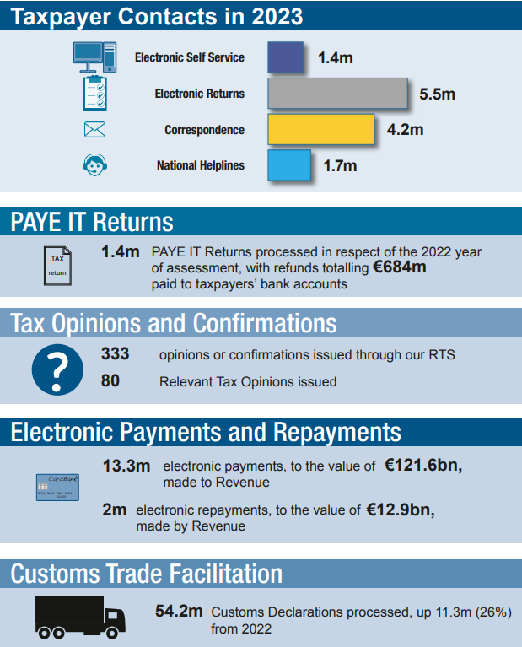
Revenue - A Digital business
In 2023, the total gross receipts were €127.9 billion, including €26.3 billion in non-Exchequer receipts collected on behalf of other Government Departments and agencies.
Revenue’s online and B2B systems are critical enablers.
Therefore, accessibility is hugely important to allow all taxpayers meet their tax & Customs obligations.

Slide 8
Revenue Website Accessibility
At a technical level, Revenue operates 4 “separate” but linked websites – Revenue.ie, ROS.ie, LPT & myaccount sites
Revenue’s accessibility statement for each states;
The Revenue Commissioners is committed to making its website accessible. This is in accordance with European Union (Accessibility of Websites and Mobile Applications of Public Sector Bodies) Regulations 2020.
The reality is that Revenue.ie, ROS.ie, LPT & myAccount sites are partially conformant with WCAG 2.1 level AA. Partially conformant means that some parts of the content do not fully conform to the accessibility standard.
Notes:
Known limitations for Revenue website
Tables: Some tables do not have correctly defined headers.
Tables: Some tables have form elements with no associated labels.
Checkboxes: Some checkboxes do not have keyboard operations.
Labels: Some UI components do not have labels.
Lists: Some unordered lists may contain more than only <li> items.

Slide 9
2023 NDA Audit of Revenue
Score 92.65 *
13th out of 145 websites audited *
52% of WCAG Success criteria fully passed
No blockers found in 2023 Audit
222 Critical issues identified
ROS.ie (189) and MyAccount (33)
Similar issues were flagged in multiple places for the 222 critical issues, most issues were not unique
*Monitoring-Report-EU-WAD-Ireland-2023 (Table 5.3 pg. 116)

Slide 10
2023 Audit Issues Found
Form field errors not identified (Fixed)
User not warned of timeout (Fixed)
Info & relationships not conveyed programmatically (Fixed)
Missing or irrelevant alt text for images (Fixed)
Keyboard only accessibility issues (Fixed)
Focus indicators not adequate (Fixed)
Reading order and code order mismatch (Fixed)

Slide 11
2024 Audit
The 2024 Audit focused on ROS.ie as that was where issues seemed to be focused
Pages for the audit were picked based on traffic, to ensure maximum benefit
A mix of last year's pages (to check our progress) and new pages and elements were audited this year
Currently awaiting the results of this audit
The NDA audits are hugely beneficial to Revenue and ensure that accessibility receives a strong focus

Slide 12
The forgotten front?
Revenue has 7000 staff;
-blend of in-office and remote working
-24x7 service
How accessible are our line-of-business applications?

Slide 13
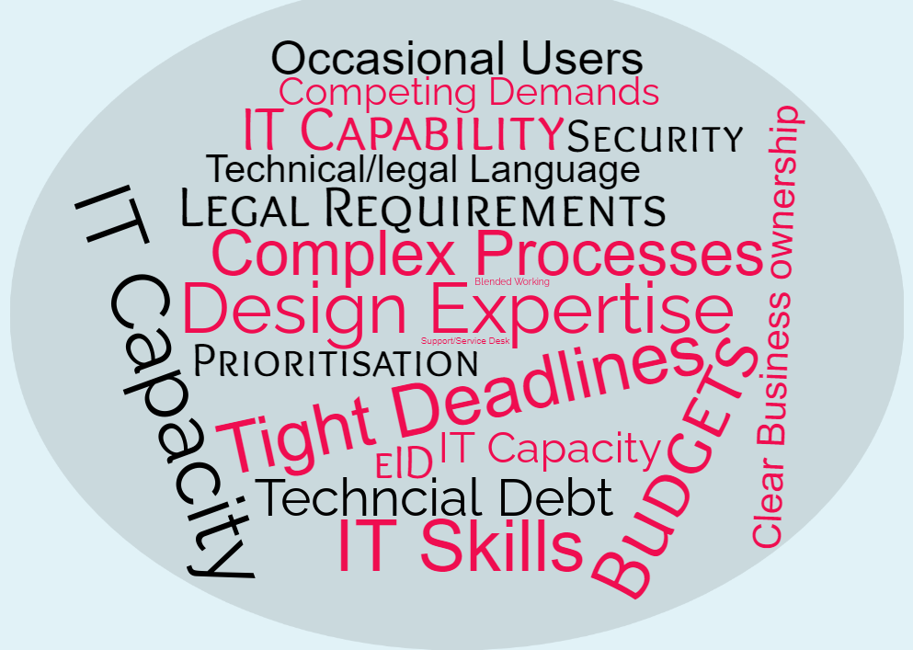
Challenges

Slide 14
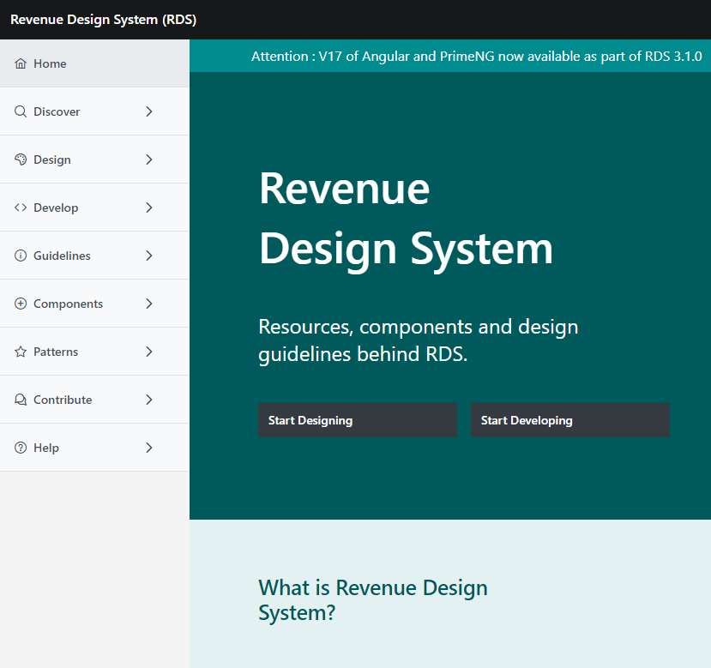
Revenue Design System
Accessibility integrated into the UI from the start
Comprehensive accessibility guidelines and documentation
Prioritising accessibility features and enhancements
Change management through internal communications
Sharing best practices for inclusive design
Collaborative approach to accessibility testing and feedback
Continuous improvement through user feedback and industry standards
Notes:
Design System. UI components are reusable, modular elements like buttons, input fields and dropdowns used to construct user interfaces. They ensure consistency, improve development efficiency, and enhance user experience by providing standardised elements across applications.

Slide 15
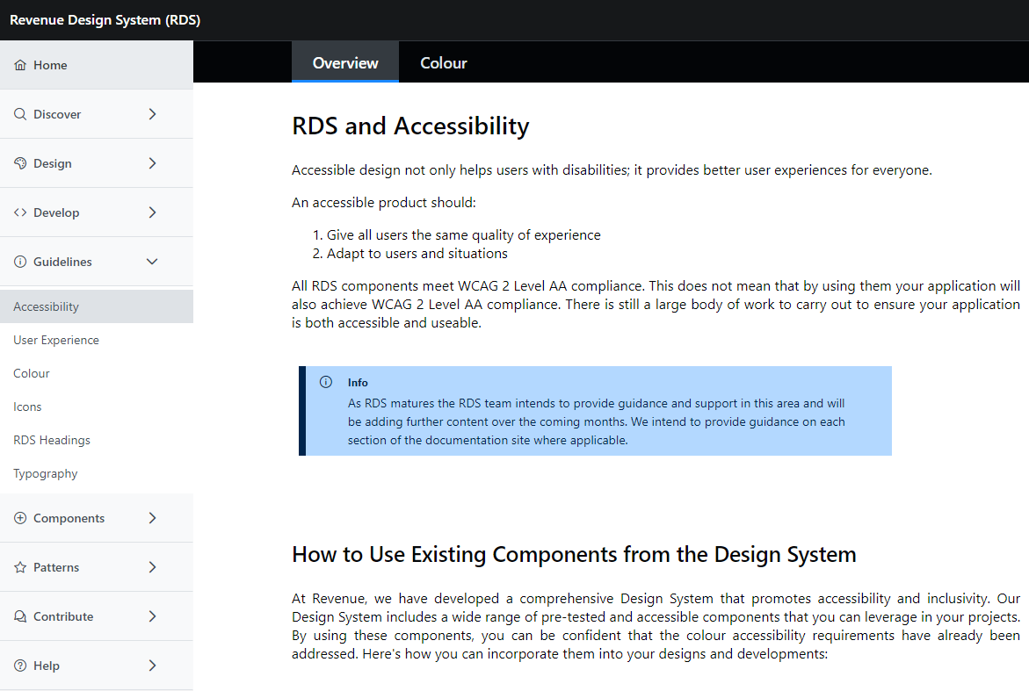
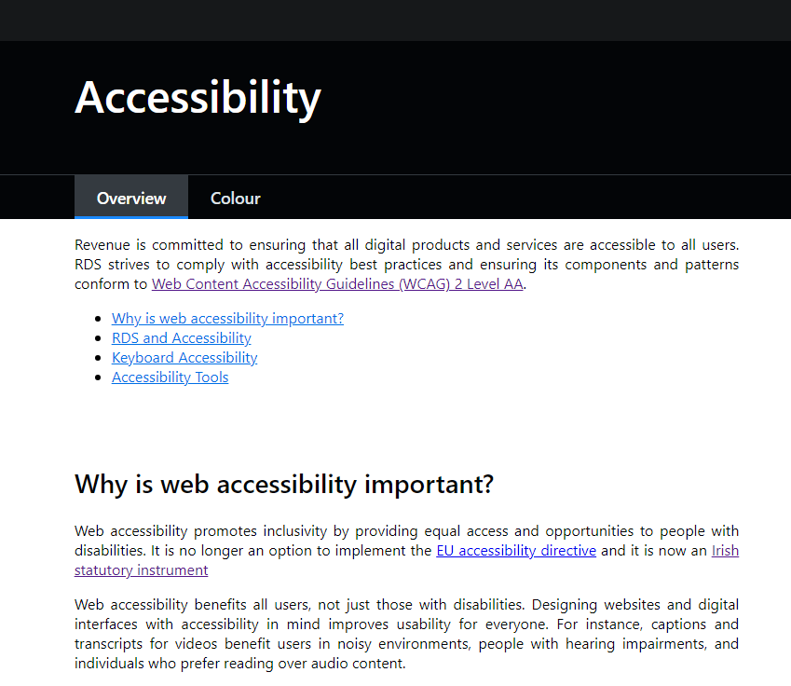
Accessibility in Design System Components
Integrated into Components from the Start
Colour contrast
Typography
Spacing and layout
States and Interactions
Responsive design
Icons
Form elements
Validation & error states
Notes:
Accessibility at the component level: How does DS ensure the accessibility of its components
Colour Contrast: Ensuring that text and interface elements have sufficient colour contrast
Typography: we address size and spacing accessibility requirements.
Spacing and Layout: Pay attention to spacing and layout considerations - Standardization approach.
States and Interactions: Making interactive elements perceivable and operable. Include focus states for keyboard users to create keyboard-accessible components.
Responsive Design: Ensuring our components are responsive.
Icons: Defining consistent padding requirements for icon usage in components.
Form Elements, Validation, Error States: Providing standardisation and guidance on validation messages in our documentation. We have been working on the content, and it will be added to the doc site

Slide 16
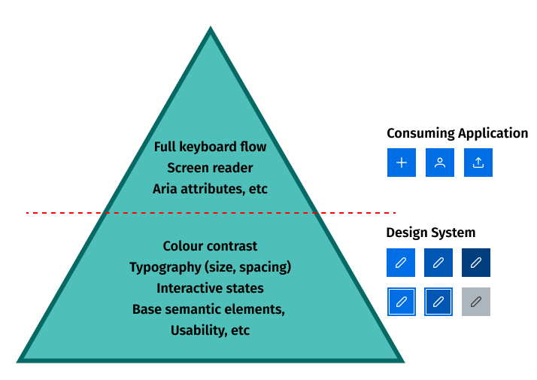
Accessibility at Scale
Responsibilities and Ownership
Development Teams: Can be confident that components meet accessibility standards, workload reduced
Development Teams: Have a responsibility to ensure the flow of application is correct and accessibility attributes have been applied
Design System Team: Has ownership and responsibility for core accessibility
Design System Team: Ensures accessibility across the UI while allowing teams to adapt components to their needs
Notes:
Context is key: Much of accessibility is context-specific, and can’t be fully implemented without that end-usage context.
<image>
DS level:
Default Hover Active
Focus HoverFocus Disabled
Important to consider:
- what aspects of accessibility we can build into our DS foundation
- what it will be need to do later when consuming the DS

Slide 17
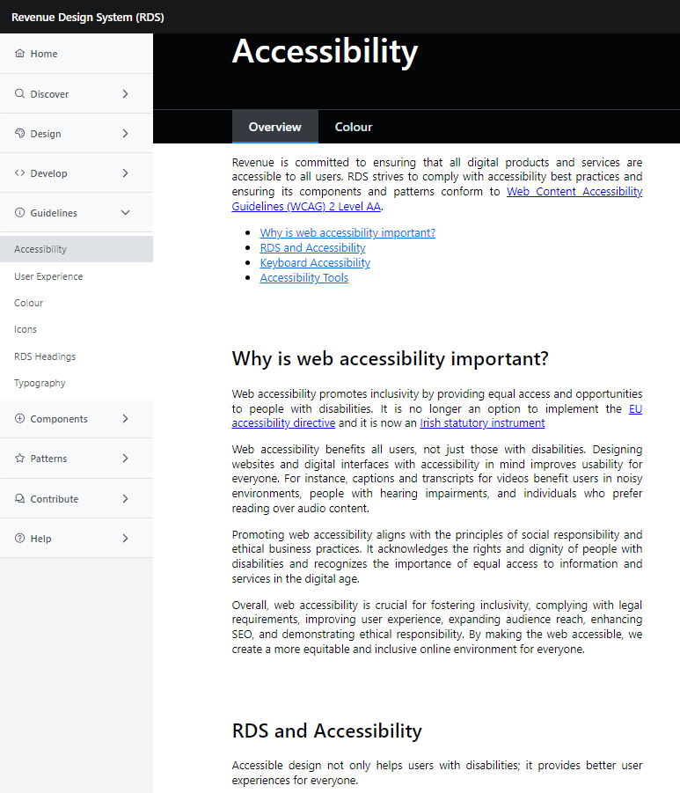
Championing Accessibility
Encouraging and communicating
Accessibility as our Priority: Ensuring everyone understands the importance of accessibility and is supported with implementation
Documentation: Revenue centric documentation ensures everyone is on the same page
WCAG AA Standards: Revenue strives to achieve WCAG AA compliance across its suite of applications
Component-Level Approach: Accessibility is baked into Revenues component Library. Ensuring all components are WCAG compliant before development commences
Improved User Experience: By making accessibility a requirement it improves usability for all users
Notes:
Improved user experience: Accessible design features enhance usability for all users, regardless of their abilities, leading to a more intuitive and user-friendly interface.
Expanded audience reach: By catering to individuals with disabilities, accessible design allows a broader audience to access and interact with web content, thereby increasing overall user engagement.
Enhanced search engine optimization (SEO): Implementing accessible design principles often leads to improved SEO, as search engines favor websites with clear, organized, and descriptive content that is easy to navigate.
Future-proofing: Creating an accessible website ensures adaptability to evolving technologies and standards, thus minimizing the need for extensive redesigns or updates in the future.
Compliance with legal requirements: Adhering to accessibility standards ensures compliance with legal obligations, helping to avoid potential lawsuits and penalties related to discrimination and accessibility violations.
Positive brand image: Prioritizing accessibility demonstrates a commitment to inclusivity and social responsibility, leading to a more positive perception of the brand among users and stakeholders.

Slide 18
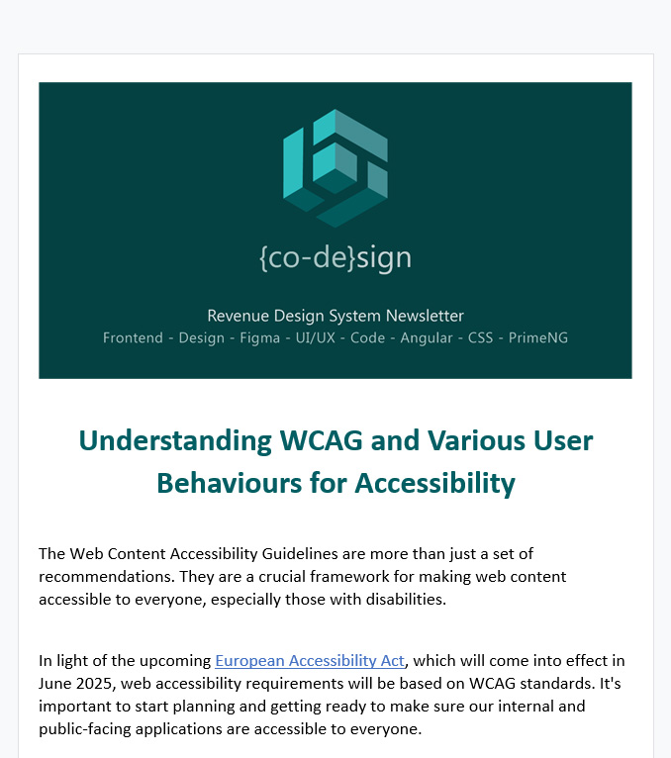
Internal communications
Managing Change
Keeping development teams informed on best practices and latest standards with monthly Design System newsletters
Promoting available courses on accessibility
Promoting accessibility testing tools and resources
Advocating for accessibly

Slide 19
User-Centric Benefits
User familiarity and consistency
Enhanced usability
Reduced learning curve
Improved trust and credibility
All provide for a better user experience
Notes:
User familiarity: Consistency in design creates a sense of familiarity, making it easier for users to navigate and interact with different parts of a product or service without feeling lost or confused.
Enhanced usability: Consistent design patterns and elements contribute to improved usability by allowing users to predict the behaviour and functionality of different components, leading to a more intuitive and efficient user experience.
Reduced learning curve: With a consistent design, users don't have to relearn how to interact with various parts of a product or service, reducing the time and effort required for them to become proficient users.
Improved trust and credibility: Consistent design instils a sense of trust and credibility in users, as it reflects attention to detail and professionalism, leading to a positive perception of the product or service

Slide 20
Accessibility & ISO Standards
Design System can support ambition in achieving ISO standards
Notes:
Optional slide:
DS can support ICT&L Ambition in achieving ISO standards, such as the standard for Software Product Quality.
This includes requirements for UI aesthetics, Accessibility, Application Learnability, Recognizability, User Error Protection all of which also correspond to good UX.

Slide 21
Accessibility is an ongoing task and is never really finished
Accessibility is like 'painting the Forth Bridge’!
It is a never-ending but essential task.

Slide 22
Final slide – thanks for listening and open to questions.
Thank you for your attention

Slide 23
Brian Dalton. Accessibility Test Lead
Notes:
https://www.flaticon.com/free-icons/blog
https://www.flaticon.com/free-icons/training

Slide 24
Agenda
11:00 -11:45 Panel 1 – Public sector perspectives on accessibility
Karin Whooley, Principal clerk (previously web manager) Houses of the Oireachtas
James Northridge, Manager for Inclusive UCC
James Killeen, A/Web manager. Mayo County Council
Ron Beenen, Deque Systems
Orla Kealy, Senior Staff Officer, Kildare Wicklow ETB
Notes:
https://www.flaticon.com/free-icons/blog
https://www.flaticon.com/free-icons/training

Slide 25
11:45 – 12:00 - Break
Notes:
https://www.flaticon.com/free-icons/blog
https://www.flaticon.com/free-icons/training

Slide 26
Agenda
12:00 -12:40 Panel 2 – Building accessibility into the design and development of digital services
Moderator: Jakub Christoph. Secretary General at CEPIS and ITPE/ ICS
Sorca Duffy, UX / UI designer. Health Services Executive
Mick Keane, Accessibility Engineer. Optum.
Aoife Geoghegan, Head of Design and Content. Office of the Government Chief Information Officer.
Brendan MacDonagh, Kooba
Bridget Connaughton, Lead Designer. ESB
Notes:
https://www.flaticon.com/free-icons/blog
https://www.flaticon.com/free-icons/training

Slide 27
Closing reflections Trevor Vaugh – Public Service Design Lead, Department of Public Expenditure NDP.
Notes:
https://www.flaticon.com/free-icons/blog
https://www.flaticon.com/free-icons/training

Slide 28
Lunch/networking
Notes:
https://www.flaticon.com/free-icons/blog
https://www.flaticon.com/free-icons/training

