Slide 1
EU Web Accessibility Directive Trainings
Accessibility InDesign - 27th November
Self-paced follow-on inDesign Training for public bodies – webaccessmonitor@nda.ie
Begin Your Own Accessibility Testing – 12th December 10:00am
European Accessibility Act – 29th November 10:00am

Slide 2
InDesign accessibility
James Baverstock Principal Accessibility Consultant, AbilityNet
November 2023

Slide 3
Welcome
This session is recorded and the recording will be sent after the session along with the slide deck
Automated captions are available and can be turned on from the meeting controls
Please add questions to the chat and I’ll pause for questions after each section
Demo file is available

Slide 4
Today we will be covering
What makes an accessible document?
Accessible content creation in InDesign
Visual design considerations for accessibility
Demo of applying accessibility principles to InDesign documents
Exporting to accessible PDF

Slide 5
Demo document
Demo file
How to create content accessibly
Headings, text, lists, tables, images, links, table of contents
Reading order
Metadata
Export tags
Source: NiroDesign/iStock/Getty Images Plus

Slide 6
Why make documents accessible?
The power of the Web is in its universality. Access by everyone regardless of disability is an essential aspect
Tim Berners-Lee, Inventor of the World Wide Web

Slide 7
WCAG accessibility principles (POUR)
Perceivable: Content is presented in ways that can be perceived by all
Operable: Content can be operated by all
Understandable: Information and the operation of user interface is understandable
Robust: Content is reliable and compatible with assistive technology and standards

Slide 8
Characteristics of accessible documents
Searchable text
Navigational aids (bookmarks, headings, table of contents)
Metadata e.g. title and document language
Programmatic document structure e.g. tags
Logical reading order
Interactive elements such as links that can be tabbed to with keyboard
Alternative text for non-text elements
Appropriately formatted tables

Slide 9
Questions?

Slide 10
Creating accessible content in InDesign

Slide 11
Accessibility should not be the last step
A last-minute approach usually results in a bad design
Accessibility is easier and less costly when considered at the design stage or the source document
No need to repeat all the accessibility activities for new versions

Slide 12
InDesign accessibility strategy
Bake in as much accessibility as possible into your InDesign source file.
Export to tagged PDF
Test and clean up any remaining issues. Remediate the few areas which cannot be handled in InDesign – e.g. setting scope for table headers and header/cell ID associations for complex tables.

Slide 13
Avoid relying on the formatting toolbar
Avoid formatting items individually using the tools in the formatting toolbar as it leads to:
Inaccessible documents
Visual inconsistency
More time and effort in the long run

Slide 14
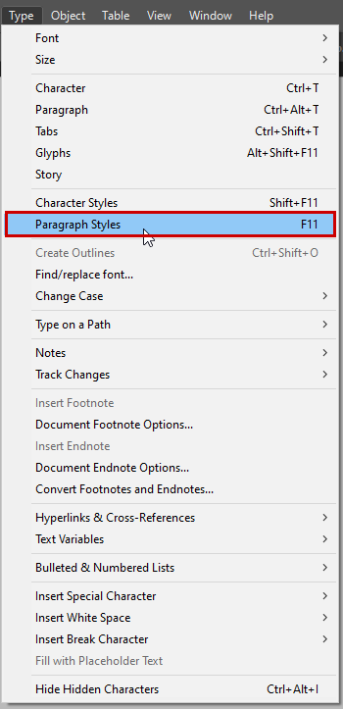
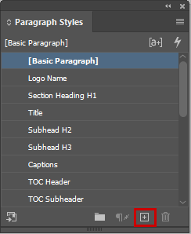
Use paragraph styles
Set up paragraph styles and assign export tags:
Create paragraph style: Type > Paragraph styles
Open the style editor: Double-click on the new style icon
Assign a name to the style
Format the visual style as desired (e.g., font family, style, size)

Slide 15
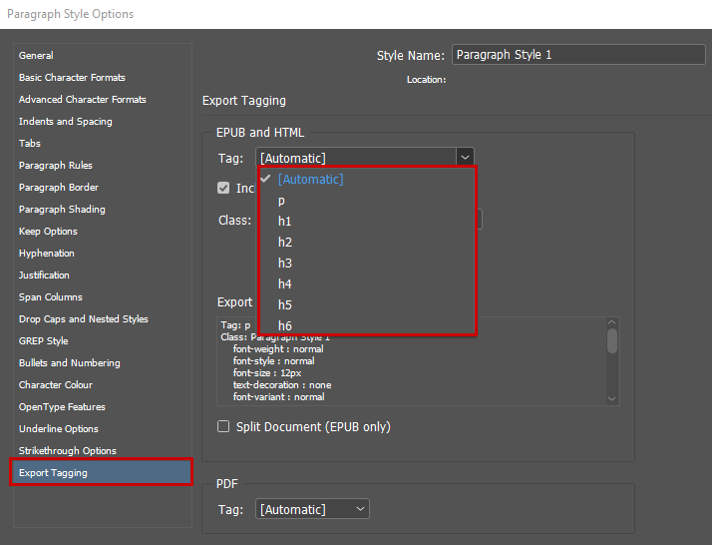
Assign appropriate tags for export to PDF
In the Paragraph Styles, select the appropriate tags:
Plain text: P tag
Headings: H1 to H6 tags
All other elements (e.g., lists, tables): Automatic tag

Slide 16
Use built-in tools
Use built-in tools where possible instead of creating elements manually. For example:
Paragraph Styles > Bullets and numbering
Table > Insert table
Layout > Table of contents

Slide 17
Questions?

Slide 18
Visual design considerations

Slide 19
Visual design considerations
Use of colour
Images of text
Colour contrast
Typography
Layout

Slide 20
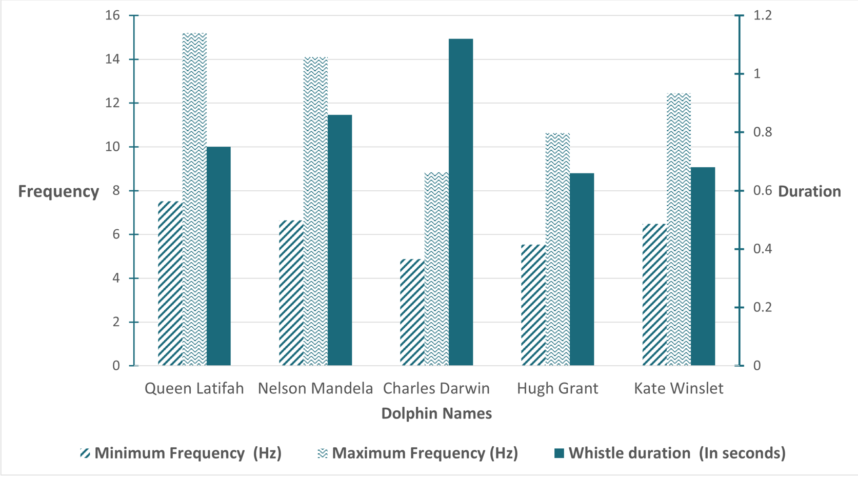
Use of colour
Ensure that colour is not the only way that information is communicated
Provide alternative to colour (e.g., text, textures and patterns)
Links should have some decoration (e.g. underline, outline)

Slide 21
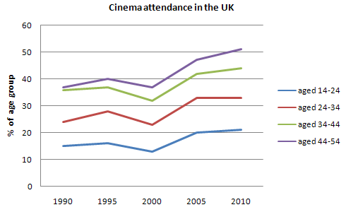
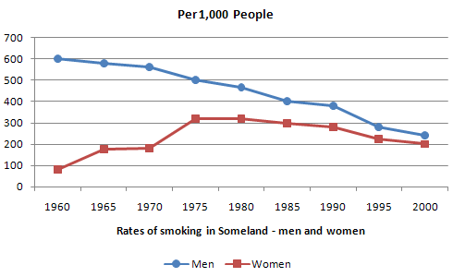
Use of colour: graphs and charts

Slide 22
Other sensory considerations
Ensure instructions provided for understanding and operating content do not rely solely on sensory characteristics of components:
Shape
Size
Location

Slide 23
Colour contrast
Text and images of text must have a contrast ratio of at least 4.5:1 with the background and large text must have a contrast ratio of at least 3:1
Meaningful images (e.g. elements in graphs & charts) must have at least 3:1 contrast
Decorative elements and logos are exempt (but brand colours are not)

Slide 24
Colour contrast tools
Color Safe
Who can use
Colour Contrast Analyzer
Leserlich Contrast Calculator

Slide 25
Images of text
Avoid images of text unless it cannot be avoided for presentation purposes (e.g. company logo)
Text may pixelate when magnified
Text can’t be selected
Colour/size cannot be customised

Slide 26
Typography & layout
Avoid fancy fonts (e.g. cursive or unusual shapes)
Use at least 12 point font size
Use simple and uncluttered design
Consider cream or off-white non-glossy paper to reduce glare
GOV UK – Accessible Communication Formats

Slide 27
Questions?

Slide 28
Demo InDesign techniques

Slide 29
Types of content we need to make accessible
Headings
Images
Text
Complex images
Lists
Tables
Table of contents

Slide 30
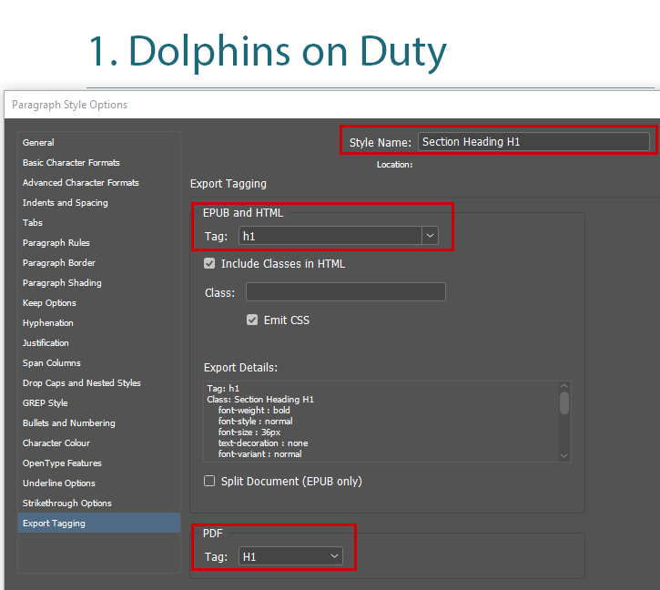
Example: Headings
Don’t use styling alone for headings
In the Paragraph Style Options, export tags: H1 – H6.
Use a logical heading order to ensure the visual structure of the page is perceivable to those who can’t see it.

Slide 31
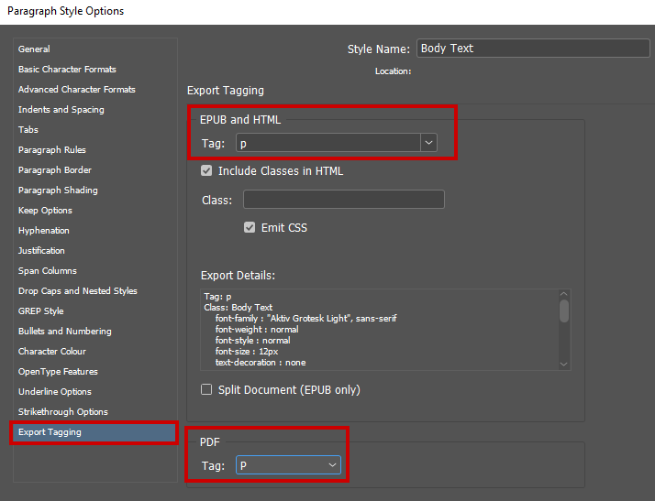
Example: Body text
In the Paragraph Style Options, export P tag
Use threaded text frames for continuous content between frames so that assistive technologies will read the text uninterrupted

Slide 32
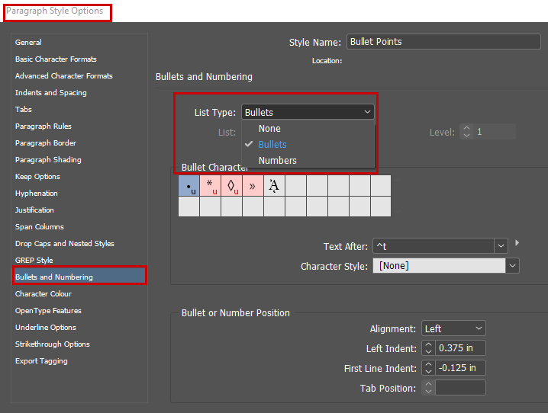
Example: Lists
Don’t use styling alone, use InDesign’s built-in lists
In the Paragraph Style Options, select Bullets and Numbering > Select list type
Select Bullets for unordered lists and Numbers for ordered lists

Slide 33
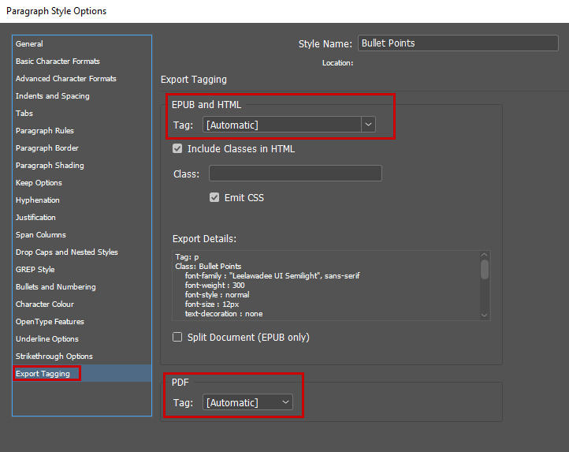
Example: Lists continued
In the Paragraph Style Options, Automatic should be selected for Export Tagging

Slide 34
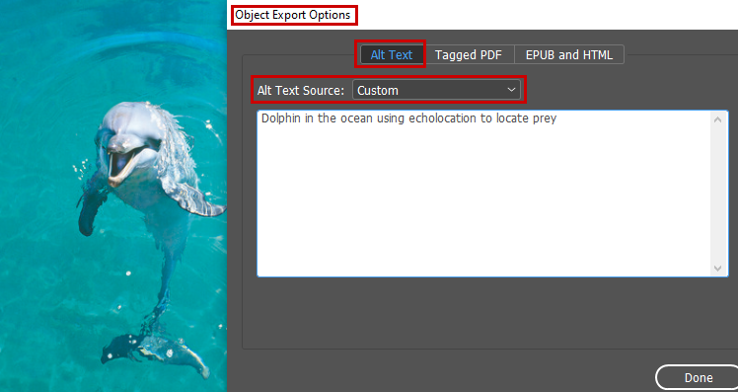
Example: Informative images
For informative images, provide appropriate alt text
Select Image frame > Object > Object Export Options > Alt Text tab > Custom
Anchor images to the appropriate location

Slide 35
Example: Informative images continued
Anchor images to define reading order: Click and drag the solid blue box to the desired reading position.

Slide 36
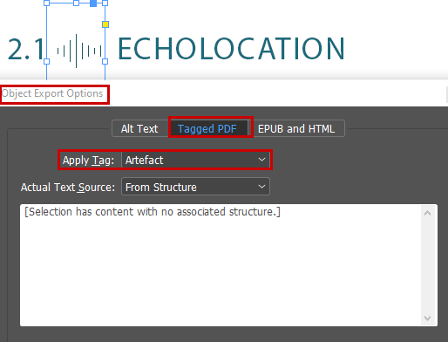
Example: Artefact decorative images
For decorative content such as icons, mark as Artefacts
Select Image frame > Object > Object Export Options > Tagged PDF > Apply Tag Artefact
WAI - Alt Decision Tree

Slide 37
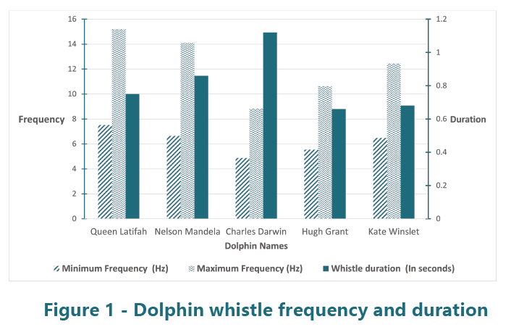
Example: Complex images
For complex images such as graphs, charts, and illustrations, provide a two-part text alternative
Provide short alt text
Provide long description with one of these methods:
Long description in document
External link
Footnote link

Slide 38
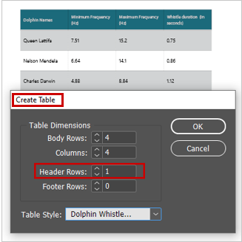
Example: Tables
Don’t create tables manually
Use built-in tables: Table > Insert Table > Select Header Rows (no option for setting row headers)
In the Paragraph Style Options, export text in tables as automatic

Slide 39
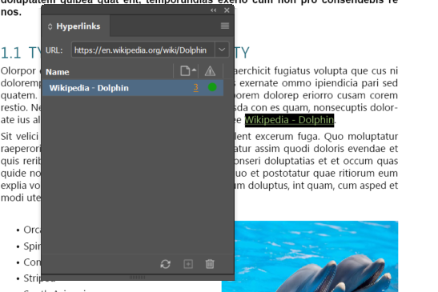
Example: Links
Select Window > Interactive > Hyperlinks
Enter the destination URL of the link
Uncheck “shared hyperlink destination” unless you are sharing the same destination across links
Hyperlink style is editable in character styles but remember not to rely on colour alone to indicate links

Slide 40
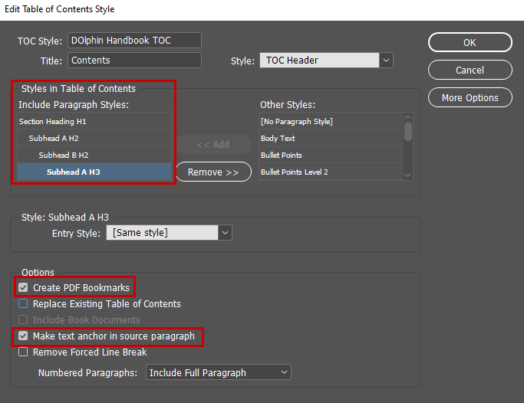
Example: Table of Contents
Layout > Table of Contents > Add heading styles in the “Styles in Table of Contents”
Select the checkbox “Create PDF Bookmarks”
Select “Make text anchor in source paragraph”

Slide 41
Questions?

Slide 42
Reading order

Slide 43
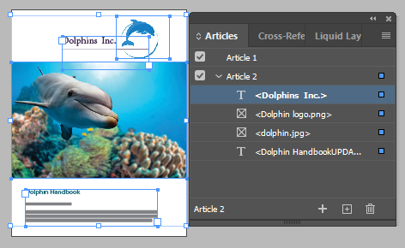
Reading order
Tag order is defined in the Articles panel
Articles panel is read from top to bottom
Anything left out of the Articles panel is artifacted in the PDF
Object order is defined in the Layers panel
Layer panel is read from bottom to top

Slide 44
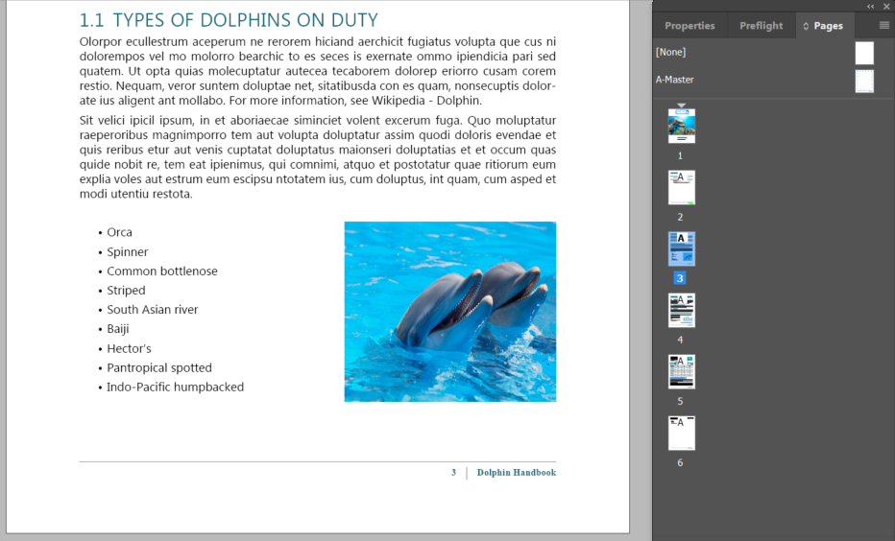
Headers and footers
Headers and footers should be artifacted in the PDF document
If they are built into your master pages they will automatically be artifacted when you save to PDF, or you could leave headers and footers out of your articles panel to artifact them if you are not using master pages
Ensure that any essential information in headers and footers is repeated elsewhere in the document – e.g. the title page

Slide 45
Providing metadata

Slide 46
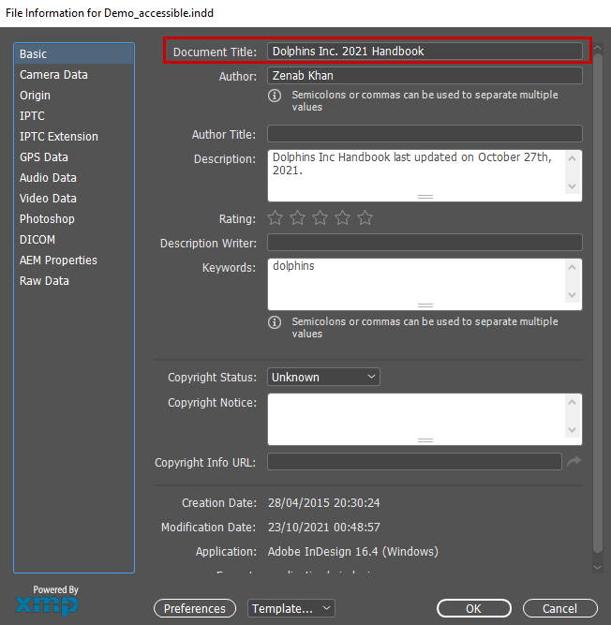
Setting metadata
Add document title to the metadata: File > File Info
Complete at least the Document Title field
Complete other fields such as Author, Description, and Keywords

Slide 47
Exporting to tagged PDF

Slide 48
Export settings for PDF
Export as interactive PDF
Export as print PDF

Slide 49
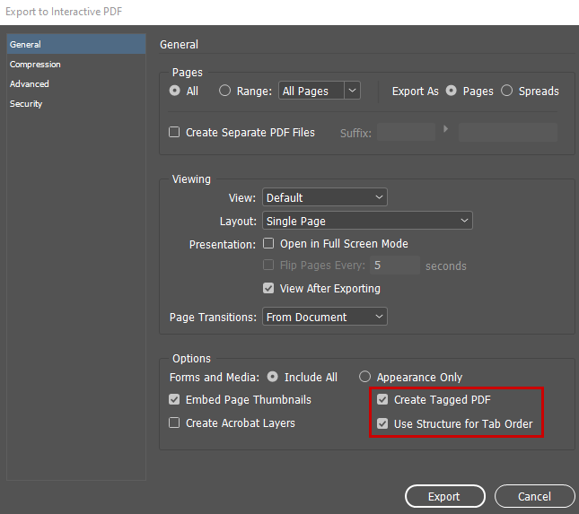
Export PDF (interactive)
Make sure the following settings are enabled in the Save as PDF options:
Options: Create Tagged PDF
Options: Use Structure for Tab Order
Advanced: Display Title > Document Title & check language is correct

Slide 50
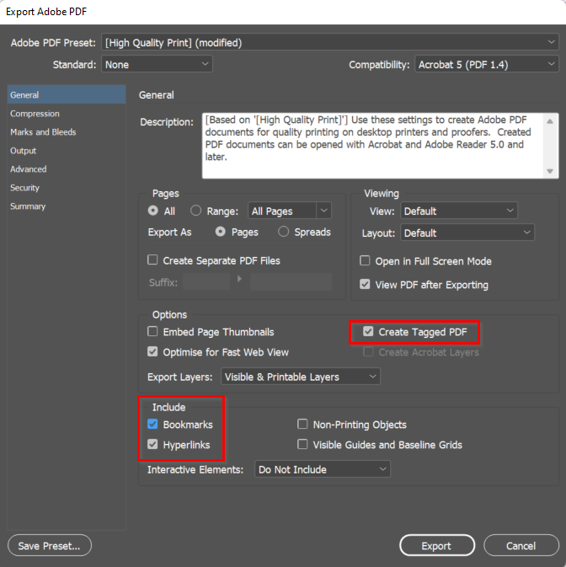
Export PDF (print)
Make sure the following settings are enabled in the Save as PDF options:
Options: Create Tagged PDF
Include: “Bookmarks” and “Hyperlinks”
Advanced: Display Title > Document Title & check language is correct

Slide 51
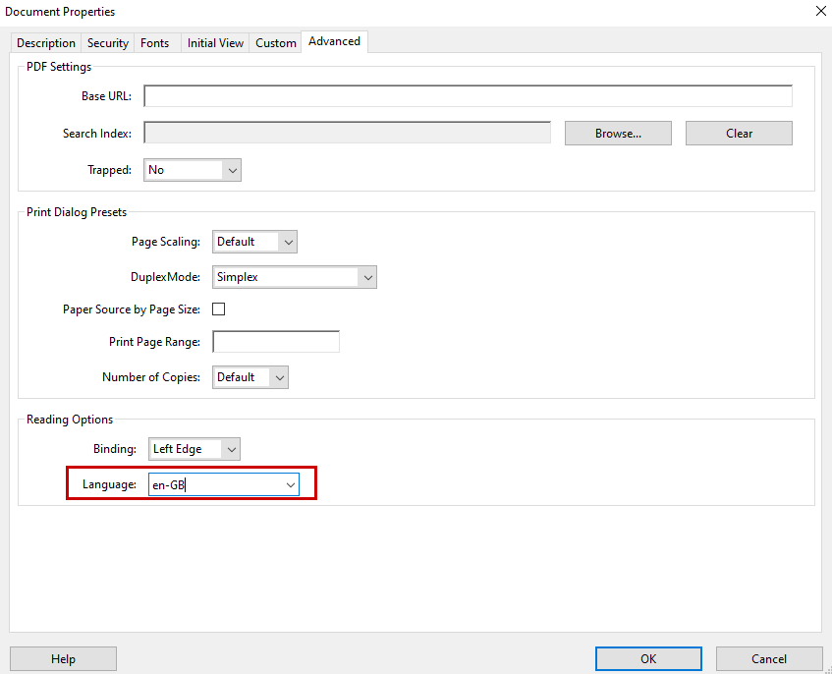
Acrobat Pro : Check document title and language
Ensure the document has a title: In the PDF, File > Properties > Description > Check title field
Set Initial View to document title: In the Document Properties, select Initial View > Show > Document title
Specify the document language: In Acrobat Pro, File > Properties > Advanced > Select Language in the Reading Options

Slide 52
PDF accessibility checkers
Adobe Acrobat Pro – check and fix
PAC 2021 – checker, freeware for Windows
CommonLook PDF Validator (require Acrobat Standard or Pro)
PAVE – online tools, some fixing possible
Manual checks will still be required

Slide 53
Optional exercise
Review the provided document and correct the accessibility problems:
Ensure export tagging has been correctly set up on the heading styles
Ensure images have alternate text or are marked as decorative
Add a table of contents
Ensure the reading order for page 1 in the articles panel is correct
Ensure the document is titled

Slide 54
Recap
We’ve covered a lot of ground! We’ve talked about:
Overview of accessibility for documents
InDesign accessibility basic strategies and tools
Visual design considerations
Demo of creating accessible content (headings, lists, images, tables, artifacts, links, table of contents)
Exporting to PDF

Slide 55
Questions?

Slide 56
Thank you!

Slide 57
Poll Do you have experience in creating accessible documents with InDesign?
No, this is completely new to me
A small amount of experience
A moderate amount of experience
A lot of experience

