Slide 1
PDF accessibility
Jess Cahill
April 2025

Slide 2
Training resources from NDA

Slide 3
Welcome
Live captions – toggle on/off
Slides, a transcript and recording will be made available
We will pause for questions throughout
Please use the chat window for questions
Two hours with a half time break
Notes:
START RECORDING
Introduce self and supporters.
Slides: don’t expect to remember all of it, we will be sending round the slides, video and transcript afterwards so you can refer back to anything or go through it at your own pace. This is an overview really.

Slide 4
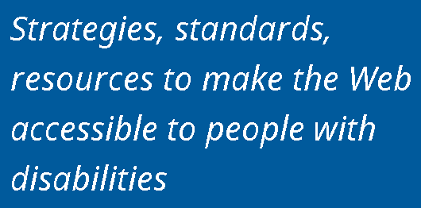
About AbilityNet
Notes:
So, just briefly, a little bit about AbillityNet for those who haven’t joined us before. We are a technology charity providing a range of free and paid for products, services and resources – at home, at work and in education. Our vision is a digital world that is accessible to all. Some of our products and services include digital accessibility consultancy, auditing and training, accessibility accreditation and diverse user testing. This along with services for the workplace and in higher education, supporting with consutancy, training and assesssments, helping to reach an accessible environment for all. All of these help to support our free services, where we have a wide range of resources available, our advice and information line and a team of over 350 volunteers across the UK supporting individuals at home.
- We are a technology charity providing a range of free and expert paid for products, services and resources. Our vision is a digital world that is accessible to all.
Products/Services include:
- Digital Accessibility Consultancy, Auditing and Training
- Accessibility Accreditation and Diverse User Testing
Mention upcoming training on accessible docs and presentations, InDesign.
https://abilitynet.org.uk/training

Slide 5
Agenda
Introduction to PDF accessibility
Checking PDFs for accessibility
Working with tags in PDFs
5 minute break
Accessibility of scanned documents
Accessibility in PDF forms
Notes:
Today we’re looking at PDF accessibility in detail
Start with introduction – what a PDF is, issues with making them accessible and how you can set up Acrobat Pro to work with accessibility
Then have a look at how you can check your PDFs for accessibility, starting by looking at the Acrobat accessibility checker and also look at the free open source tool PAC and also discuss manual checks you can do such as reading order and colour contrast
We’ll then move on to look at working with tags in PDFs. Tags work like invisible labels that supply semantic information about your content, such as headings and lists that enable your PDFs to be more accessible for users of AT and these are really core to making your PDFs accessible, so we’ll look in detail at them and how you can add and edit them yourselves using Acrobat
We’ll then have a quick break as we have a 2 hour session today and then have a look at the accessibility of scanned documents. We’ll discuss how you can identify how you can identify a scanned PDF and a workflow for dealing with it.
Then finally, we’ll discuss accessibility in PDF forms, looking at basics of how to make a PDF form accessible using the Prepare Form tool and discuss also how to tag a PDF form
As mentioned, Please add questions to chatand will pause periodically to look at questions and answer questions at the end as well.
CW: lots of content, lots of technical demos. We don’t expect you to remember it all – but when you know it can be done you will know to look for the tools.

Slide 6
Poll: What experience do you have with PDF accessibility?
None – this is completely new to me
A small amount of experience
A moderate amount of experience
Very experienced
Notes:
Take everything from first principles today so hopefully will be able to follow along even if completely new, but hopefully even experienced people will get something out of it.

Slide 7
Introduction to PDF accessibility

Slide 8
What is PDF
Portable Document Format (PDF) is a file format used to present and exchange documents independent of software, hardware, or operating system.
When you save a document as a PDF, it looks just the way you intended it to.
Quick to output from popular authoring programs like Word.
Notes:
To kick off in terms of introducing PDF accessibility, we could think a little about what PDF actually is.
PDF stands for Portable Document Format (PDF) is a file format used to present and exchange documents independent of software, hardware, or operating system
So the idea was when PDF was created that it gives you the ability to save a document as PDF and then it will look exactly the same regardless of what platform someone used to open it on. Origins of PDF are very much in a print mindset. Picture here of a compositor setting print for a print publication and PDFs were intended to provide that print level of control so your audience would see your work exactly as you intended them to. But from an accessibility point of view there may be downsides to this, as users may not be able to adjust or adapt PDFs easily to their own reading preferences (like font size/spacing,/colour and so on) as easily as they can with other formats like HTML or Office documents.
Another reason for popularity of PDFs is that they can be created very quickly from popular authoring programs like Word – literally just at the press of a button – but historically this ease of publication may have been problematic from an accessibility perspective as there tended to be less control on websites for publishing PDFs than publishing web pages and maybe less consideration for accessibility

Slide 9
Issues with PDF accessibility
Making PDFs accessible for users with disabilities can be a LOT of work
It is generally easier to make HTML web pages accessible – HTML is a more flexible format that is better supported by assistive technology and has full separation of presentation and content.
PDFs don’t have great usability on mobile - VoiceOver on iOS and TalkBack on Android only have partial support for PDF & they can cause issues for users with low vision
There are types of content (such as mathematical and scientific notation) that cannot currently be made accessible in PDF files
Paid-for tools are required for making PDFs more accessible
Notes:
PDFs do have a lot of potential issues for accessibility.
Care needs to be taken in source application like Word or InDesign
HTML docs can be more easily customised for font size, colour and so on.
Liquid mode looks promising, but doesn’t currently work for a lot of PDFs
mathML – you have to write long-winded alternative text for them
At least Acrobat Pro

Slide 10
Always consider…
Always consider if it is necessary to use PDF as your publication format as against HTML
When using PDF, it is very important to ensure that the source document is as accessible as possible before conversion
For example, follow accessibility guidelines for Word documents, such as:
Ensuring styles are used for elements such as headings and lists
Adding alternative text to images
Creating tables with table headers
Considering use of colour and colour contrast
Saving as tagged PDF
See Microsoft: Create accessible Office documents
Notes:
Covered in webinar on accessible documents and presentations
If you use InDesign there are ways of achieving the same things in your source files – we run separate Word, Powerpoint and InDesign training if these are of interest

Slide 11
Characteristics of accessible PDFs
Searchable text
Navigational aids (bookmarks, headings, table of contents)
Metadata e.g. title and document language
Programmatic document structure e.g. tags
Logical reading order
Interactive form fields that can be tabbed to with keyboard
Alternative text for non-text elements
Appropriately formatted tables
Notes:
(Don’t get too bogged down in demos for this slide)
These are some of the things that we can use to recognise if a document is accessible.
So Searchable text is a key one.
[switch to tagged PDF]
When I say Searchable text, I mean that you can open a document .. And you can often search for text, using the built in search functionality.
[Open Search box and type in “technology”]
So if I open the Search bar and type in “technology” for example, it will find that text in the document for me.
Similarly can you drag and select over it. If text is searchable it’s machine readable, it’s exposed to AT (screen readers / speech to text).
Quite a common thing with PDFs that you see is people have scanned the PDF in, it's an image. There’s no machine-readable text. We need it to be machine readable.
[Highlight a piece of the text]
That means the text is exposed as text to AT. It’s not an image of text, which is much more difficult to interpret – you would have to use optical recognition software to do that … but if you can search a document, that means that generally a screen reader will be able to announce that same content.
[go BACK TO SLIDE]
Navigational aids includes things like bookmarks, headings and table of contents.
[tagged PDF]
So here we have the headers and a heading structure. [Highlight a heading]. So they’re useful for sighted users to skim read through the document and look for a relevant section. But for screen reader users and when they’re accessing a much larger document, these headings can be used to create a Table of Contents. [Click the Ribbon icon in left-hand panel]. Here you can see the bookmarks / table of contents that has been automatically created…. And you can see how this can be useful, particularly if it was a very lengthy document. You can navigate straight to these sections by using these bookmarks [select a bookmark]. In-built navigation is really useful in a11y.
Then we have MetaData. This refers to the data about the document. So what’s the title of the document … and what’s the language of the document.
The title is something that would appear in the tab [point to PDF tab]. So if you had multiple PDFs open here, you would be able to distinguish between them easily… and we must make sure they’re meaningful and descriptive.
[go BACK TO SLIDE]
When we say document language, you can store as part of the document what language it is. So if you have a document written for an overseas market, it might be written in the language for that market, e.g. German or French, if it does not have the language attribute for the document set correctly, then screen readers users in that locale, will find that the document is read in German, but with an English accent, which can make it pretty impossible to understand. So having the document language is critical for AT .. They can then adopt the correct speech pronunciation.
Then documents should have a programmatic document structure. So, in PDF’s we have things called tags like invisible labels that inform somebody who can't see the document what the structure of the document is.
For instance, saying this is a list, this is a heading, this is a table and so on. All that means is that anything that looks like a heading, should be exposed as a heading. Same for bullets etc. So all that means is essentially using the Word built-in styles. Then we need a logical reading order. With a linear document (like Word or Google docs) this doesn’t really come in to play, because mostly the logical reading order is from top to bottom. But with presentational docs, like PowerPoint, or heavily designed InDesign files, you can put content anywhere on the screen… and if there’s an important logical order to read that content, you need to describe what that order is. Typically if you don’t, the order for AT will be the order in which the object was added to the page, so if you created a page, decided you didn’t like the heading at the top, deleted it and added a new one, the heading would then be at the end of the page for AT. Interactive form fields – if you can tab into them and enter data in to them, then that’s a quick test to see if they’re accessible. And then any non-text content, so that can be an image / logo / video / equation needs alternative text. We’ll look at that in a bit. Tables need to be appropriately formatted. You can create a table in Word pretty easily, but there are steps that we must take to make sure they’re properly accessible. Tables can make sense to somebody who can see a document, but they’re a very visual format and they need to be appropriately tagged to be handled correctly by assistive technology.

Slide 12
Versions of Acrobat
Acrobat Pro rather than Acrobat Standard is required for remediating accessibility in documents
This training shows the latest version of Acrobat Pro – Acrobat Pro DC. Earlier versions have similar functionality, but may differ in terms of where features are found in the interface.
Notes:
Before I begin, just to note that you need Acrobat Pro rather than Acrobat Standard for remediating accessibility in documents and in order to have the features I will show today.
This training shows the latest version of Acrobat Pro. If you have an earlier version, then recent versions will have similar functionality, they may just differ in terms of where the features are found in the interface. But nearly all of what I show today is going to be possible if you have a recent version of Acrobat Pro. There are also sometimes different ways of achieving the same things within this version.
Can do everything I’m showing in Adobe Acrobat X for example

Slide 13
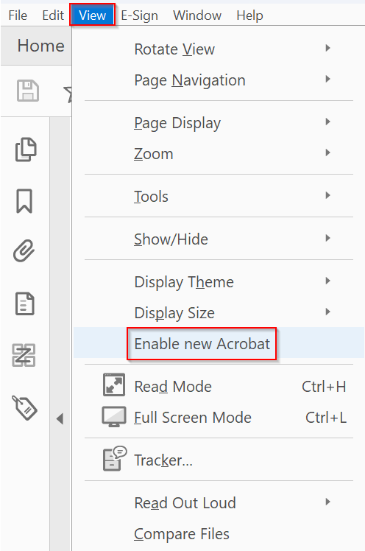
“New Acrobat” interface
Adobe have rolled out a new version of the Acrobat user interface, which they refer to as “New Acrobat”.
This training will demonstrate with this new interface.
If you still have the old interface, you can toggle to the new interface via View > Enable New Acrobat
Notes:
November 2024 – Adobe say they will swich off ability to access old interface in near future, so showing new interface
Guided actions are what was previously called accessibility wizard
Know if old interface as will have tags panel on the left instead of the right and no hamburger menu in the top left

Slide 14
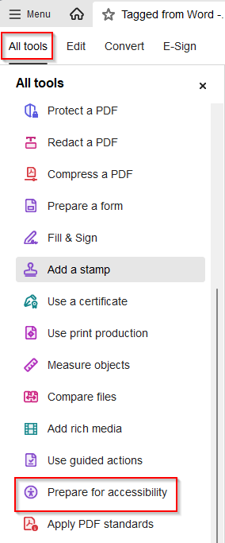
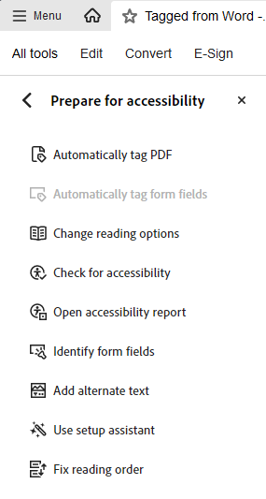
Setting up for accessibility work (1)
From the All tools link in the top menu go to Prepare for accessibility to access the accessibility tools.
Notes:
Demo
Can add favourite tools to mini menu
You may have to click “View more”
You can drag it to the top of the tools menu and it should stay there

Slide 15
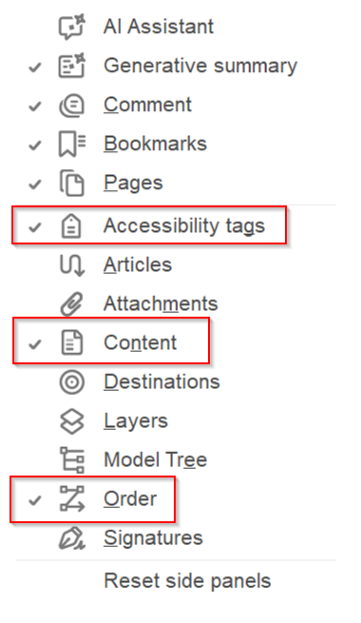
Setting up for accessibility work (2)
Add the Accessibility tags, Content, and Order panes to the side panel on the right of the screen by right-clicking on the navigation pane and selecting them.
Notes:
Alternatively, you can add them via Menu > View > Show/Hide > Side panels and choose Accessibility tags, Content and Order

Slide 16
3 views for a PDF
Physical view - a visual representation of text and graphics in the document showing what the document will look like when printed. (The default view)
Tags structure view – the layer that establishes the content structure and reading order for assistive technology. Tags are like invisible labels that tell assistive technology what each element is. (Available in the Accessibility tags pane)
Content view – the layer where the actual textual and graphical content of the PDF resides. (Available in the Content pane)
Notes:
We need these 3 panes because we need to think about different views of the PDF
Tags view is the most important when thinking about accessibility but we’ll see we may need to refrene the content view for content order issues, which we’ll discuss later
[Use Tagged PDF]
When I refer to the physical view, this is the default view you will be used to when you go into a PDF, and the view that we are looking at now.
This is a visual representation of the text and the graphics in the document … showing what the document will look like when it's printed out.
And as well as the physical / default view, we can also get the tags view. We can get that by clicking on the tag icon here. This opens up the tags pane.
This is really critical for working with accessibility. So the tag structure view establishes the content structure and the reading order for assistive technology like screen readers.
And Tags work like invisible labels…. They tell assistive technology what each element is.
For example, here we have a tag for the H1 for the main heading, and we have a tag for this paragraph and so on.
So we have got something that explains what the document is semantically.
And then finally, in terms of the three views that we have of the PDF.
We also have the content view, which we can get by clicking on the content icon here [CLICK on the Content icon in left-hand panel].
The content view is the layer where the actual text and graphical content of the PDF resides. [CLICK and show]
We can see series of containers that contain the actual text and on page two we have some images.
So it contains the actual text and the actual images that are in in the document. The content view isn't as important as the tag structure view when it comes to working with accessibility.
But you do need to know it is there. It does come into play a bit when you are thinking about reading order and content order… and we will discuss that a bit more later on.

Slide 17
Questions? (3)

Slide 18
Checking for PDF accessibility
Notes:
What tools can we use for checking accessibility in PDFs – automated checkers are the obvious first thing to use

Slide 19
Poll: How many accessibility issues in a PDF can an automated checker detect?
All accessibility issues
Most of them
Some of them
Notes:
Depending upon the PDF checked both most or some could be correct – but almost definitely not all issues unless PDF is very simple

Slide 20
Automated Checkers
Benefits
Easy to use
Vital for checking structural issues with the PDF
Report a lot of issues quickly
Provide help on how to fix issues
Limitations
Cannot pick up all issues
Can give a false sense of security
Some errors reported can be difficult to understand
Notes:
Fully tagged PDF may bring up
Very difficult to check structural issues manually
Can check no alternate text for image but can’t check if makes sense. Can’t check if text is correctly marked up as heading, as can’t necessarily tell what part of your page is semantically acting as a heading. And we’ll talk about reading order, which is a big issue that can’t be automatically checked later on.
Quite a lot of people just run accessibility check in Acrobat – but doesn’t cover some quite big things
Diff to understand – particulary applies to PAC checker, but will show how can find additional information
many more issues than an untagged PDF since checker has more to check

Slide 21
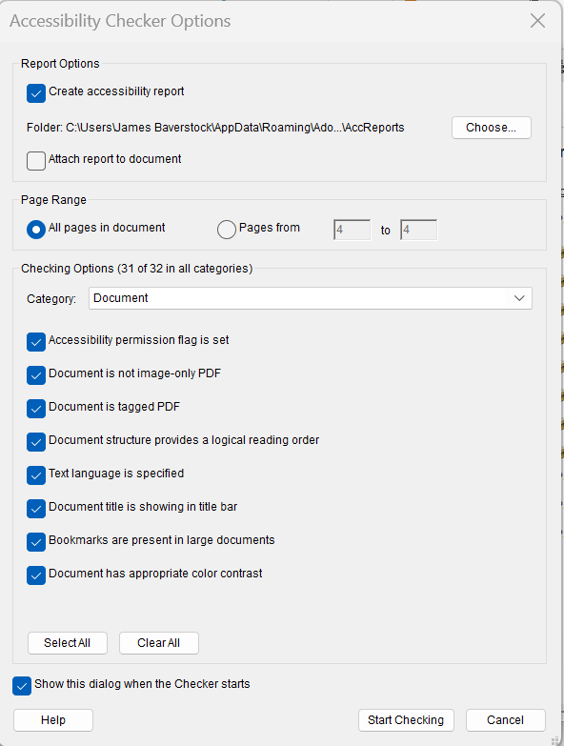
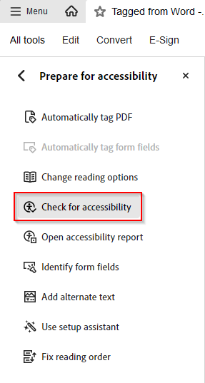
Acrobat Accessibility Checker
Available from “Check for accessibility” in the Accessibility Tools
Should always use for a primary check on a PDF
Notes:
Show tagged from Word document with check – reasonably accessible Word document
Demonstrate running the tagged example through the checker
Use the version that is created from Word as a tagged PDF
[Use Tagged PDF]
Here is a PDF created in Word and it’s reasonably accessible in Word. It has things like headings and alternative text defined correctly.
So I have converted that to a tagged PDF. Let’s run the accessibility checker on it now.
[Run: Accessibility > Accessibility Check] ….. I’ll keep the default settings
It comes up with a list on the left-hand side. Not too many issues.
There are a few things it has picked out.
[HIGHLIGHT THE ISSUES THAT NEED A MANUAL CHECK]
[Show Logical Reading order]
[Show Colour contrast] and we’ll look at how we can do this later on
[TITLE – FAILED]
If I right-click on [Title -failed], we can see more options.
You can click on [Explain] it will go to the Adobe site and give you an explanation of what the problem is and how to fix it.
You can also just choose to [Fix] the issue here. If I wanted to fix this I could untick "leave as it is" put my descriptive title in there to fix that.
So, because this was created as a reasonably accessible document in Word … it has gone through and hasn't brought up that many issues.
Show that it doesn’t show too many errors – note that is not very useful on what the table error is

Slide 22
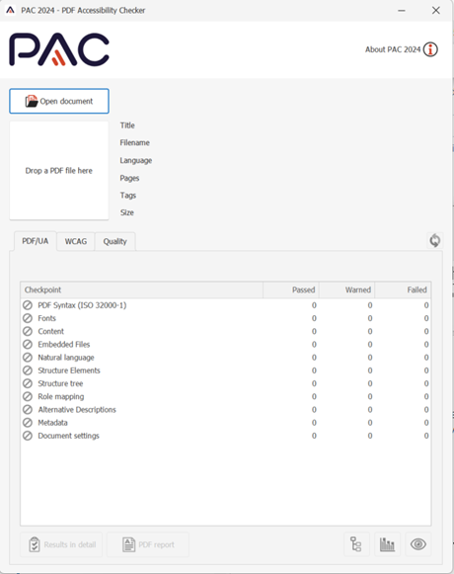
PAC (PDF Accessibility Checker)
PAC 2024: Free third party PDF checker for PC
Useful supplement to the Acrobat Accessibility Checker – tests for WCAG and PDF/UA
Notes:
Screen reader preview view – takes the PDF and represents it as an HTML page – good for check heading structure, alt text for images and tables. Good for diagnosing table regularity issues.
Tagged PDF taggedpdf.com – show the Help Centre – video for each issue reported in PAC
Based on PDF/UA rather than WCAG 2.1.
PDF/UA is an ISO standard based on the principles of WCAG 2.0. It complements WCAG but has some differences. It is strong on providing a valid tag structure for your PDFs. You don’t have to comply with PDF/UA to comply with WCAG though. PAC 3 will commonly report issues that aren’t WCAG failures which needs to be born in mind – e.g. flagging the document for PDF/UA compliance, supplying annotations for adequately descriptive links, never having missed heading levels.
Demonstrate running the screen reader example through the checker – note the extra issues it picks up over the PDF checker
Tagged PDF site has examples of how to fix PDF UA issues if something is not covered in this training
[Use PAC CHECKER APP]
Open app (on my desktop taskbar)
Drag PDF on to it (“Tagged from Word”)
Show [Results in Detail] section
Structure Elements > Tables
Go into the results in detail to see the issues. It is reporting more things than were reported in the built-in Acrobat checker. So you potentially get extra things reported.
Structure Elements > Tables > Table Header cell has no associated
Tends to be better than the Acrobat checker at showing you exactly where the issue is sometimes. So here it’s bringing up an issue about the table headers and it does nicely indicate where the problem is. Sometimes you get things reported in the built in Acrobat Checker and you can be a bit unsure where problem is. So you could then run it in PAC and see if it gives you more detail.
Show screen reader preview
Another nice feature that it has is the screen reader preview, which you can get if you click on the eye button here.
This brings up a view of the document which will show you clearly what your headings are in the document, where your paragraphs are, your lists etc
This is particularly useful as you get an easy view of whether your headings are properly structured. Also, if you are working with tables it gives you a nice visual view of how your table, rows, headers and so on are applied.
Some of the things which you might see in the PAC-Checker can be a bit technical. To assist with this, there is a very useful site though, that you can use to compliment the PAC checker … called Tagged PDF.COM [SHOW LINK IN CHROME]
The PAC-Checker itself doesn't include the links through to detailed help like the acrobat checker does, so you can use this tagged PDF site.
[select HELP CENTER]
It has a help centre. It goes through all the checks that the PAC-Checker does. Then, produces helpful articles.
[Scroll down to video]
There is a video of what the problem the PAC-Checker is trying to get at is and how you can fix that problem.
So I would recommend using the PAC checker and this website together to be able to better understand some of the things that PAC raises.

Slide 23
Colour contrast checker
Colour issues should be checked and corrected in the source document but you may sometimes need to check colour contrast in a PDF if you don’t have the source file.
Paciello Group Colour Contrast Analyser - https://developer.paciellogroup.com/resources/contrastanalyser/
Notes:
As well as using automated checkers, we may need to do some other manual checks.
You’ll want to check for colour contrast between text and background. But this should really be checked and corrected in your source document Word / InDesign file before converting to PDF.
Sometimes you may need to check colour contrast in a PDF if you don't have the source file. Although often there is not a lot you can do to actually correct it within the PDF file. But maybe you want to check whether the PDF is compliant. The best resource to use here is the TPGI (Paciello Group) Colour Contrast Analyser. https://www.tpgi.com/color-contrast-checker/
It’s a free download which you can get from the link when you get the slides.
[Demonstrate the eyedropper tool] We need to check that regular text has 4.5:1 with background, large (18pt, or 14pt bold) text and graphics 3:1.
Word has colour contrast checker as does PAC

Slide 24
Metadata and language settings
Menu > Document Properties
Set a descriptive title under Description
Initial View set to show Document Title not File Name
Security > Content Copying for Accessibility is Allowed
Under Advanced > Reading Options the primary language is configured in the Language field
Notes:
Then you also want to do manual checks of the document properties of the metadata and the language settings.
[OPEN TAGGED PDF]
File > Document Properties > Description tab
So we need a descriptive title set - here we want to add a title like "an introduction to screen readers" and make sure that we have a descriptive title set for the document.
File (now Menu) > Document Properties > (ie same screen) Initial View tab > Windows Options > Show dropdown
We want to have the initial view set to show the document title and not the file name. So we want a screen reader to read out the document title and not the file name when the document is opened up.
File > Properties (ie same place) > Security tab
Under "security" we want to make sure that [SHOW - Content Copying for Accessibility is Allowed].
This is the default state so this shouldn't be changed. You just want to make sure that it’s OK. So that is not going to affect assistive technology adversely. Sometimes is turned off if protection is applied.
File > Properties > Advanced tab
Finally, under Advanced > Reading Options you want the language to be set correctly to the right language to the document. It's correct here it's EN-GB.

Slide 25
Testing content order in PDFs
A PDF has 2 main content orders that matter for accessibility.
Tag order (the order in the Tags pane)
Reflow order (the order in the Order or Content pane)
Notes:
And then finally you want to think about testing the content order. Content order can sometimes get jumbled if a document has been designed in say PowerPoint, where you might go back and add an image to a slide or move things around for visual presentation. As ever we want to address that in the source document before exporting to PDF.
Potentially confusing area. Tag order – AT such as screen readers
Reflow order – matters for reflow function in Acrobat

Slide 26
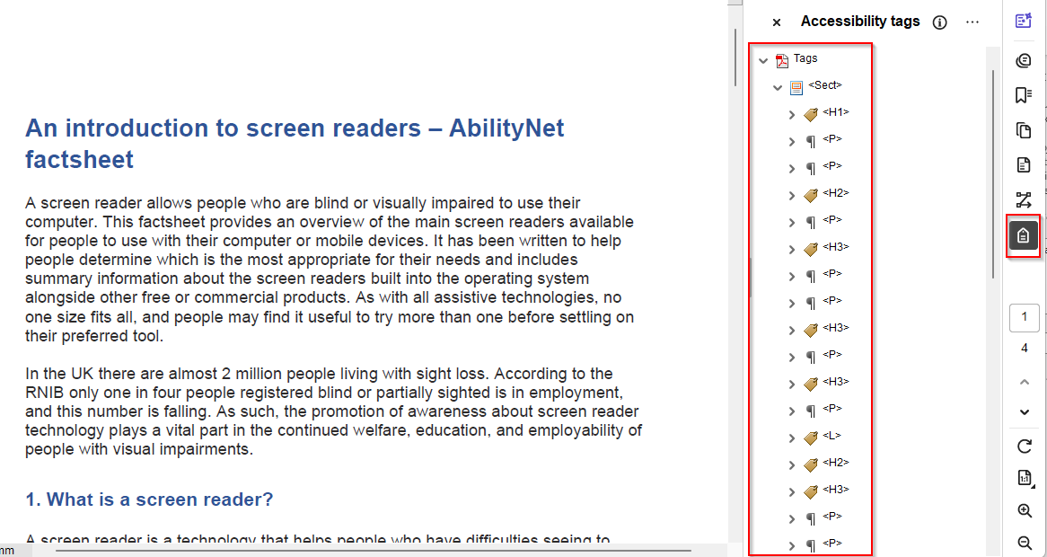
Tag order
This is the reading order for assistive technology such as screen readers
Arrow through the tags in the tags pane and check they appear in order
Can also be tested with a screen reader such as NVDA
Notes:
So the tag order is the order of the tags in the Tags pane. This is the reading order for assistive technology such as screen readers.
You can test this just by arrowing through the tags in the Tags pane and checking that they appear in order. You can also check this by reading a PDF with a screen reader such as the free NVDA screen reader or with JAWS. The order of the tags is the order that a screen reader like NVDA or JAWS will read the document in.
Also the screen reader preview mode in PAC screen reader preview will also show this order

Slide 27
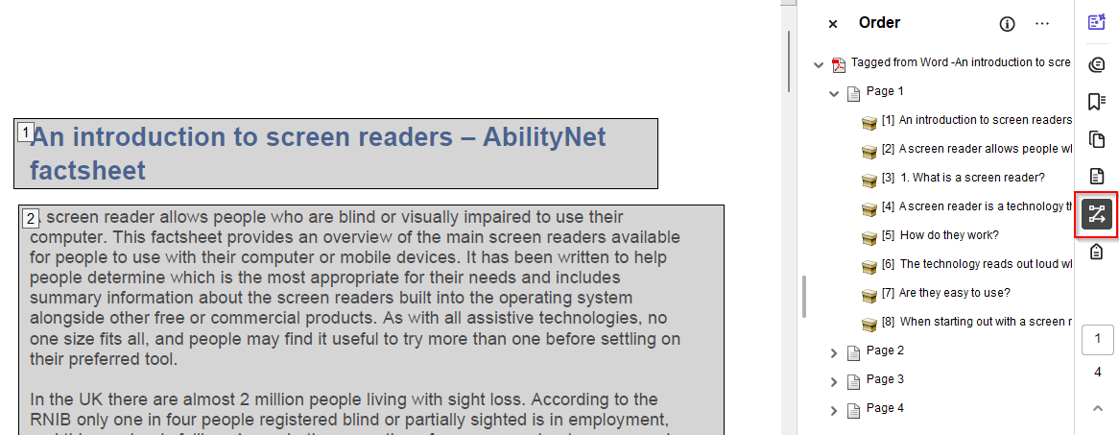
Reflow order
This is the order that matters for reflowing the text and is also used by some text-to-speech tools.
Check in the Order or Content pane or via View > Zoom > Reflow
Notes:
There is another order that also matters for accessibility, the Reflow Order. This is the order that matters if people use the “reflow” function, within Acrobat. This order is also used by some text-to-speech tools. So text-to-speech tools are like more simple screen readers that are used by people with dyslexia or low vision, for example – so they support visual use rather than replacing it.
So the reflow order is the order that you see if you go into the content pane.
And this is the order in which the document is structured if you use the reflow function.
You can get to it via View > Zoom > Reflow. Someone with low vision may use the reflow function to reflow the page … so that they can view it at an increased magnification without having horizontal scrolling.
[DEMONSTRATION – WORD TAGGED PDF]
[TAGS PANE][arrow down through tags]
So by doing this we are just checking that they are all in the order that we expect.
[REFLOW ORDER – open Order Pane]
When you open here the order pane it puts numbers against each item. So you can go through the numbers – all looks good … [PAGE 2] however when we come to this image, that doesn’t seem right. So the JAWS logo comes before the NVDA logo. So the practical effect of this is, if I were to use the reflow function, it would move the items around. Can fix it by dragging things around in the Order Pane
Watch out that it doesn’t affect the Tags Pane order Potentially rather change it in the Content Pane as this shouldn’t affect the Tags pane.

Slide 28
Questions? (3)

Slide 29
Working with tags in PDFs

Slide 30
Example files for tagging
Untagged PDF – Untagged file for practice
PDF with fixes – PDF with fixes demonstrated in the webinar
Notes:
We have a couple of example files here. There’s an untagged version of the PDF and a PDF with the fixes applied.
If you want to follow along, you can do so with the untagged PDF. Or, because the session is being recorded, you could watch me do this the first time and then follow along with the recording.
Tagging is something which, if you haven't done before, it's a good idea to actually have a go at doing it, with the example files or with your own PDFs … because it's quite difficult to understand just from watching it. Like most things it makes a lot more sense once you start doing it yourself.
If you’ve started with accessible Word files, you shouldn’t have to do a lot of this, but may need it now and then.
Example files for tagging
Untagged PDF: https://abilitynet.org.uk/sites/abilitynet.org.uk/files/PDF%20accessibility%20-%20Untagged%20version%20-%20An%20introduction%20to%20screen%20readers.pdf
PDF with fixes: https://abilitynet.org.uk/sites/abilitynet.org.uk/files/PDF%20accessibility%20-%20Final%20version%20-%20%20An%20introduction%20to%20screen%20readers.pdf

Slide 31
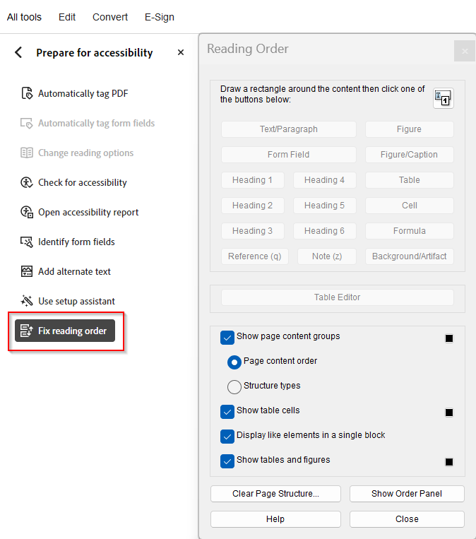
Adding tags with the Reading Order panel
Basic tagging can be performed with the Reading Order tool
With the Reading Order tool open, marquee the element you want to tag and select the tag name from the tool.
Notes:
Ideally when creating your PDF you want to have created a tagged Pdf from Word or InDesign that has tags, but if you don’t have a source document and need to add tags, or if you have tags that are wrong and need to be edited, you’ll need to do this in Acrobat
You can do basic tagging with the Reading order tool in Acrobat.
With Reading order tool open you can select the tag name from the tool.
[OPEN UNTAGGED PDF]
I have a completely untagged version. I deliberately saved this Word document without tags.
Which is something you usually never want to do and hopefully will never encounter if your org is setting up PDFs from Word or Indesign correctly.
[OPEN LEFT-HAND PANEL TO SHOW THERE ARE NO TAGS]
Generally you are not going to have an entirely untagged document unless you have something where somebody has saved your source document as an untagged document and you no longer have the source file or you have something like a scan where you have got a completely untagged PDF.
[OPEN ACCESSIBILITY ON THE left PANEL AND READING ORDER]
This is for the sake of demonstration to show how you can add tags if you absolutely have to.
I can go through and tag by marking the various elements and then selecting the appropriate tag. For instance:
[DEMONSTRATE – SELECT HEADING > THEN HEADING TAG]
This would be a heading 1.
This paragraph will be Text/Paragraph.
…..
Then this will be another paragraph and so on.
So you can see, as I'm doing that, the Tags pane is populating with these tags.
[SHOW TAGS PANE IN right-HAND PANEL]

Slide 32
PDF tagging: Headings and paragraphs
Headings and paragraphs are the main tags for providing semantic structure to documents.
<H1> to <H6> = Heading (1-6)
<P> = Paragraph
Notes:
The main tags you will be using are things like headings and paragraphs. You have <H1> to <H6> for headings and the paragraph tag. (explain this is family tree, not list)
Effectively creating a virtual skeleton that mirrors the visual skeleton of the document.

Slide 33
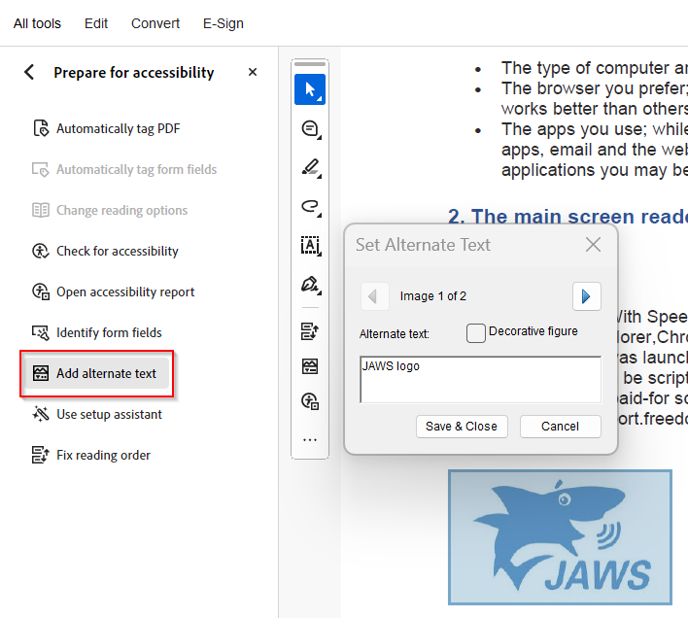
Alternative text for images:
Images should be marked up with the <Figure> tag
Check figures have descriptive alt text with “Add alternate text”
Ensure decorative images are indicated as such by “decorative image” in the “Set Alternate Text” box or artifact using the reading order tool
Notes:
Another thing we want to make sure is marked up is the images in the document and should be marked up with a <Figure> tag and check they have descriptive alt text applied to them.
UNTAGGED PDF > reading order pane
Select NVDA logo > Select Figure in Reading Order tool.
Then right click on the Figure in the Tags Panel and show how you can add alt text
[RIGHT CLICK FIGURE in TAGS pane > PROPERTIES > ALT TEXT FIELD]
Alternatively use the global “Set Alternate Text” option in the Accessibility pane, which will go through the document looking for images.
If the image is decorative ie adds no meaning or context, mark as decorative in the alt text box [this can only be done with the “set alternate text” tool in Accessibility Tools], or use reading order tool to mark as artifact – this is a way of hiding content from AT.

Slide 34
PDF tagging: Container elements
Container type tags exist to group together other tags. They are more for the benefit of the document author than the end user and do not convey any sematic meaning to assistive technology.
<Document> = the root element of a document’s tag tree
<Part> = structures a large division of a document
<Div> = generic block-level element
<Span> = generic inline element
<Art> = (Article), self-contained section of text acting as a single narrative within a larger group of content
<Sect> = (Section), general container element type
Notes:
Container elements are the highest level of element and provide hierarchical grouping for other block-level elements. However, these tags do not convey any semantic meaning to the document. They are simply used to organize the tag tree structure and are more for the benefit of the document author than the end user. They will not be picked up or announced by screen readers, but they might be very helpful to find your way around in a long document.
Show how to add a <Document> tag and drag tags into it but note that this will be done by default if creatings

Slide 35
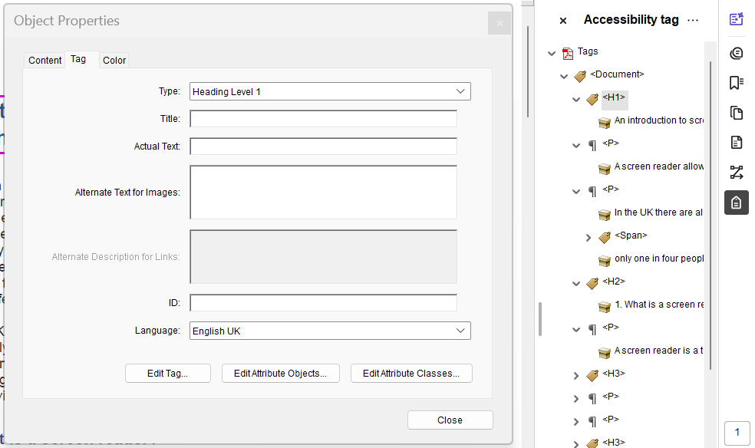
Editing tags with the tag pane
To locate which tag relates to a section of content, select the content and choose “Find tag from selection” in the Tags menu
To edit a tag directly in the tag pane, double click on it and rename
Alternatively, you can right click on a tag and choose “Properties” to change the tag type
The “New tag” tool can be used to add a parent tag – such as for a parent list item.
Notes:
You can edit tags by using the tags pane.
[TAGGED FROM WORD PDF]
Highlight a heading element you previously marked as a heading
Open tags pane if not open
Select the dropdown that is to the left of the info icon
Select “Find tag from selection”
Go to the heading level in the tags pane
So if I wanted to edit it I could click on the tag and change it by typing (highlight heading element and edit). But this is not the best way.
The safer way to change it is to Right-click on the tag > Properties > Type dropdown
As well as “find tag from selection” you can right click on a tag in the tags pane and choose “highlight content” – reverse.

Slide 36
PDF tagging: Lists
Lists are made up potentially of 4 nested tag elements. These cannot be created from the Reading Order tool.
<L> = List
<LI> = List item
<LBody> = List Body (the individual text of each list item)
<Lbl> = Label (optional – used for the bullet of each list item)
Notes:
Lists have four potential elements a bit like an HTML list.
You’ve got a:
list tag,
list item tag.
list body tag that sits within the list item tag and contains the individual text of each list item.
Optionally you can also have a label tag to hold the bullet of each list item.
So it’s a potentially complicated structure and this cannot be created directly from the Reading Order tool.
If you’ve created your PDF from a Word document correctly using the built in bullet formatting you won’t have to do this.
Here’s how to do it in the pdf though.
Untagged PDF > List on page 2
Open reading order tool from accessibility pane.
Highlight list item and make Text/para.
Right click in left pane > properties > change type from dropdown > List Item Body
Go to dropdown at top of left pane > add new tag > add List Item
Drag List Item Body into this
Add new tag also for List > drag List Items into this.
Just demo one list item for time.
[DO NOT use the reading order tool to create the upper level tags – this erases the lower tags.]

Slide 37
PDF tagging: Links
An accessible link has two components:
<Link>
<Link-OBJR> (necessary nested annotation for an accessible link)
To add OBJR tags, use the Options Menu in the Tags Pane to Find Unmarked Links and tag them.
Notes:
Another type of feature which can be difficult if you haven’t created this in the source doc correctly are links.
An accessible link has two components:
It needs to have a link tag and
a tag called link OBJR…Which is nested within the link.
Go back to the document again.
[UNTAGGED PDF > page 2 “download a JAWS trial” link]
I will demonstrate how we can mark up a link from scratch.
Open reading order tool from accessibility pane
The link goes over two lines: hold down shift to marquee these elements
Tag this as a text paragraph – there is no option to tag as link.
Right click tag in tags panel and go to Properties to make it a link.
Then add OBJR tag. Go into the tag options [dropdown next to info icon in right-hand pane] > Find > Unmarked Links > Search Page then Tag Element. This will add the OBJR tag to the link in the tags pane.
Note to avoid confusion: PAC 3 will flag an error if the link is missing Alt Text (right-click the link tag > Properties > Alternate Text), even if the link text is meaningful. The error you will receive is: Alternative description missing for annotation. (Deque University)
“Parent tag of link annotation doesn’t define alt attribute”? https://taggedpdf.com/508-pdf-help-center/alternative-description-missing-for-an-annotation/
Alternative description missing for an annotation
PAC 2 Error
Alternative description missing for an annotation
Category
PDF/UA > Logical Structure > Alternative Descriptions > Alternative descriptions for annotations
Failure Condition
Matterhorn Protocol Checkpoint 28-012: A link annotation does not include an alternate description in the Contents Key. – under pdf standards
Update: If you are using Acrobat Pro DC, there is an easier fix that will copy the body link text and apply it to the Contents key – so, not really an “alternate” description, but for links with meaningful text or for internal links like in a Table of Contents, it is a much less time-consuming solution …
Tools > Print Production > Preflight > At the top of the Preflight dialogue, select Acrobat Pro DC 2015 Profiles in the drop down box > Under PDF/UA, select Fix problems in PDF tagging structure. This will add the Contents key to link tags that are missing it, and will apply few other fixes if needed.
Suggestion
For older versions of Acrobat Pro, or to apply a specific alternate Description …
In the PAC 2 test report, click the error to see the location of the link in the document. In the Tags pane in Acrobat Pro, right-click the Link tag and select Properties. On the Tag tab of the Object Properties dialog, click the Edit Tag button. In the Tag Element dialog, expand items and drill down to the “/Obj <<Dictionary>>” item (I usually find it under “/K [Array]”; then “[0] <<Dictionary>>”. Select “/Obj <<Dictionary>>” then click the New Item button. In the Add Key and Value dialog, enter Contents in the Key field, change the Value Type to String, and enter a meaningful alternate description in the Value field. For external links, a good practice is to use a description that matches the Title property of the target page. For internal links such as those in a Table of Contents, it may make sense to simply use the text of the link itself.
Note: In the case of a link that is split across a line break such that there are two Link-OBJR objects nested under the Link tag, you should find two “[#] <<Dictionary>>” items, each with a “/Obj <<Dictionary>>”, both of which will need a Contents key with an alternate description.
Example PDF with this error

Slide 38
PDF tagging: Tables
Tables need to correctly indicate table headers for assistive technology users.
<Table>
<TR> - Table row
<TH> - Table header
<TD> - Table cell
Check tables created from other documents or via the Reading Order tool to ensure they are tagged correctly.
Notes:
Tables can also be complex. [explain tables create visual association]
Tables need to correctly indicate the table headers and how these relate to the table cells for AT. If you are familiar with HTML tables in webpages, they are marked up in a very similar way.
You have the table tag and within that table rows, table headers and table cells.
If we start with a simple accessible Table in Word we should be good, as long as it doesn’t have more than a single header row and a single header column for screen readers. Word can’t handle more than that. You can't properly designate nested table structures where you have multiple header rows or column rows.
Really the easiest thing to do for accessibility is to keep your tables as simple as possible.

Slide 39
PDF tagging: Complex tables
Keep tables simple if possible and avoid multiple layers of headers or cells that span columns or rows.
If necessary, the Table Editor can be used to mark up complex tables.
Set Span for cells that span more than one column or row
Set Scope for table headers that have more than one set of headers or which have cells spanning across multiple columns or rows
Associating table cells with table headers via ID is another technique for very complex tables
Notes:
If you do have to deal with a complex table, where you have nested headings or cells that cover more than one column or row, you can set the Table Cell Properties appropriately with the table cell editor. You can set the span for cells that span more than one column or row.
You can set the scope for table headers that have more than one set of headers or which have cells spanning across multiple columns or rows…. And Associate table cells with table headers via the ID for complex tables.
[OPEN TAGGED PDF “FINAL VERSION”]
Second table here is quite complicated because we have two layers of headers for the rows. The “desktop header” spans two rows.
Potentially difficult for AT.
We need to tell the screen reader that this cell spans two rows.
We need to tell the screen reader explicitly for each cell which headers relate to that cell.
[OPEN READING ORDER TOOL]
Highlight table [RIGHT CLICK ON TABLE > TABLE EDITOR] Explain … what TH / TD is etc. [DESKTOP TH, RIGHT CLICK Desktop row > TABLE CELL PROPERTIES]
Here we can see that I defined it having a scope of row.
Also see Row Span – this is because it is spanning over 2 rows.
You can also associate cells with headers by giving the header cell an ID and then associating them, for very complex tables.[right click any data cell to show this]

Slide 40
Footnotes
A tagged footnote requires:
<Reference> for the footnote reference
<Note> for the footnote text
A link can be nested inside the reference to link to the note
The <Note> should be placed in the tag tree under the paragraph with the <Reference>
Notes:
Couple of things where we might want to think a bit about where something should be in the reading order, eg footnotes. What happens when a SR encounters a reference to a footnote?
You need a reference tag for the footnote reference and a note for the footnote. You can put a link inside the reference to link to the footnote.
The note can be placed in the tag tree under the paragraph with the reference so it's read straightaway afterwards by SR. Word exports footnotes to PDF like this by default.
[OPEN FINAL PDF, p3, and HIGHLIGHT “ChromeVox1”]
To find footnote in tag pane choose the Selection Tool and select it. In tag pane go to dropdown > “find tag from selection”.
When we go there we have a "reference" tag. This contains a link to the footnote – see the OBJR tag there.
Then if we look at the tag order there’s the next sentence, and then the text of the footnote itself.
The screen reader will read the note by default directly after the link to it. Well, in fact here we’ve set it to read after the next sentence.

Slide 41
Setting additional languages
If there are language changes within a document, then the language needs to be specified for the relevant elements using the Object Properties dialog in the Tags Pane.
If the section is alone in a block-level element such as a heading or paragraph, apply the language to that tag via Language in the Tag Properties.
If it is an inline language change, add a <Span> tag and apply the language change to that.
Notes:
To meet WCAG we need to set the language of documents, we’ve done that in the meta information in the document properties, but you also need to indicate when you have language changes within a document.
You can do this via tagging in Acrobat, by specifying the language for each particular element using the Object Properties dialogue in the Tags Pane.
We have a random bit of French, “comment allez vous”, in the text here.
[FINAL Doc. Look in - HOW DO THEY WORK p1 >“comment allez vous”]
Highlight the French words > tag options (next to info icon) > Find tag from selection > Scroll down to the span tag > Right click Properties > Note the Language at the bottom of the modal

Slide 42
Headers and footers
Headers and footers can be added directly via the authoring tool
Ensure essential information is available elsewhere in the document as headers and footers will not be tagged by default and the information in them will not be available unless you tag them.
Notes:
We also want to think about how headers and footers are treated by AT. Visually they are at the top and bottom of the page but are they in the reading order?
If you add headers and footers in Word, when they are converted to PDF the headers and footers will not be tagged by default. They won’t be read at all.
This is deliberate so that the headers and footers don't get announced in the middle of sentences in the document when they go across a page break – could be really annoying/confusing.
If essential information include it elsewhere in the document. eg if we have something here like "AbilityNet fact sheet, January 2019”, we might want to include that date on the title page so that it gets announced.

Slide 43
Questions? (3)

Slide 44
5-minute break

Slide 45
Accessibility of scanned documents

Slide 46
Issues with scanned PDFs
PDFs that originate from scans potentially present the biggest accessibility problem
They may have no searchable text for assistive technology to use, unless OCR (optical character recognition) has been performed.
Notes:
So, in the final section today we will go through the accessibility of scanned documents and then also PDF forms. There can be really big issues for accessibility with scanned PDFs.
A scan is effectively just an image and won't have any searchable text for assistive technology to potentially use unless you perform OCR.

Slide 47
Identifying scanned PDFs that need OCR
A scanned PDF without searchable content will appear as a single blue image when you attempt to select text
No text will be available in the content pane – only images
If the PDF is poorly scanned you can use All Tools > Scan & OCR > Enhance scanned file
Notes:
If a scanned PDF doesn't have searchable content will appear as a single blue image when you attempt to select text.
No text will be available in the Content pane, only images.

Slide 48
“Make Accessible” guided actions
If you have an image-only file or an untagged PDF with no source document, the best first step is to run the “Make Accessible” guided actions which includes steps to recognise the text using OCR and to autotag the document. (This was previously the “Make accessible action wizard.)
All tools > Use guided actions > Make Accessible
Notes:
Guided Actions in new interface – Make accessible Action wizard in old interface

Slide 49
Optical Character Recognition (OCR)
For the “Recognize Text – General Settings” box:
Select the document language
Select “Searchable Image” for Output
Select Downsample To 300dpi for grayscale content and 600dpi for colour content

Slide 50
Checking scanned text and tagging
Select Tools > Scan & OCR
Use Recognize Text > Correct Recognized Text
Check the tagging with the Tags pane. Look particularly for issues like correct heading levels which autotagging is unlikely to get correct.
Notes:
Can use Tools > Edit PDF for minor edits.
Show headings and so on
OCR is a bit variable. For pretty clear text like this it’s probably fine. For anything blurry, on thin or foxed paper, antique fonts, etc, it can be not brilliant.

Slide 51
Accessibility in PDF forms

Slide 52
Accessible forms – Word vs PDF
Word Forms
Word forms are not recommended for accessibility
Built-in form controls have limited accessibility
Protecting content so only form fields can be edited makes the file inaccessible
PDF forms
Can be made accessible if form fields are tagged along with the rest of the file
Complex forms can be costly to make accessible
Microsoft Forms, Google Forms or online survey tools like SurveyMonkey can be good alternatives
Notes:
Word forms are really not recommended for accessibility. You can in theory create form controls in Word but they have limited accessibility, and if you protect content in a Word document so that the only the form fields can be edited it makes the file inaccessible for screen reader users. Word forms are definitely not something you should be using.
However PDF forms can be made accessible as long as you tag the form fields along with the rest of the file. Complex forms can be time-consuming/costly to make accessible. Say if you finish carefully setting up a form and then someone tells you a bit of the text needs changing elsewhere in the document you’re probably going to have to start all over again.
Web forms the way to go – easier and cheaper to make accessible. Tools like Microsoft Forms, Google Forms and SurveyMonkey are accessible nowadays. Data protection – GDPR.

Slide 53
Example form files
Starting file – Starting state of form in demo
Final form – Form example with accessibility features discussed in the webinar
Notes:
Example form files
Starting file: https://abilitynet.org.uk/sites/abilitynet.org.uk/files/PDF%20accessibility%20-%20Start%20version%20-%20Membership%20form.pdf
Final form: https://abilitynet.org.uk/sites/abilitynet.org.uk/files/PDF%20accessibility%20-%20Final%20version%20-%20Membership%20form.pdf

Slide 54
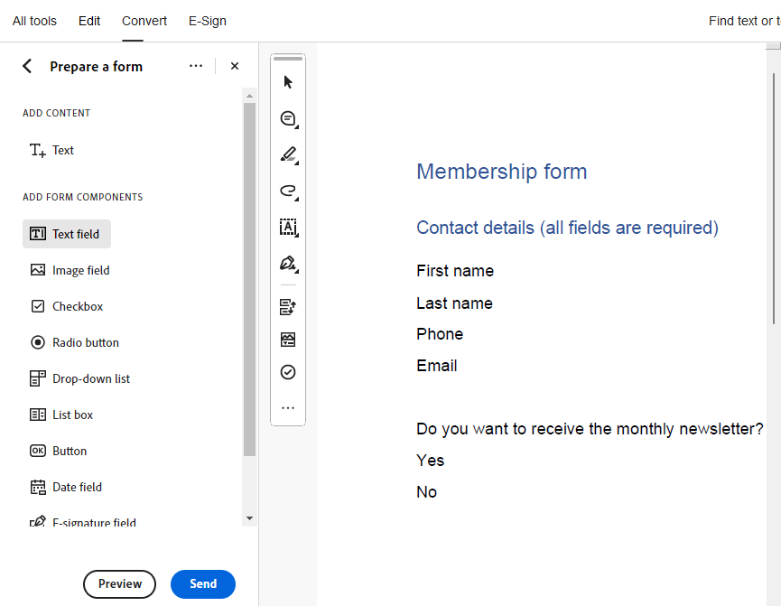
Acrobat Prepare Form tool
Set up the document visually in Word
Use the “Prepare a form” tool
Fields can be added directly via the options in the “Prepare a form” toolbar
Form field auto detection can be used if you have the fields visually in the original document
Notes:
We can set up the document visually in another programme like Word or InDesign and use the Prepare Form tool in Acrobat to add in our fields … and then adjust the Properties in the Prepare Form tool eg add validation or determine input type.
I’m going to show you now how you can create some basic form fields. I have some basic paragraph tagging here.
Tools pane > add Prepare Form tool > Start
Prepare form tool will appear at top. Drag or draw text field. Go to All Properties in the yellow dialogue box. Add tooltip.
Add border colour.
For radio boxes the tooltip is the legend, the label for the radio button goes in the Options tab > Radio button choice. (Right click – create multiple copies - for radio buttons)
Add border colour. Remember to give border to field

Slide 55
PDF form field considerations
All fields must have the tooltip property specified. This provides an accessible name for the field and is announced when a screen reader tabs to the field. Don’t include the type of field in this name.
Names of fields must be unique or the wrong tooltip may be applied
Notes:
Add text field – resize – hold down CTRL and drag to add copies – align
Radio buttons – group name = Do you want to receive the monthly newsletter? Choices – yes and no
All fields need to have the tooltip property specified. This provides the accessible name for the field ie what gets announced when a screen reader tabs to the field. You don’t need to add “text field” or whatever type of field it is.
If you are familiar with HTML forms in webpages you know that every form field has to have a programmatically defined label for screen readers to announce. The tooltip is the equivalent for the PDF form.

Slide 56
Required fields
Required fields can use the required property but must also provide an additional visual indication other than the red outline to the field that they are required
Notes:
By default the red line is the only visual indication

Slide 57
Tagging form fields
Use the reading order panel to tag form fields
Then move the tags into the appropriate location in the tag tree
Correct order for form tags: Paragraph > Visible label > Form tag > OBJR tag
Notes:
Paragraph, Visible label, Form tag, OBJR tag
Use the second method with find unmarked annotations
Change form field appearance.
Save after adding form fields and before tagging them.
Or use
Tag pane > dropdown > find > Find unmarked annotations

Slide 58
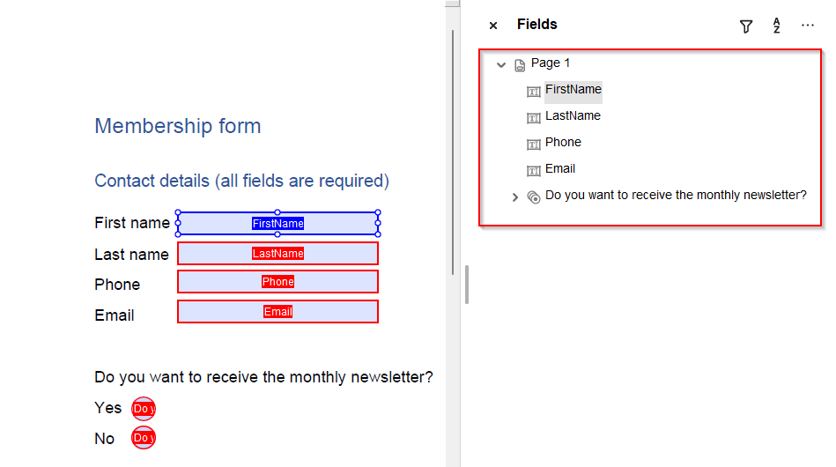
Checking tab order
Check the tab order is logical under Fields in the Forms Editing menu
Fields can be dragged and dropped in the menu to change their order
Preview the form and tab through it to check tagging and content order
Notes:
Radio buttons and checkboxes – navigate through these with up/down arrow key, not tab.

Slide 59
Summary
Consider if information could be presented in HTML before using PDF
Ensure accessibility is implemented in the source document before converting to PDF
Use accessibility checkers but remember to do necessary manual checks too such as content order and use of colour
Use the Make Accessible Guided Actions initially for scanned documents and non-tagged PDFs where you don’t have the source file
For PDF forms, you can create the form visually in another application then apply the form fields and tag with Acrobat

Slide 60
Questions? (1)

Slide 61
Resources
Adobe: PDF accessibility overview
Section508.gov: Create accessible PDFs
PAC 2024 PDF checker
Tagged PDF site

Slide 62
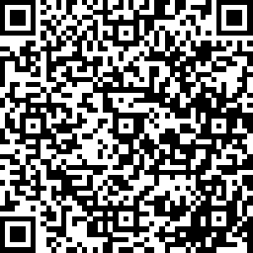
Thank you
Please let us know what you thought: uk.surveymonkey.com/r/Feedback-About-Our-Training
Scan to leave feedback
Notes:
Any final questions?

Slide 63
Thank you!

