Slide 1
Simplified Reviews 2024
February 2024 | Dónal Rice, Ben Adamson, Jess Byrne
Notes:
What’s expected in compliance
How we can support you on the accessibility journey

Slide 2
Agenda
Universal Design & Accessibility
Legal Obligations
Simplified Reviews
Practical demo
Strategies
Q&A

Slide 3
Introductory Slide
Notes:
The Centre for Excellence in Universal Design (CEUD) is dedicated to enabling the design of environments that can be accessed, understood and used regardless of a person's age, size, ability or disability.
We are a part of the National Disability Authority.
Built environment, digital services, research

Slide 4
Principles of Accessibility
“I need to Perceive the content, then I need to Understand it. Once
I’ve Understood it, I need to Operate it, using a device of my choice,
in a Robust way that won’t break it. ”

Slide 5
Legal Obligations
EU Web Accessibility Directive / S.I. 358/2020 What public bodies must do
Ensure all their websites and mobile apps comply with AA WCAG 2.1
Provide and maintain a detailed Accessibility Statement
Include clear access to a Complaints and Redress mechanism (Enforcement procedure)
Build capacity and awareness of web accessibility

Slide 6
Content
What’s Covered
What’s Exempt
Accessibility Statements
Notes:
Covered
Office file formats e.g Word, PDF
Navigation
Images
Videos
Forms
Search
Extranets/intranets
Social media
Exempt
Office file formats and videos prior to Sept 2018
Live Media
Maps – alternative for navigational maps
3rd party content not under control of a public body
Consider
Website & mobile apps
Documents content – not just HTML pages
Social media posts
Accessibility Statements
Compliance status
Non-accessible content
Preparation of this accessibility statement
Feedback and contact information
Enforcement procedure

Slide 7
“If anybody asks me what the Internet means to me, I will tell him without hesitation: To me (a quadriplegic) the Internet occupies the most important part in my life. It is my feet that can take me to any part of the world; it is my hands which help me to accomplish my work; it is my best friend - it gives my life meaning.” Dr ZhangXu

Slide 8
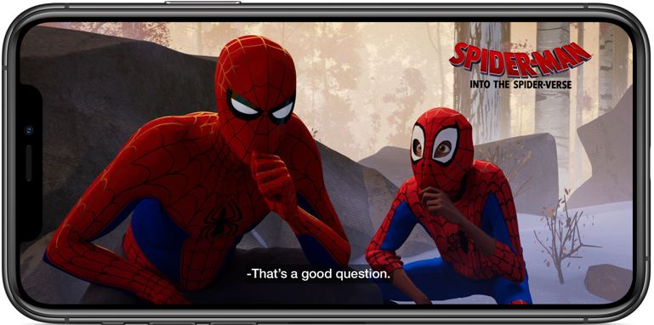
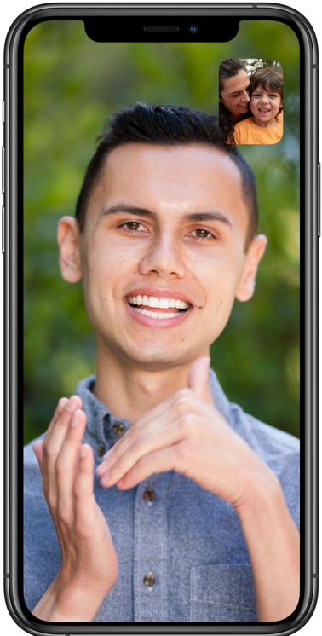
Examples of Web Accessibility
Closed captions on a video
Speech output while driving
Using sign language on a
video call

Slide 9
What is a Simplified Review?
Automated testing to provide a baseline understanding of accessibility health
~ 400 pages per scan, incl PDFs. ~50% of standard
Understand key trends through larger data sample
Gain information on areas in which to direct resources to first
Weekly report
Free!
Notes:
Courtesy Deque systems

Slide 10
Simplified Reviews –2024

Slide 11
Working with the results

Slide 12
The numbers don’t lie, But they don’t tell the whole truth
The numbers don’t lie,
But they don’t tell the whole truth

Slide 13
Practical demo

Slide 14
Using Simplified Review results - 1
Understand the data – some technical (e.g. ARIA), some branding (colour contrast), some content/communications (images, links)
Provide results to developer/web agency to remediate
Incorporate into internal QA, web management and communication processes
Monitor results over time

Slide 15
Using Simplified Review results -2
Prioritise issues
Critical issues – fix these first
Frequency - some may be template issues e.g. header/footer, Search bar
High value pages – homepage
Create remediation plan (with help of agency)
Use when procuring new services
Conduct your own review

Slide 16
Monitoring is just the beginning
User feedback and engagement
Accessibility Statement and supports
Code
Managing accessibility
User
WCAG compliance

Slide 17
Resources
Deque University (We have licences!)
Training programme for your team. Courses and reference library, useful to understand In-depth & Simplified Reviews
How NDA monitors compliance
Guide to monitoring process under WAD
ICS WAD Training Series
Accessibility webinars hosted by NDA
Web Accessibility Techniques
Accessibility webinars hosted by NDA
Monitoring Reports Ireland’s past reports
Customer Communication Toolkit
Getting you thinking about the content on your website/app and how the public interacts with it
Introduction to Web Accessibility
W3C’s introduction to accessibility
W3C ARIA Authoring Practices Guide
Includes a library of accessible design patterns
Writing an Accessibility Statement
Learn how to structure and include information in accessibility statements

Slide 18
Closing Slide: CEUD Contact details
https://universaldesign.ie/
@CEUD_NDA
www.linkedin.com/showcase/the-centre-for-excellence-in-universal-design-ceud

