Slide 1
How to create accessible documents and presentations
Joe Chidzik
May 2022
Notes:
Make sure recording has started!
Also enable live captions!

Slide 2
Welcome
This session is recorded
Captions are available​
Slides and the recording will be shared via an email in the coming days​
Please use the chat window to ask questions ​- I’ll pause periodically for questions
Notes:
Make sure recording has started!
Also enable live captions!

Slide 3
Example documents
Inaccessible Word document:
https://drive.google.com/open?id=0B-oEnszZrEaMYmt6LXJoaWxGbGs
Accessible Word document:
https://drive.google.com/open?id=0B-oEnszZrEaMM0t6dTExNU5LTW8
PDF version:
https://drive.google.com/open?id=0B5w8EXu9wtOqeW8zSVJQZUtmSVE
Open Education Resources from the MOOCAP project
Notes:
Inaccessible Word document:
https://drive.google.com/open?id=0B-oEnszZrEaMYmt6LXJoaWxGbGs
Accessible Word document:
https://drive.google.com/open?id=0B-oEnszZrEaMM0t6dTExNU5LTW8
PDF version:
https://drive.google.com/open?id=0B5w8EXu9wtOqeW8zSVJQZUtmSVE

Slide 4
Agenda
Applying accessibility principles to documents
Creating accessible templates
Creating accessible content
PDF accessibility
Accessible forms options
Notes:
We’ll be focusing on Word and PowerPoint documents
We’ll look at some of the difficulties for forms, particularly Word forms.

Slide 5
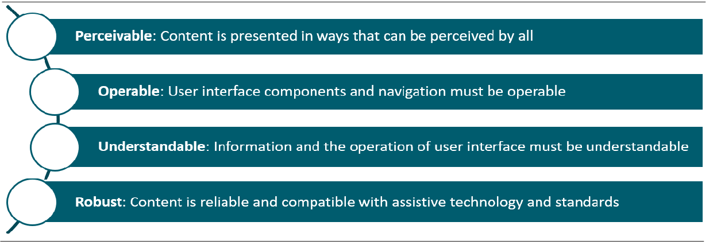
Accessibility principles: POUR
Notes:
These principles are taken from the WCAG 2 which you may be familiar.
Summarise digital accessibility neatly.
Whilst they apply to web pages, they can also apply to documents as well

Slide 6
Remember, some documents:
Convey information visually – so they need to be perceivable if personalised or accessed through assistive technology
Are interactive – so they need to be operable
Request user inputs – so they need to minimise user errors
Will have different levels of support for assistive technology
Choosing the correct document format will influence the effort involved to make it accessible
Notes:
Informative images e.g. info graphics, or charts
Interactive e.g. embedded videos
User inputs e.g. form fields
Though at this point we’re reaching the limits of where documents are the best format e.g. web forms might be better for requesting user information
The reader being used, along with any relevant assistive technology, will influence how accessible a given document is for a user.

Slide 7
International accessibility standards
Web Content Accessibility Guidelines (WCAG) 2.1 Level AA
ETSI EN 301 549
Aligned to WCAG 2.1 AA
Section 10 covers non-web documents
Note – note all WCAG requirements transfer to documents
Notes:
EN 301 549 is an accessibility standard that covers all ICT (Information and Communication Technology) and is mentioned explicitly in the public sector regulations
Requirements in clause 10 apply to documents:
-that are not web pages
-that are embedded in web pages and that are not used in the rendering
-and that are not intended to be rendered together with the web page in which they are embedded.
For web pages, these guidelines are identical to WCAG 2.1
For documents, however, ETSI identifies which WCAG standards relate to documents e.g. perhaps repeated blocks of navigation on web pages, or bypass blocks, do not apply to documents

Slide 8
Characteristics of accessible documents
Searchable text
Navigational aids (bookmarks, headings, table of contents)
Metadata e.g. title and document language
Programmatic document structure e.g. tags
Logical reading order
Interactive form fields that can be tabbed to with keyboard
Alternative text for non-text elements
Appropriately formatted tables
Notes:
High level view of the criteria for accessible documents; =
Searchable text e.g. not scanned text with no OCR, but machine readable
Metadata describing doc language particularly useful for screen reader users
Programmatic doc structure using tags – without appears as just jumble of letters. Example would be headings within word. Demo here with Word headings – large text and outline view

Slide 9
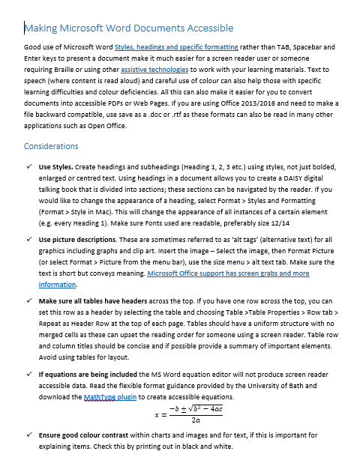
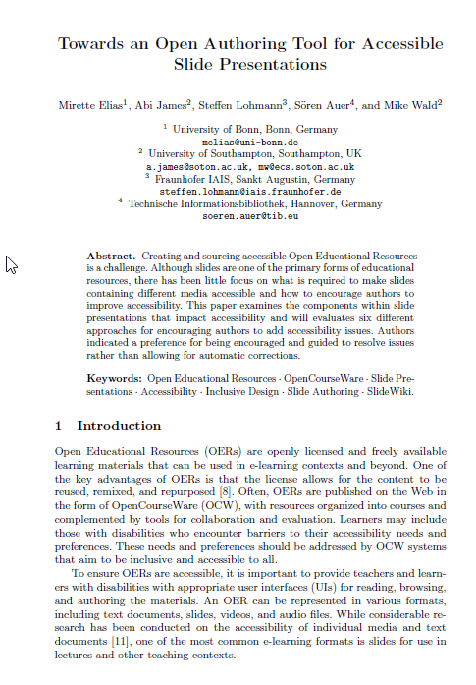
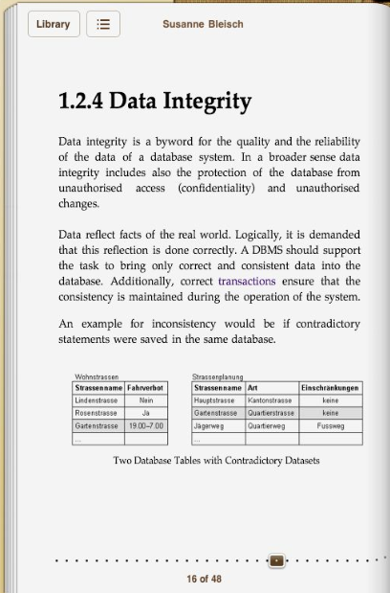
What types of documents are we talking about?
Notes:
Time: 10 minutes!
We refer to 3 types of document
Office docs – editable, and shareable
PDFs – print focused, locked format
ePub; not hugely popular generally, but is used at University level. Is a very accessible format.
HTML obviously broadly used across the web, but also for standalone docs

Slide 10
Poll What document formats does your organisation post online or share?
Editable documents (e.g. Word)
Presentations (e.g. Powerpoint)
Spreadsheets (e.g. Excel)
Locked documents (e.g. PDFs)
Other – please state in chat pane
Notes:
Here we have a multiple choice poll.
<Give poll, then announce results>

Slide 11
Accessibility pros and cons for document formats
Format | Pros | Cons
Office format e.g. *docx, *.pptx | Easiest to make accessible Compatible with wide range of assistive tech & devices Can be personalised by the user | Interactive features are not accessible Accessibility compromised by security settings
PDF | All users get the same view & difficult to edit Forms can be made accessible | Creating / fixing accessible PDFs requires specialist skills and tools Cannot be personalised by the user
HTML based format e.g. web page, ePub | All users get the same view but can be personalised. Compatible with wide range of assistive tech & devices Interactive activities can be made accessible | Accessibility may need specialist skills or tools. No default viewer at the moment for ePub
Notes:
Office format is easiest to make accessible for a number of reasons.
The office format, once proprietary, is now more open and can be read on a wide range of devices – pcs, macs and mobiles. It is has good support across assistive technologies e.g. the JAWS and NVDA screen readers.
User’s can also adjust the docs to meet their needs; change font size, background colour and so on.
All of this really applies to simple office documents; more complex ones do introduce accessibility challenges.
In addition, due to the ubiquity of it’s interface; pretty much everybody will have access to, and be familiar with, the office range of products.
Main benefit of PDF is that it’s view is the same for all users; so creators know how it will look to users. It is also possible to ensure interactive features are made accessible. Companies may also not want to publish Word docs which are easily edited.
Whilst editing PDFs is possible, it requires specialist software.
With ePub, and HTML, user’s have control over the appearance of the content e.g. text and background colours, font style.
It is possible to ensure interactivity is accessible as well.
Could demo epub here

Slide 12
Creating accessible templates to avoid potential issues
Notes:
Time ~ 20 minutes
Pause for any questions on last bit of content.
Creating accessible template is the easiest way to manage accessibility across an organisation.
Templates, along with appropriate training for teams, ensure a base level of accessibility is baked into docs from the outset.
This accessibility is then carried through into PDFs you create as well

Slide 13
Office template: Styles and structure
Set up styles for:
Headings 1 – 6: use outline level to set heading level
Normal text: think about paragraph and line spacing, font style and colour
Bullet and numbered list: ensure there are styles for common types of text
In PowerPoint create layouts with Title and content areas
Notes:
Talk about headings/text etc
In PPT, title is like the heading for a slide

Slide 14
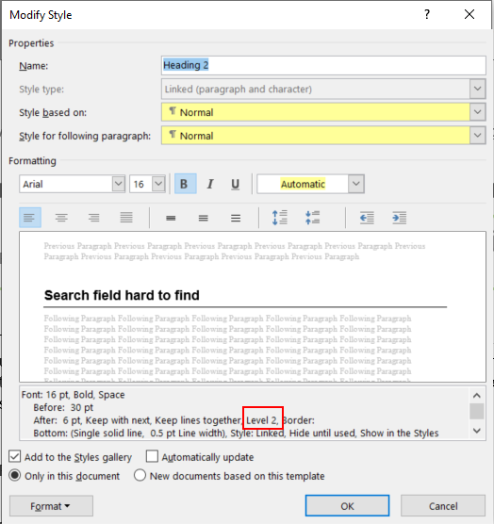
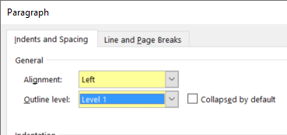
Example: Setting heading level in word
On the Home tab, in the Styles group, select a heading style, for example, Heading 1 or Heading 2.
Do not use headings only for styling.
Notes:
Demo on accessible demo doc
Make use of document outline!
Show how to edit the heading via styles > modify, paragraph dialog AND outline view!
Whilst you can change the name of a heading, we advise against it!
Do not use headings for styling text!

Slide 15
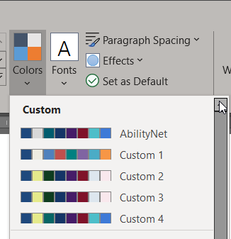
Example: PowerPoint layouts
Select Slide Master in the View tab
Ensure title placeholder is present on each template.
Set colours to provide good contrast.
Notes:
Powerpoint is a little different than Word.
Instead of styles, it has Layouts.
Critical is to ensure every slide has a title placeholder – equivalent to a heading for the slide. Without this, no heading for screen reader users.
Go meta here – we will explore the accessibility of the slide deck I’m using today (a duplicate one anyway).
View > Slide master
Right click slide > Master layout – we need title and text selected here
Can also go to customise colours here.

Slide 16
Template: Decorative content
Headers and footers
Use built in tools to add headers, page numbers etc. so they are ignored by assistive technology
Background images
Ensure background graphics are marked as decorative
Notes:
Also important is defining decorative content – typically repetitive content for assistive technologies
By default they are ignored – to ensure this, use Word/PowerPoint features to add in Headers/Footers
This carries through to PDFs as well
Ensure that important information e.g. authors name, within headers/footers is duplicated on title slide or elsewhere.
AT provides ways to get page number for example
Also good to ensure background images are marked as decorative.

Slide 17
Decorative image announced by screen reader
Notes:
In this example, the NVDA speech viewer reads “graphic” constantly – likely due to background graphic on page
Use demo slide deck, slide 17 > right click image > edit alt text > mark as decorative!

Slide 18
Questions? Break 1
Notes:
Time here ~ 30 minutes

Slide 19
Adding content to documents
Notes:
Time ~ 30 minutes
PAUSE for questions or comments on previous section
So far we’ve looked at templates, and now we will look at adding content to documents.
Before that, we’ll have another poll.

Slide 20
Poll Does your organisation check accessibility when content is created?
Yes
No
Sometimes
Don’t know
We have a policy but it’s not policed
Notes:
Here we have a multiple choice poll.
Read out options whilst poll showing
<Give poll, then announce results>
Talk about results, note that some automated tools (SIteImprove, Axe Monitor) can check PDFs when they’re live
But best to check before publishing – we will look at some of the ways in which you can check content using built in tools

Slide 21
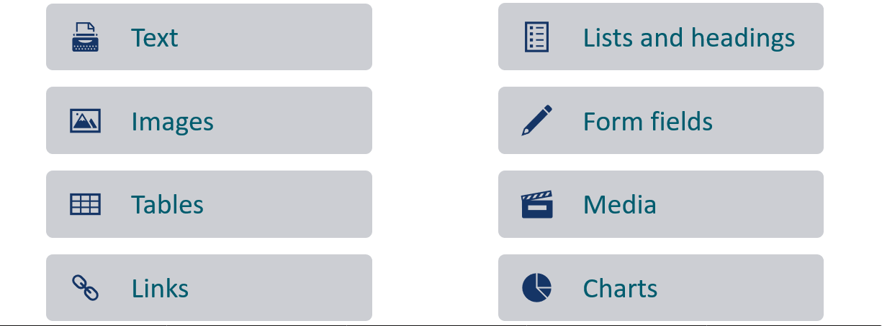
Types of content we need to make accessible
Notes:
Text – ensuring available as machine readable!
Form fields – labelling, keyboard accessible

Slide 22
What do we mean by accessible text?
It is not an image.
You can select and copy it.
When you select all text / convert to a text document, it has the correct reading order.
If it is non-standard characters then an accessible alternative is provided e.g.
Answer 1 (Correct)
Answer 2
Notes:
e.g. we cannot just scan a page of text and include as an image. If doing this, likely need to OCR the image.
You can export a PDF as text; this will reflect the order in which SRs will read text content.
Open demo PPTX to slide 21
Note that answer 1 has a bullet, but answer 2 has an image icon with correct alt text.
Better to use lists and then provide descriptive text as well.
Non-standard characters differ between screen readers. Mathematics in particular is a challenging area.

Slide 23
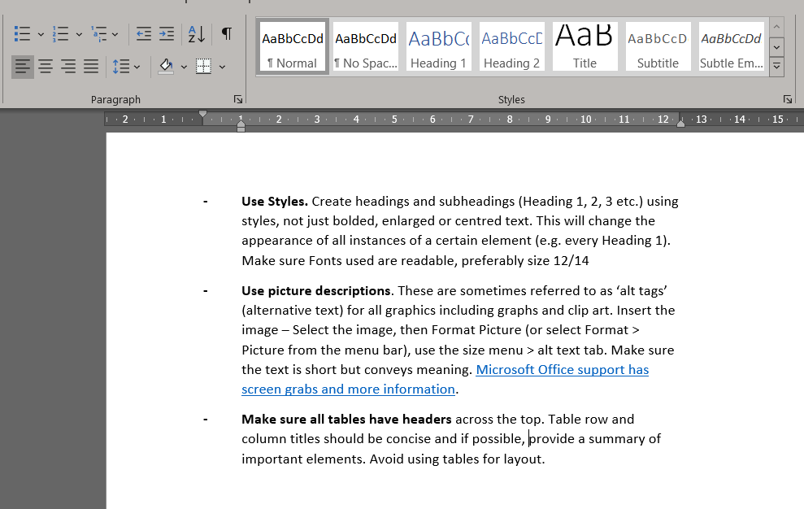
Example: What can we do wrong with lists?
Notes:
Please add to chat if you have any suggestions over what we could do wrong in this example of a list
Go onto next slide to show bullets have normal style – not lists!

Slide 24
Example: What can we do wrong with lists?
Notes:
Time ~ 40 minutes
Using normal style, not lists!
DEMO: inaccessible word doc: uses presentational table, but no lists again! Whilst visual lists are present, these are images!
Then demo accessible doc to show how they are done well!

Slide 25
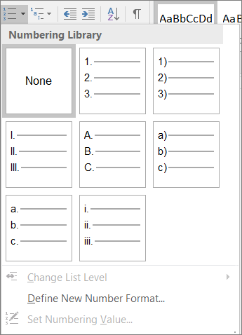
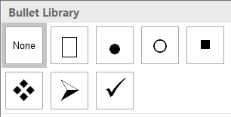
Formatting – Bullets and Lists
Use bullets and ordered lists as opposed to images, clip-art, etc to create lists.
List paragraph styles can be used to adapt spacing and fonts
Notes:
Important to use proper bullets and not images.
Can modify styles to cater for spacing around bullets/list items, and chose bullets from library

Slide 26
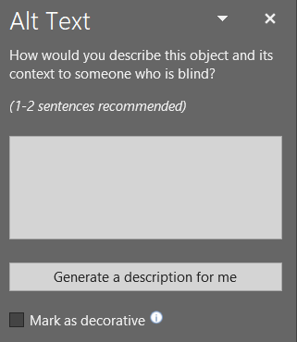
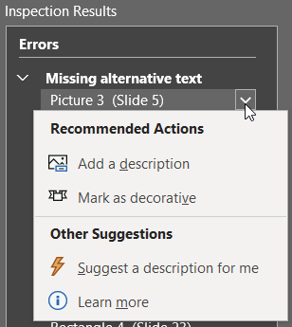
Adding ALT text to graphics in Office
From the images
Right click an image
Edit Alt Text
Type a description or mark as decorative
From accessibility checker
Select dropdown on graphic and choose appropriate option
Notes:
Showing what we looked at earlier;
Demo PPT slide 24 e.g. adding alt text OR add as decorative
Can use automatic description, but not always good!
2 ways to add alt text; manually or through accessibility checker to identify images lacking alt text and then add!

Slide 27
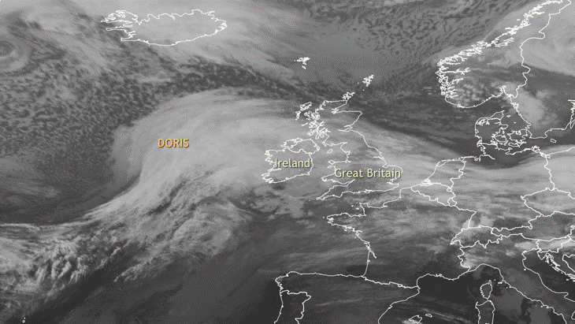
Example: Images and alternative descriptions
B
Notes:
On this page we have an exercise.
Each of you, please pick one image and then write the alternative text you would write. So write the letter e.g. A, followed by your alt text
No absolutely right answer; down to context – let’s see the suggested answers here! Best to keep it short though. Remember with screenreaders, onscreen text better as can use reading commands.
The best person to write the alt text for the image is the person who put it there – they are the only person who understands the reason for that image.
Within a PowerPoint doc, you can also add image descriptions to the notes pane which are accessible for screen reader users. Useful to alert screen reader users to this at the beginning e.g. additional info in the notes tab.
At the end of this presentation is a link to “the alt text decision” tree from the W3C which can be useful to help decide when an image is decorative or not
Also a link to a tool called the Poet Training Tool, which interactively guides you through the process of deciding alt text

Slide 28
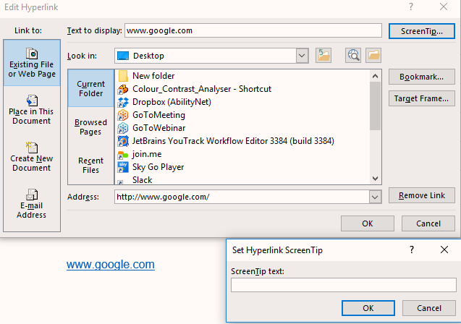
Links
Ensure that the purpose of links is obvious and self-evident from tabbing onto them.
Where possible, enter a meaningful name into the text to display field.
Use the screentip pop-up to provide a tooltip for users.
Notes:
Time ~ 50 minutes
Best practise to ensure the meaning of links is clear – SR users can extract list of links
If doc meant to be print, could include URL in link name
Use screen tip as a popup for mouse users (not screen reader users!)

Slide 29
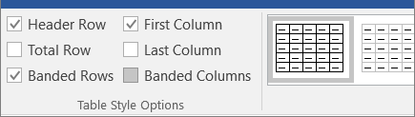
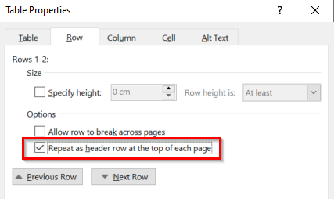
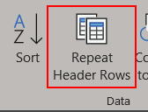
Formatting – Tables
Use table headers:
Table Design > Table Style Options
Select Header Row and First Column
In Word Select Table properties: “Repeat as header row at the top of each page”
Add a caption or alt-text
Notes:
Simple tables work best; with Word you can only have tables of one header row/column
If you have more complex tables, you will want to consider how to simply them.
Demo with Word doc by adding table.
Point out header row in table toolbar.
Then right click > table properties > row
Check “Repeat header across pages”
Could also add alt text
Note that Word tables are v. simple e.g. cannot merge cells, have single rows of headers
IF creating PDFs from word docs, de-select the first check box re: allow row to break across tables.
Demo adding title to the

Slide 30
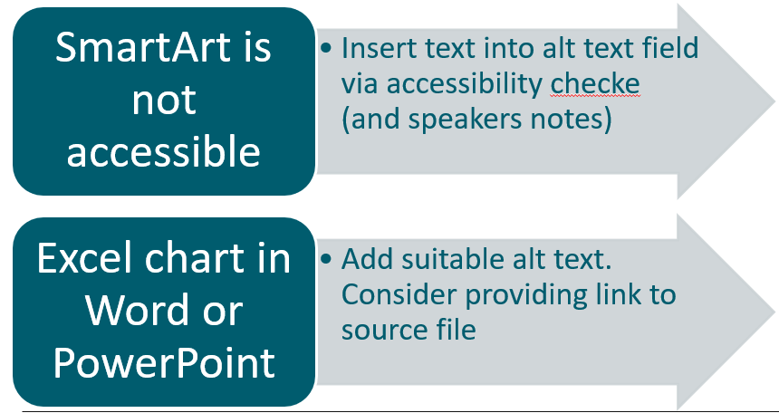
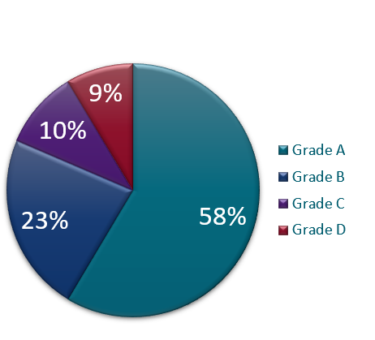
Embedding graphics: inaccessible version
Notes:
Graphics are another accessibility concern
Use smart art, but note that it is not accessible out of the box.
Demo PPT – point out multiple components of smart art; use accessibility checker to find outline of smart art for adding alt text!
Move to next slide for accessible version!

Slide 31
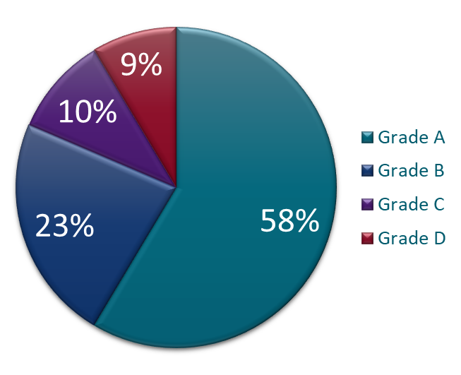
Embedding graphics – accessible version

Slide 32
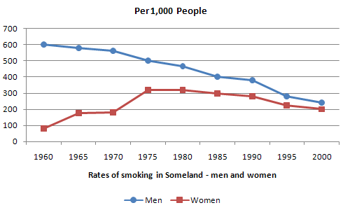
Use of Colour
Ensure that colour is not the only way that information is communicated.
links should have some decoration (e.g. underlined) and charts shouldn’t rely on colour vision.
Remember text and graphics need good contrast
Notes:
Don’t rely on colour alone

Slide 33
Microsoft Word Accessibility
Golden Rules:
use the formatting tools to provide meaningful structure
ensure that non-text content (e.g. images) have alternative text
use colour and meaningful hyperlink text to ensure perceivability
Make your Word documents accessible - https://support.office.com/en-us/article/Make-your-Word-documents-accessible-d9bf3683-87ac-47ea-b91a-78dcacb3c66d

Slide 34
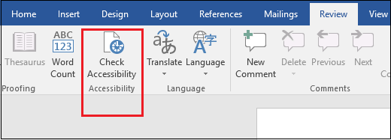
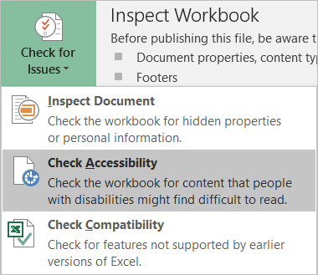
Microsoft Office Accessibility Checker
The Accessibility Checker finds accessibility issues, explains why you should fix these issues and how to fix them. Review > Check Accessibility.
Google docs – see Grackle suite
Notes:
Demo on Good AND Bad Word docs
If you do one thing! Use this accessibility checker.

Slide 35
Questions? Break 1
Notes:
Time here ~ 30 minutes

Slide 36
PDF Accessibility
Notes:
Time ~ 60 minutes
Pause for questions
This is thought to be very challenging;
PDFs often scanned documents – no machine readable text, requires OCR etc.

Slide 37
PDF accessibility – why is this so challenging?
Why are PDFs so challenging to make accessible?

Slide 38
The challenge of making PDFs accessible
Often scanned documents
Require additional accessibility tags to add structure
Don’t have great usability on mobile
Often heavily designed and complex layouts
Some types of content (such as mathematical and scientific notation) have limited accessibly support
Additional software and skills required to make PDFs accessible

Slide 39
Additional requirements for accessible PDFs
Text is not an image
Permissions are set correctly
File has appropriate metadata e.g. title and language
Content is tagged
Applies alternative text, semantics and reading order
Notes:
As covered before; text is selectable and machine readable
By security – if you start adding extra security this can be a problem e.g. read only, password protection

Slide 40
PDF accessibility checkers
Adobe Acrobat Pro – check and fix
PAC 3 – checker, freeware for Windows
CommonLook PDF Validator (require Adobe Standard or Pro)
PAVE – online tools, some fixing possible
Manual checks will still be required
Notes:
Really need Acrobat Pro for running the accessibility checker; this can identify AND fix issues.
If you don’t have this you can still use PAC3 for Windows (Mac version in progress) for checking only
PAVE completely online; can do some fixing.
Typical automated rules apply; issues can be checked e.g. alt text present, but tool cannot say if text is appropriate!

Slide 41
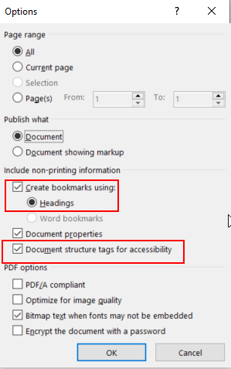
Exporting Word to accessible PDF
Add Title and other metadata
Convert embedded Office objects to images and add alt text
Select the following options in Save As *.pdf:
Create bookmarks using headings
Document structure tags for accessibility
Notes:
Demo with accessible word doc here.
You can convert smart art to images through copy > paste as image
Save as PDF
But if have Acrobat installed, can click the icon

Slide 42
Lightweight PDF check
Run the PDF document through a checker. Look for:
Image only file – this will need OCRing
No tags – this will need lots of remediation if complex structure
Permissions affecting accessibility
Tab through the file to check if links and fields are interactive
Use File > Export To > Text (Accessible) and View > Zoom > Reflow to check for reading order issues
Notes:
Time ~ 70 minutes
All need some work e.g. no headings, too many heading H1s, only a single H1 etc.
If no tags, much better to remediate source document.
Can open accessible PDF in Adobe Reader – show tag structure
This came from an accessible doc!
Then open inaccessible doc

Slide 43
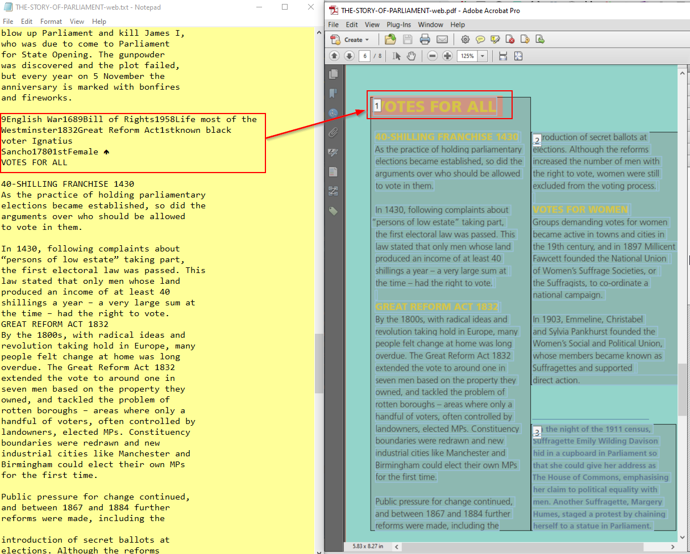
Reading order issues in PDF
Any content that is not laid out linearly could be read in the wrong order.
Without tags, content likely to read in the order it was added to files and text will be concatenated where there were line breaks.
Notes:
Here some hidden text is announced – this can be a problem, and could be exposed by exporting accessible text to read through.

Slide 44
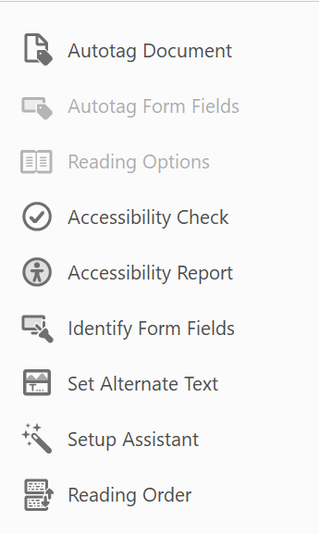
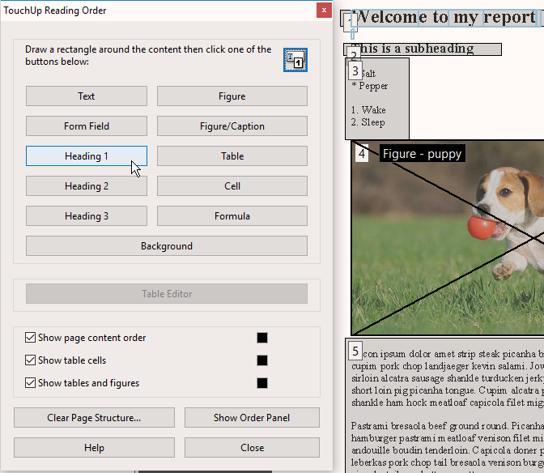
Using Adobe Pro to check & fix issues
Run Full Check and view report
Fix metadata and permissions issues
TouchUp Reading Order
Fix annotations and links
Notes:
Refer to our PDF accessibility guidance doc (to share) Demo with acrobat pro on accessible PDF
Much better to start with an accessible doc from Word

Slide 45
Accessible Forms
Notes:
Time ~ 80 minutes

Slide 46
Accessible Forms – Word vs PDF
Word Forms
More accessible if plain text e.g. leave empty space to fill out the form.
Built-in form controls have limited accessibility
Protecting content so only form fields can be edited makes the file inaccessible
PDF forms
Can be made accessible if form fields are tagged along with the rest of the file
Complex forms will be costly to make accessible
Many users will struggle to complete the form digitally
Notes:
Word forms are not accessible for screen reader users!
If you do have to use Word forms, use plain text entry and not built in forms.
PDF forms CAN be made accessible
Digital forms in general can be challenging for any users

Slide 47
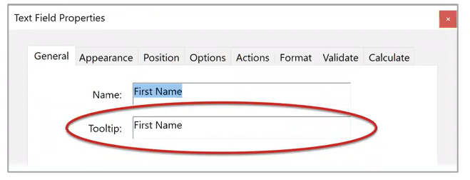
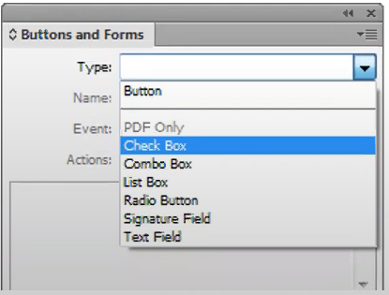
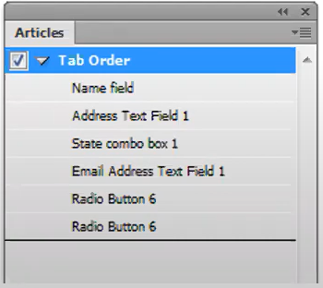
Accessible PDF forms requirements
In Adobe Acrobat every field needs to
be added, given a tooltip & tagged
Tab order must also be checked
Forms can also be created
in Adobe InDesign
Notes:
Tooltip acts as a the accessible label or name
Created in the form fields properties.
If interested in this topic, we do a complete webinar on PDF remediation

Slide 48
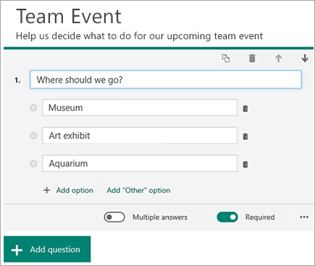
Easy accessible online form solutions
Microsoft Forms
Google Forms
Online survey tools e.g. Survey Monkey
Remember data protection
Notes:
Consider if a document based form is the most appropriate; web forms easier to setup and with good accessibility
Microsoft / Google forms are both v. good nowadays; consider if these are more appropriate for you

Slide 49
Summary
Accessibility requirements apply to all digital documents
Always consider if information needs to be in another format, or could be presented as HTML.
Accessibility is best implemented at the source when creating PDF documents and a good initial publication process is essential
Ensure you have a clear accessibility documents policy, good templates and procedures for checking content.
Notes:
One of the key takeaways from today is that accessibility guidelines apply to all kinds of content – documents and web pages.
It is far easier to address accessibility at the outset than trying to fix a PDF later on.

Slide 50
Questions?

Slide 51
Resources
Microsoft: Create accessible Office documents
Adobe: PDF accessibility overview
Daisy Consortium: WordToEPUB - Conversion tool for ePUB from Word
Web Accessibility Initiative: alt decision tree
Benetech: Poet alternative text training tool

