Slide 1
Accessibility Testing in Mobile Applications
Joe Chidzik
Accessibility and Usability Consultant
May 2022

Slide 2
Welcome
This session will introduce the tools and techniques for accessibility testing in mobile applications.
Live captions during the online event – toggle on/off
Slides, a transcript and recording will be made available
Please use the Q&A window for questions
Please use the chat window for general conversation
Feedback form will be shared after the event

Slide 3
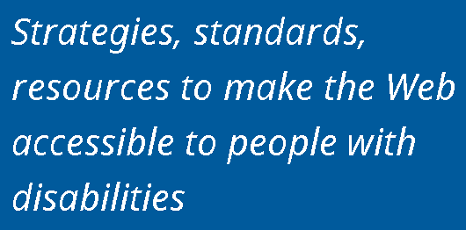
About AbilityNet
Notes:
- We are a technology charity providing a range of free and expert paid for products, services and resources. Our vision is a digital world that is accessible to all.
Products/Services include:
- Digital Accessibility Consultancy, Auditing and Training
- Accessibility Accreditation and Diverse User Testing

Slide 4
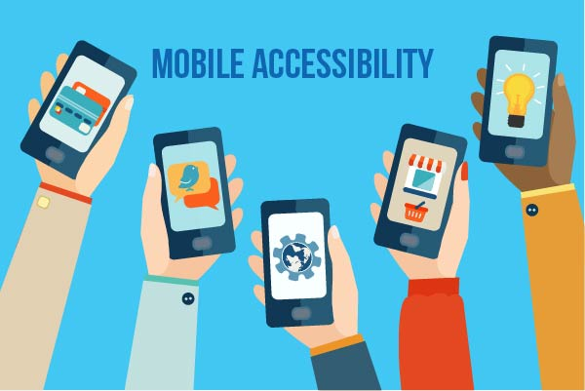
Agenda
Mobile Application Types
Assistive Technology for Mobiles
Using Mobile Screen Readers
Testing Considerations
Automated Testing
Design Considerations
Notes:
Here's an outline of what we will cover today.
* We will first look at application types and tips for how you can determine the type if you're not involved in developing the app itself

Slide 5
Question: What is your experience with mobile accessibility testing?
No experience
A little experience
Moderately experienced
Very experienced

Slide 6
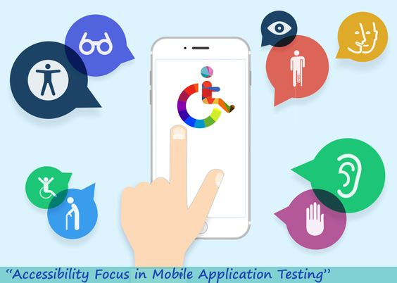
Discussion
Have you been involved in making mobile apps accessible?
What is your experience of creating mobile apps, what about using them?
What is your favourite app? What do you like about it.

Slide 7
Application Types

Slide 8
Types of Mobile Application
Responsive site/Web app – HTML, CSS and JavaScript
Native app – Java & XML/Kotlin or Swift
Hybrid app – Xamarin or React Native, WebView
Notes:
Web apps are created using the web technologies we're familiar with: HTML, CSS and Javascript.
They are effectively a website with the look and feel of an app running in the browser. They can be saved to the device so they appear as an icon on the Home screen, but they cannot be downloaded from the app store.
Usually a single page application and typically written in Javascript frameworks such as React or Vue.
Not to be confused with mobile websites which are the responsive versions of the websites we're used to. Aside from making more efficient use of the screen real estate, they typically still look and feel like websites.
In both cases, our recommendations are still those we are used to.
A web app is restricted to the device functions the browser can access.
Native apps are created using the technologies supported on the respective platform.
For Apple apps this is Objective-C or Swift (or SwiftUI)
For Android apps this is Java or Kotlin
Typically the platform provides an IDE or Integrated Development Environment to help you build these apps. For Apple, it is Xcode on the Mac. For Android, it is Android Studio. Both are free. They also include simulators to help developers preview their apps during development.
Our recommendations would reference native code and components.
Hybrid apps can be a mix of the two: effectively a webpage running in a browser inside a native app container. This is achieved using a webview wrapped in a native app container. Frameworks such as Cordova or Ionic Capacitor can do this for you. To get the look and feel of a native UI, frameworks such as React Native and NativeScript exist.
A hybrid app can have some access to device functions using extensions.
Our recommendations can reference web technologies and/or the framework used. I would also fall back on native recommendations as needed.
From a development perspective, a native app means better performance, consistent UI and easier access to functions of the device such as the camera and touch ID. Whereas going the hybrid route means a single code base that can be used across multiple platforms.

Slide 9
Assistive Technology for Mobiles

Slide 10
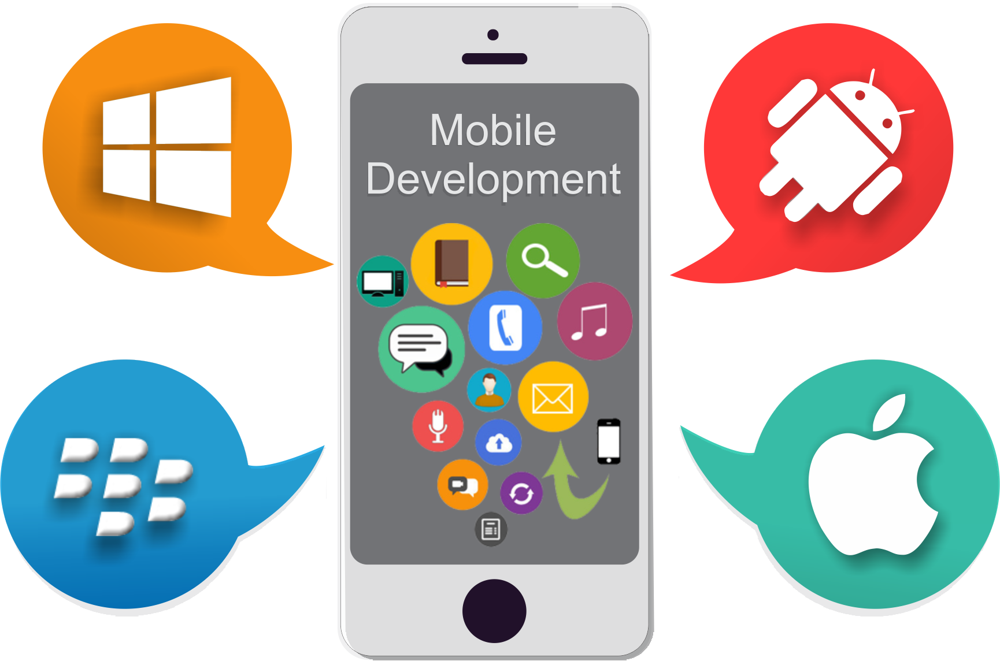
Mobile Accessibility Tools
Screen readers – TalkBack or VoiceOver
Display settings – Display and font, contrast
Interaction controls – Voice Access or Voice Control, Switch Access, Google Assistant or Siri
Braille – BrailleBack or Bluetooth enabled braille display
Audio – Captions, real-time text (RTT), or mono audio
Notes:
I want to briefly discuss assistive technology for mobiles. We can't assume everyone will interact with our apps in the same way.
Screen readers – an application that converts text to speech – allows users to navigate and operate their mobile phone and apps, even if they cannot perceive the information on screen.
VoiceOver and TalkBack are the two main screen readers on iOS and Android
Samsung created their own version – Voice Assistant – however it doesn't have as many options as Talkback does. You can download Talkback from the Google play store.
Display settings – font size, font colour, contrast, dark/light mode
https://support.google.com/accessibility/android/answer/6122836?hl=en-GB

Slide 11
Mobile Screen Reader Usage
Mobile Screen Reader | Percentage of Respondents
VoiceOver | 71.5%
TalkBack for Android | 29.1%
Voice Assistant | 7.6%
VoiceView | 6.1%
Mobile Accessibility for Android | 3.4%
MobileSpeak | 0.5%
Nuance Talks | 1.0%
Other | 3.4%
Respondents in the survey answered “Which of the following mobile screen readers do you commonly use? (Choose all that apply)”
Source: Webaim’s Mobile Screen Readers Used
Notes:
In May - June 2021, WebAIM surveyed preferences of screen reader users. This was a follow up to a previous survey in 2019. There wasn't a survey in 2020 due to the global pandemic.
A total of 1568 valid responses were received. However, the sample was not controlled so may not represent all screen reader users.
VoiceOver and Android remained overwhelmingly the main choice on iOS and Android devices. These figures have remained relatively stable for the last three surveys, with a minor drop for Android (3.9%) and a minor increase for VoiceOver (0.3%) since the last survey.

Slide 12
Using Mobile Screen Readers

Slide 13
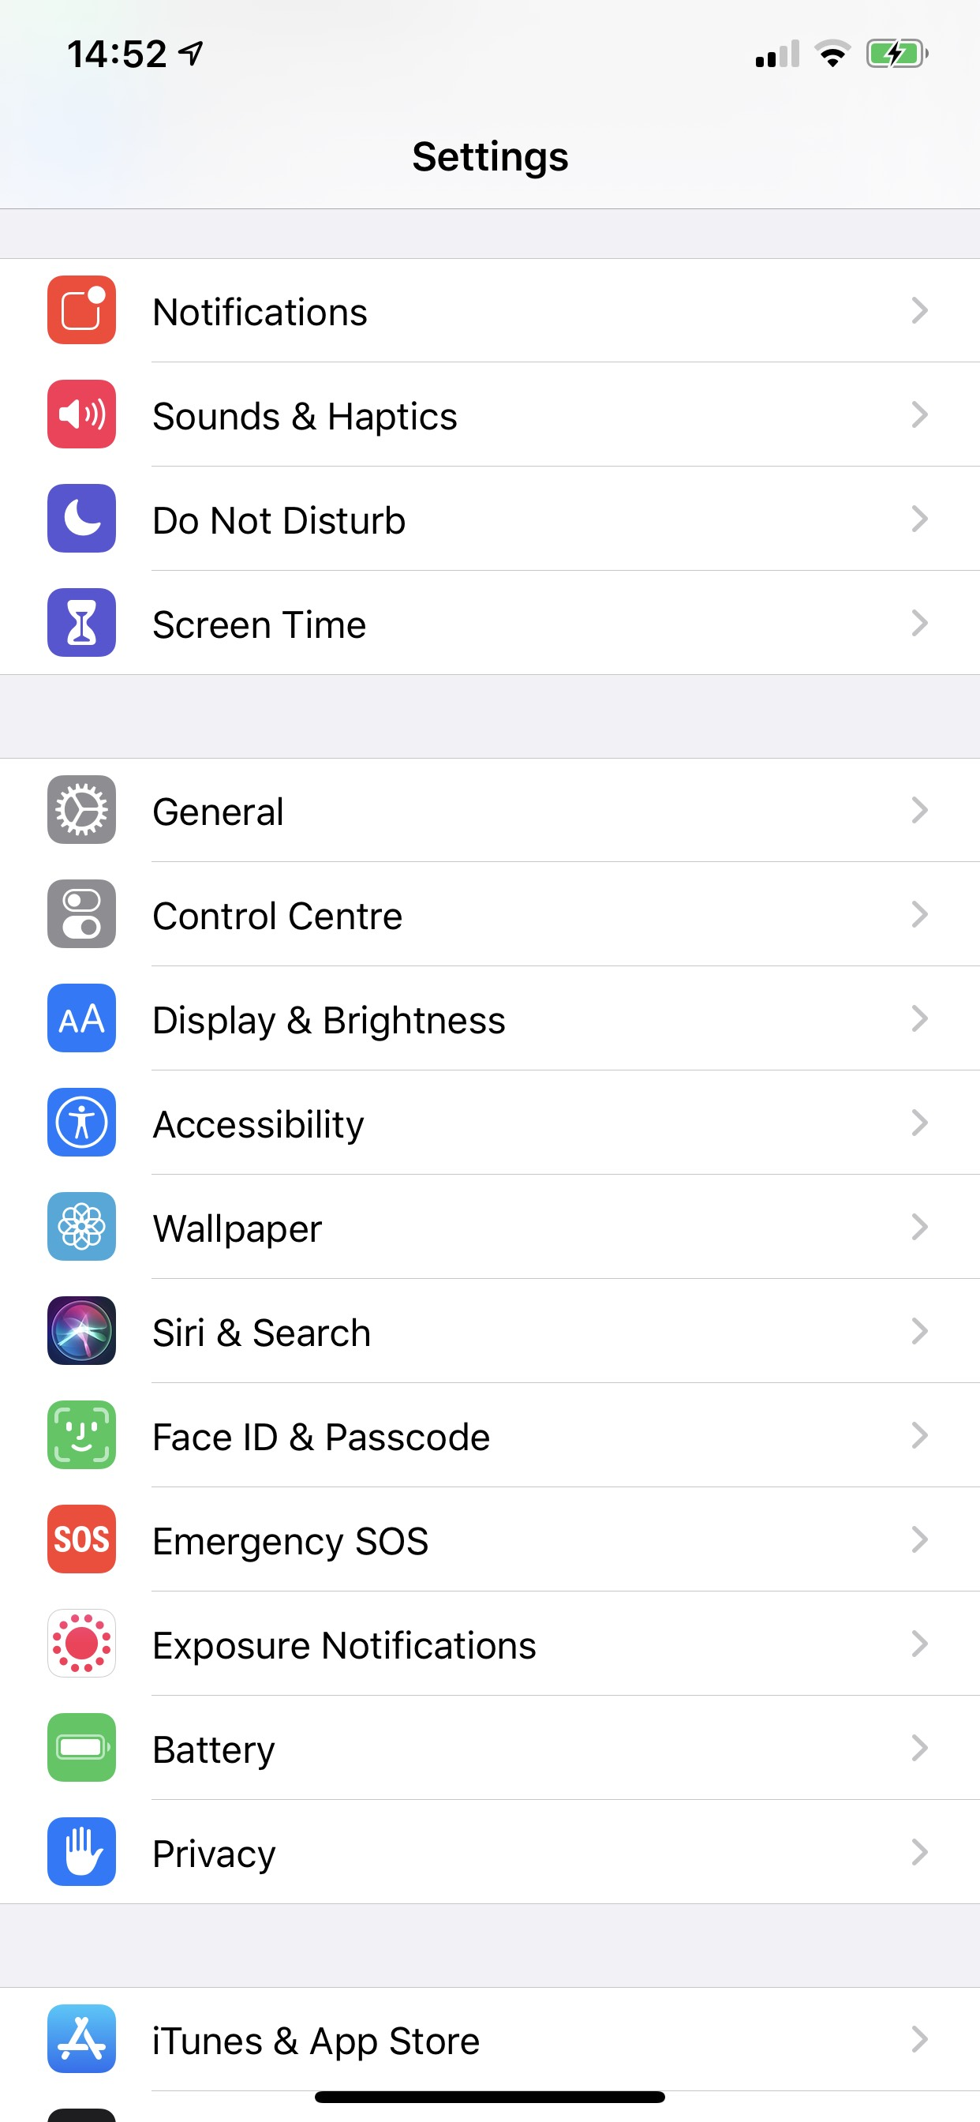
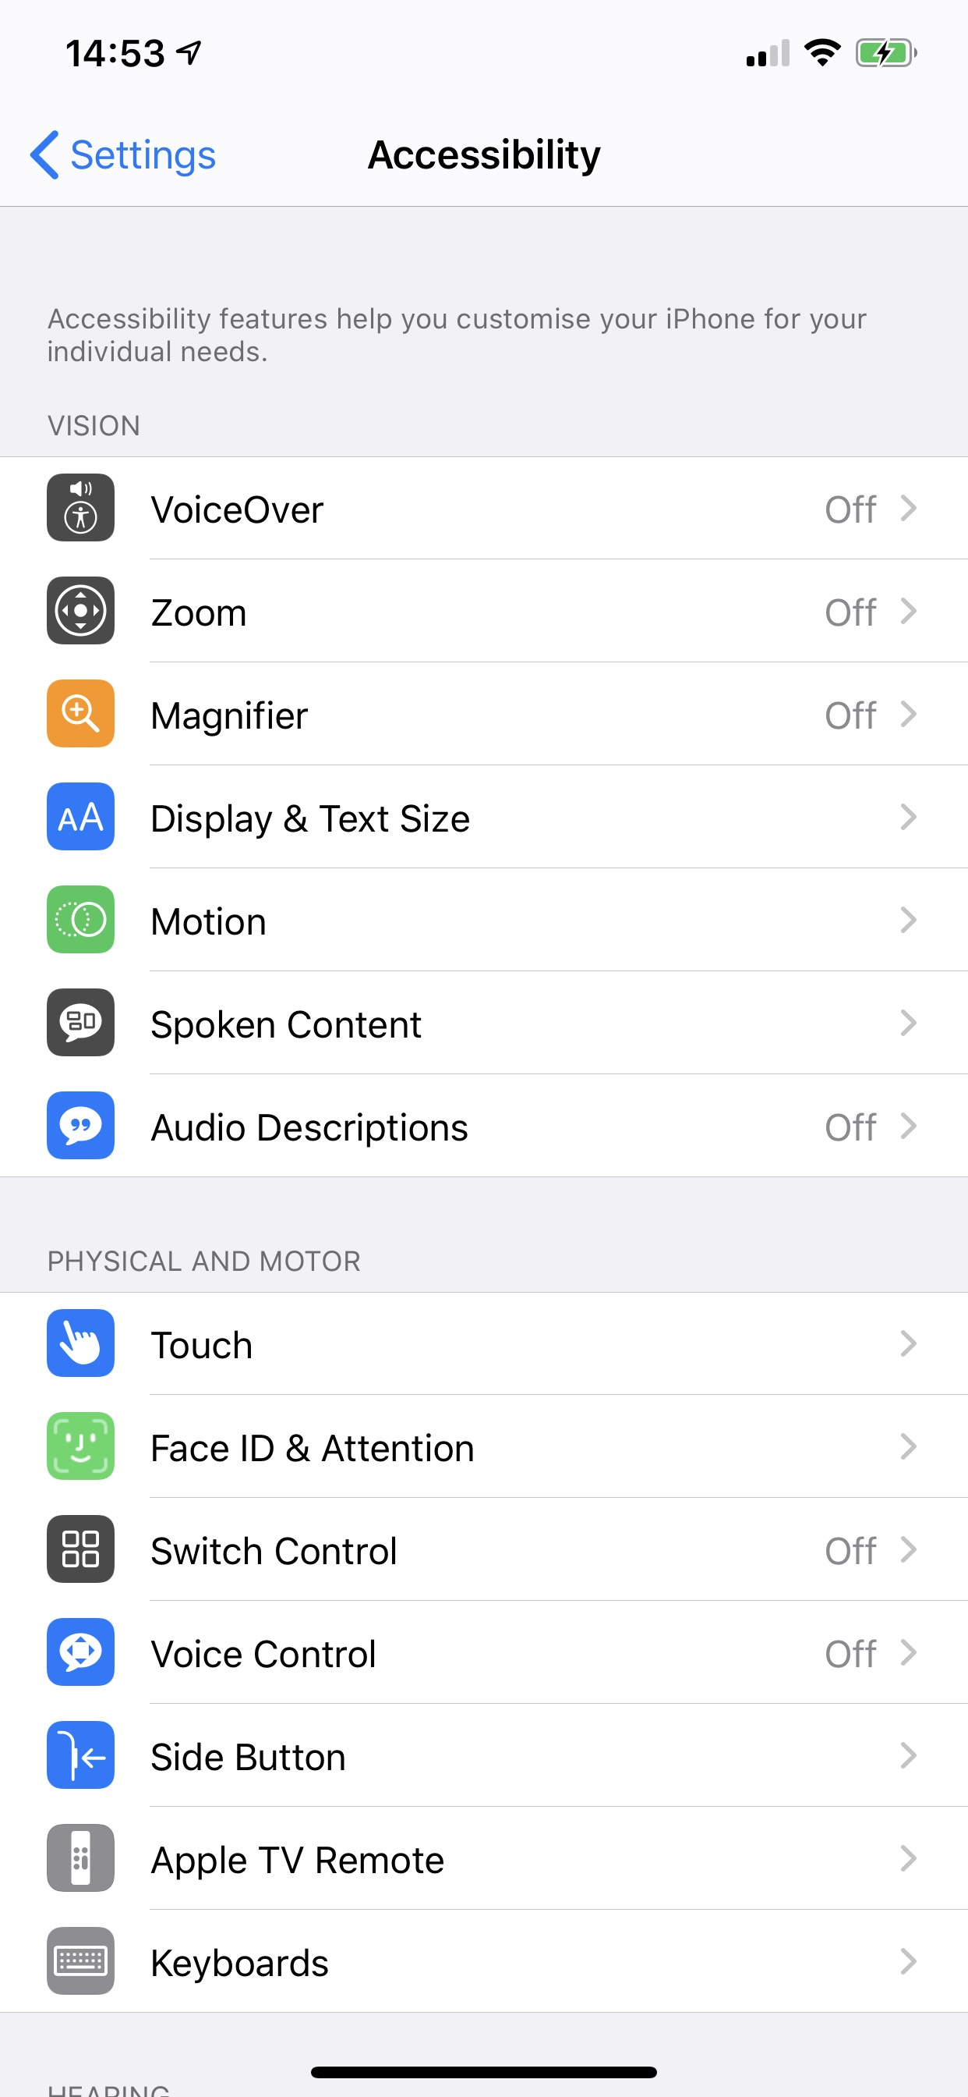
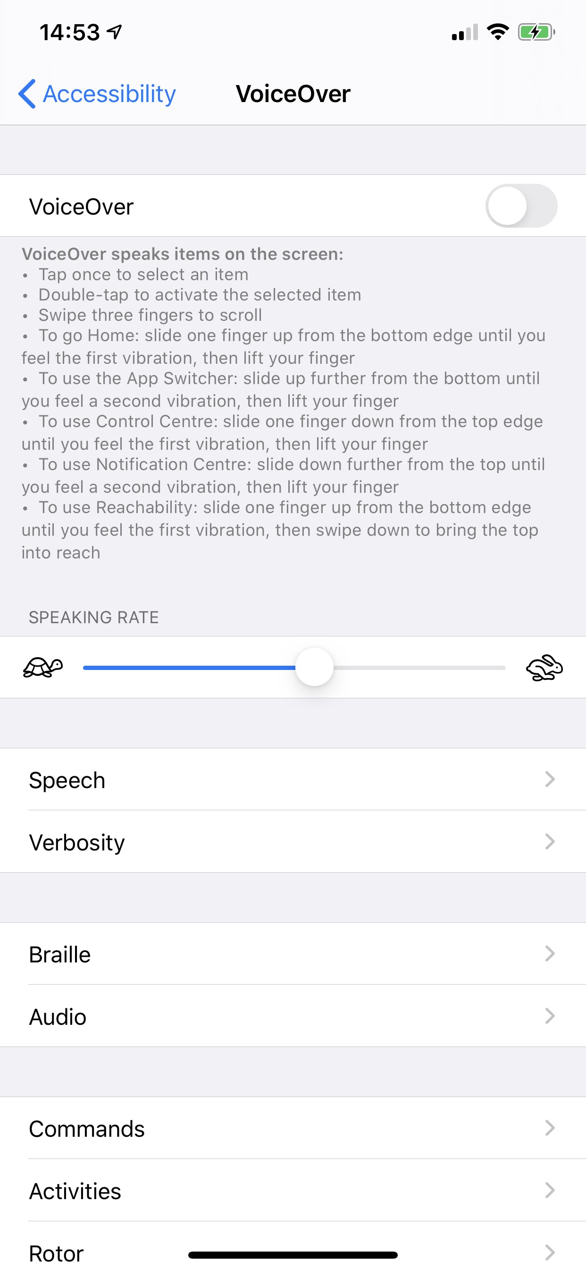
Activating VoiceOver
Go to Settings > Accessibility > VoiceOver > Turn VoiceOver on.
Notes:
In older versions of iOS, the Accessibility option was under General.

Slide 14
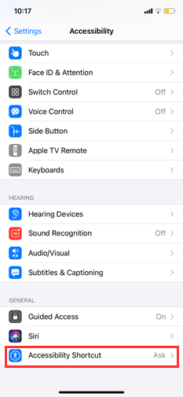
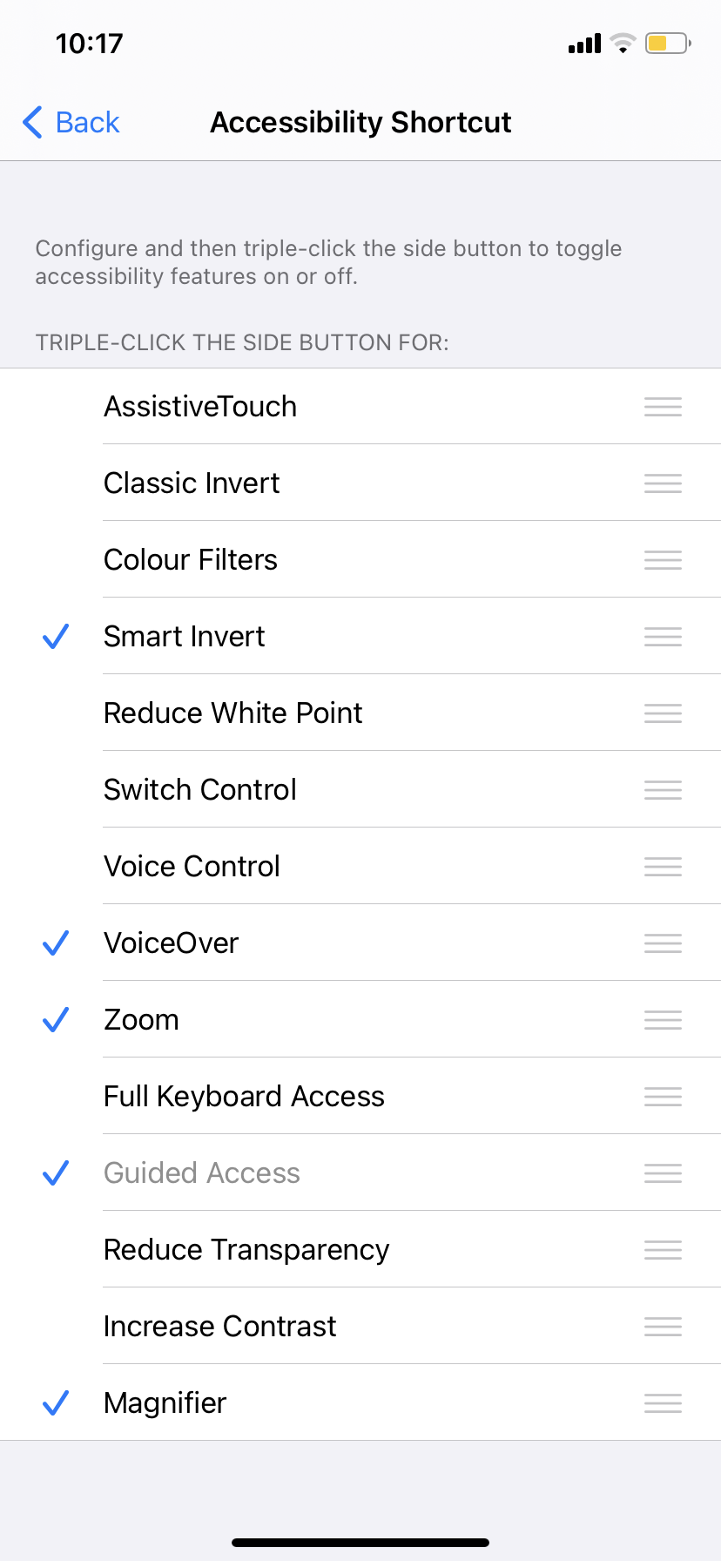
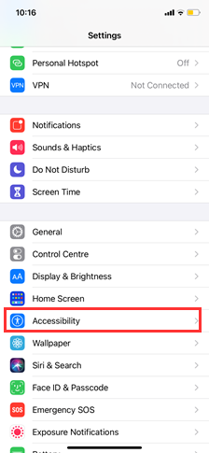
iOS Accessibility Shortcut
Notes:
. Settings
→ Accessibility → Accessibility Shortcut → VoiceOver
Triple tap home button or side (power) button

Slide 15
VoiceOver Demo (iOS)
Notes:
Explore by touch
Element by element (swipe left/right)
Activate (Double tap)
Stop speaking (Two finger tap)
Rotor – speaking rate, headings
Back (two finger scrub)
Home (one finger swipe up – one pip)
App switcher (one finger swipe up – two pips)
Scroll (three finger swipe)

Slide 16
VoiceOver Basic Gestures
Explore by Touch involves dragging one finger around the screen.
Swiping left and right with one finger moves the screen reader cursor element-by-element.
Double tapping with one finger activates whatever element the screen reader cursor is on.
Two finger tap once to pause VoiceOver speaking
Notes:
Daniel
Over the next two slides basic VoiceOver gestures are introduced. These can be demonstrated by navigating the Home screen on a real device.

Slide 17
VoiceOver Rotor
Making a twisting motion updates the rotor setting, such as Words, Characters, Headings.
Swiping up and down moves the screen reader through whatever is selected in the rotor.
Notes:
Daniel

Slide 18
iOS VoiceOver Advanced Gestures
2 Finger Gestures:
Swipe up - read all from first object in selected area
Swipe down - read all from selected item
Scrub back and forth - go back, cancel, close pop-up
3 Finger Gestures:
Swipe left or right - move to previous or next horizontal screen/page
Swipe up or down - move/scroll down or up

Slide 19
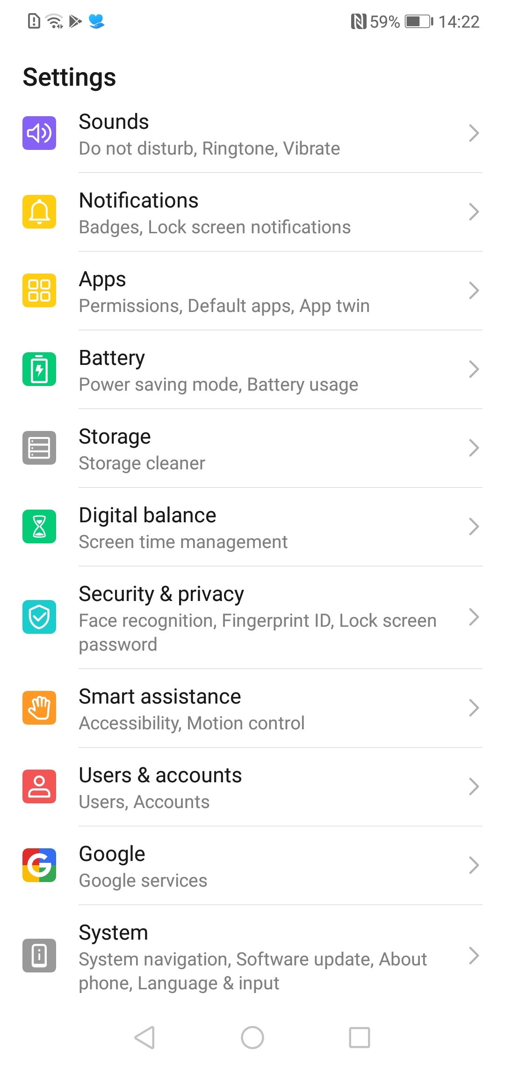
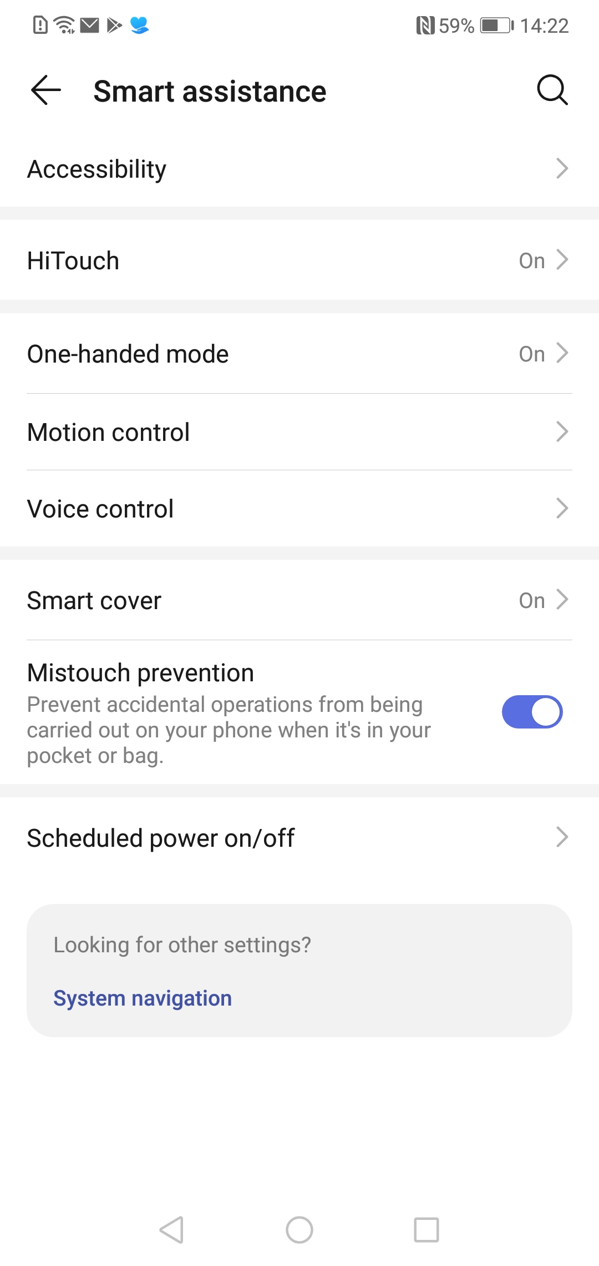
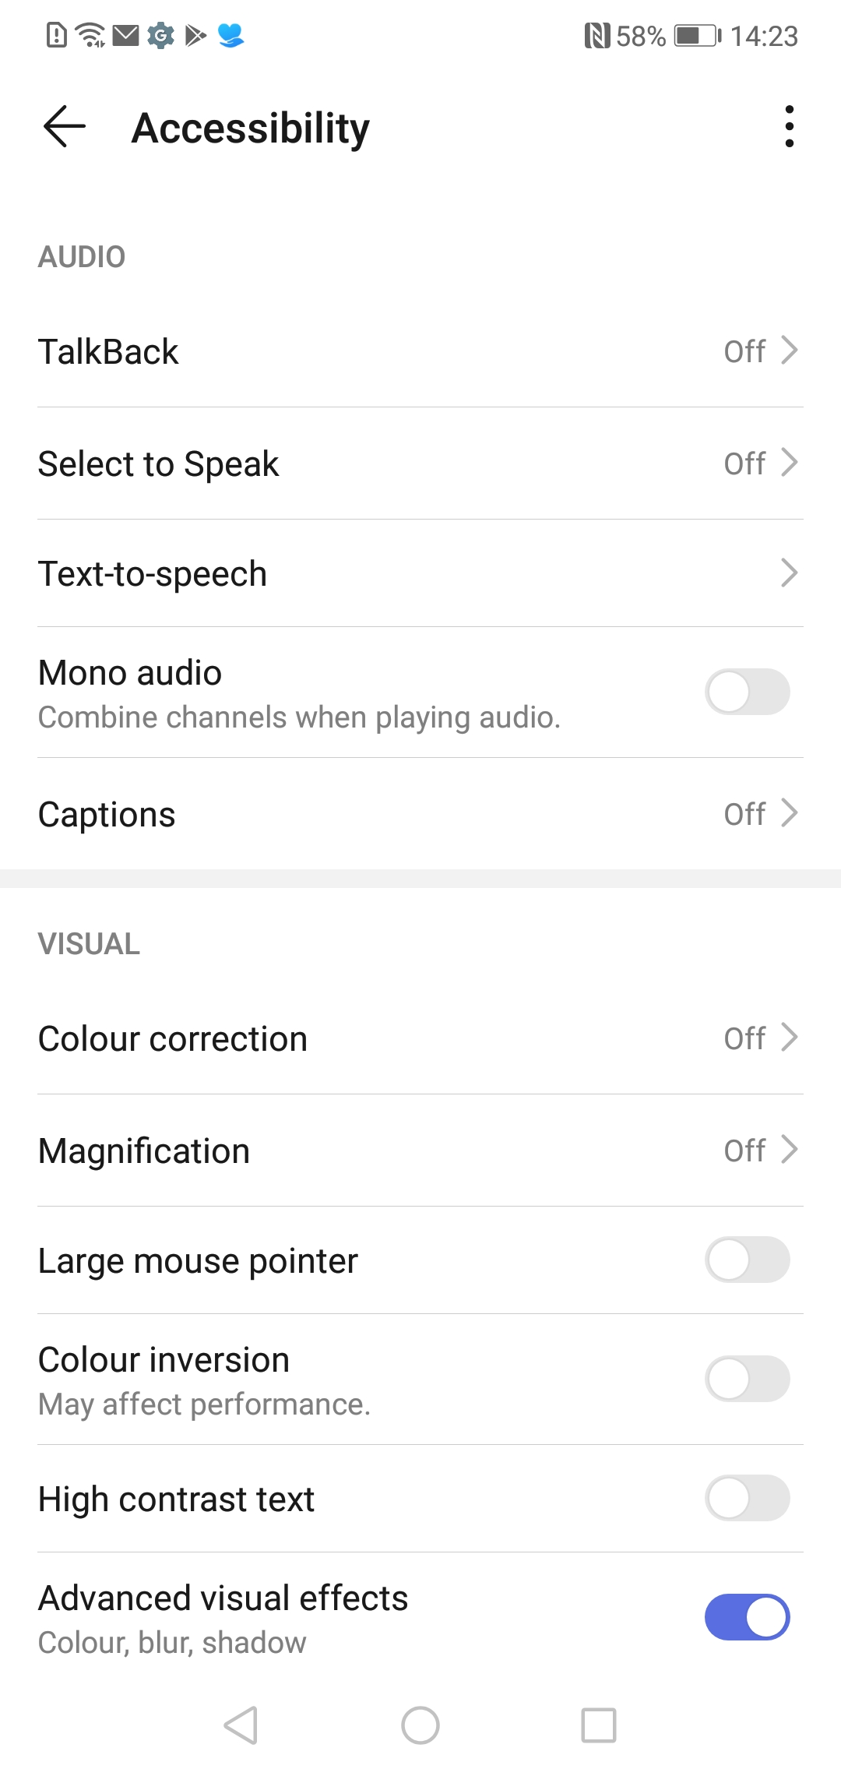
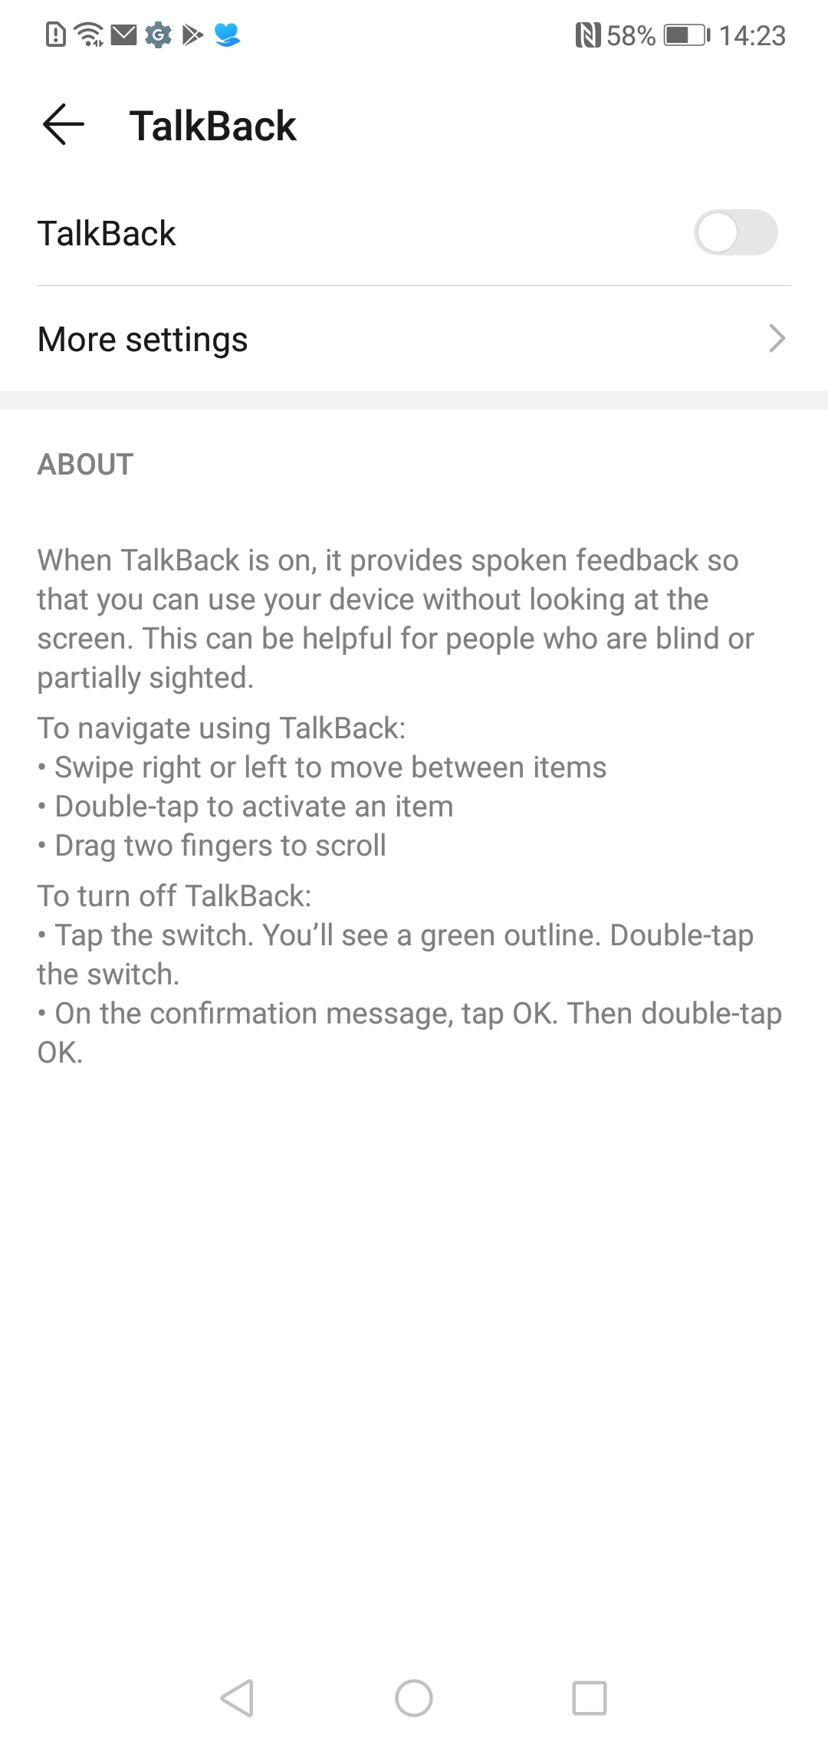
Activating TalkBack
Go to Settings > Accessibility > TalkBack > Turn TalkBack on. (Varies on different makes)
Notes:
Exact location of the option may depend on device. For example,
You can enable the accessibility shortcut to activate TalkBack without using the menus:
Press and hold the up and down volume buttons
2-finger swipe up from bottom (3-finger swipe with TalkBack turned on).

Slide 20
Android Accessibility Shortcut
Settings
→ Accessibility → Accessibility Shortcut → TalkBack
Hold volume up and volume down for three seconds.
Notes:
Note that in different versions of Android the menu items may be named slightly differently.

Slide 21
TalkBack Demo (Android)
Notes:
Explore by touch
Element by Element (swipe left/right)
Activate (double tap)
Silence (two finger tap)
Scroll (two finger drag)
Talkback menu (up then down, navigate with up or down)

Slide 22
TalkBack Basic Gestures
Explore by Touch involves dragging one finger around the screen.
Swiping left and right with one finger moves the screen reader cursor element-by-element.
Double tapping with one finger activates whatever element the screen reader cursor is on.
Two finger tap silences the screen reader.
Two finger drag to scroll the page.
Notes:
On this slide some basic TalkBack gestures are introduced. These can be demonstrated by navigating the Home screen on a real device.
Two finger drag to scroll.

Slide 23
TalkBack Menu
In Talkback 9.1:
Swiping up then down / down then up changes the selection in the TackBack menu.
Swiping up or down moves the screen reader through whatever is on the TackBack menu.
In older versions:
Swiping up or down to change the selection in the local context menu.
Swiping left or right moves the screen reader through whatever is on the local context menu (if not Default)
Notes:
In earlier version of Android, the local context menu is used by:
* Swipe up or down to change the local context menu option
* Swipe left and right to move through the selected option
In newer versions of Talkback,
Swipe up then down or down then up to change local context menu option
Swipe up OR down to navigate these options. Left or right to navigate all options.
On previous versions of talkback up then down moves to first item on the screen.
LCM and GCM have been unified: up//down and right take you there
In previous versions:
Local Context Menu - Down then right
Global Context Menu – Up then right

Slide 24
TalkBack Advanced Gestures
1 Finger Gestures:
Swipe up then down - move to first item on screen
Swipe down then up - move to last item on screen
Swipe right then left - scroll forward on page or move slider
Swipe left then right - scroll back on page or move slider
Swipe up then left - Home button
Swipe down then left – Back button
2 Finger Gestures:
Swipe down then right – global context menu
3 Finger Gestures:
Up or down swipe – changes the screen reader voice
Left or right – change the navigation options that are used in the single up or down swipe
Notes:
Pre 9.1

Slide 25
TalkBack Advanced Gestures
1 Finger Gestures:
Home – up then left
Back – down then left
Talkback Menu – down then right
App Switcher – left then up
2 Finger Gestures:
Scroll up / down – Two-finger swipe
Scroll left/right – Two-finger swipe
3 Finger Gestures:
Talkback menu – tap
Copy – double tap
Paste – triple tap

Slide 26
Questions? Break 1

Slide 27
Practical Exercise

Slide 28
Hands on Exercise
Using your mobile, open your favourite application and turn on the screen reader
Try navigating to the menu of the application and opening it
Try doing a task you normally do in the application using a screen reader
Notes:
45 mins

Slide 29
Share in the chat
What worked well?
What was hard and why?
Was there anything surprising?
Notes:
What worked well?
What was hard and why? Was this due to the app or unfamiliarity with the screen reader?

Slide 30
Testing Considerations

Slide 31
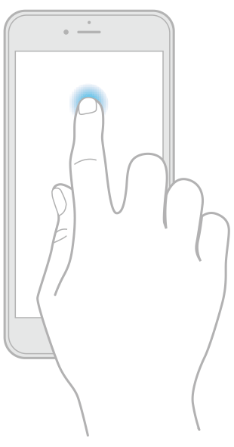
Testing Defaults
Having clear documented defaults ensures consistency across test devices.
Device and OS version
Settings
Screen reader settings
Notes:
iOS: Accessibility > Caption Panel
Android: Settings > Advanced Settings > Developer Settings > Display Speech Output
Android
To enable Developer Options, under About phone, tap the build number seven times.
Then under System > Advanced > Developer options, enable the Show Layout Bounds option
https://developer.android.com/studio/debug/dev-options

Slide 32
What to look for
Semantics
Interactive elements
Meaningful sequence
Text alternatives
Form errors and status messages
Text Resize
Colour and Contrast
Orientation
Notes:
Semantics – do elements have the appropriate role? E.g. is a button announced as a "button"
Interactive elements – are all controls focusable and operable with the screen reader
Meaningful sequence –
Text alternatives – are images described appropriately
Errors and status messages – are dynamic updates announced
Text Resize – can text be resized without loss of content or functionality
Colour and contrast
Orientation

Slide 33
Questions? Break 1

Slide 34
Automation

Slide 35
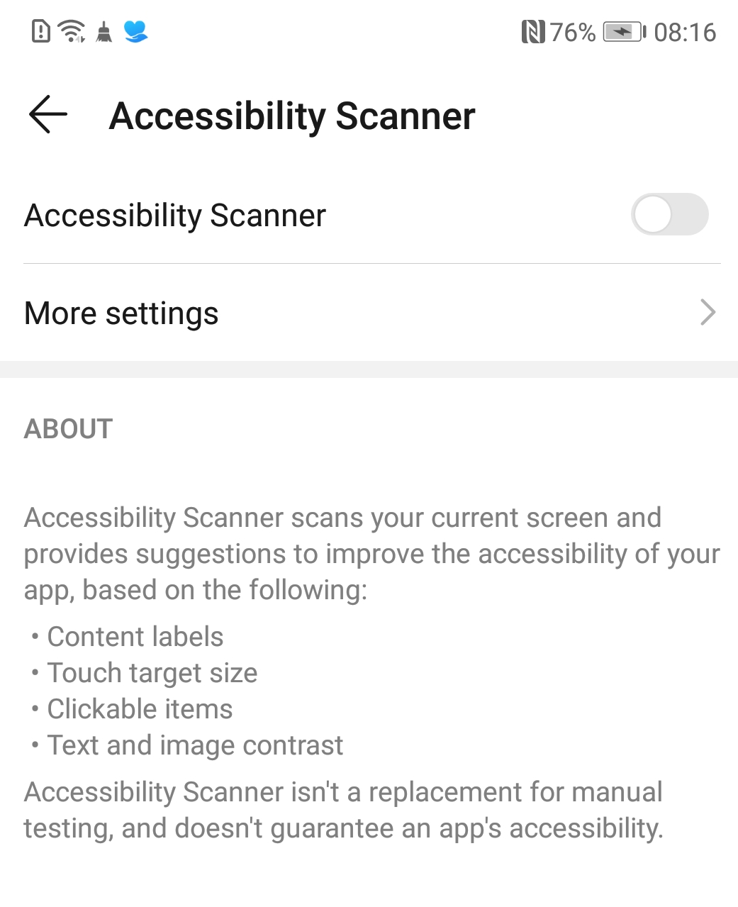
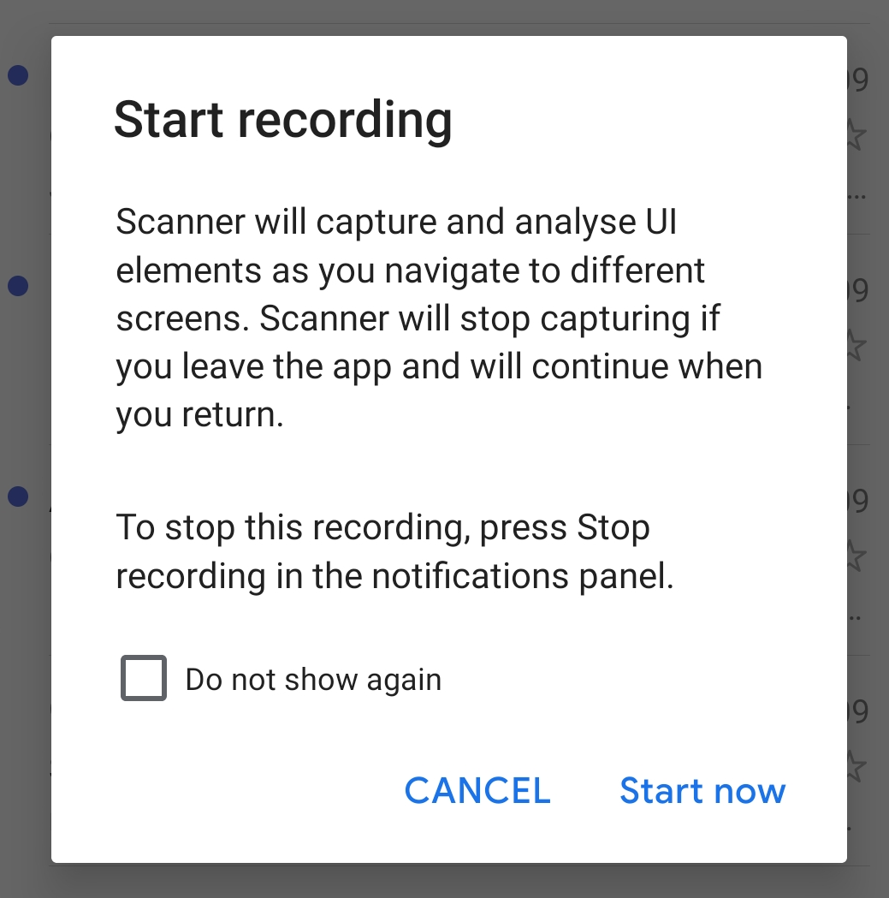
Android Automated Testing Tools
Google Accessibility Scanner
Download app from the Play Store
Scans applications on the phone as they are used
Notes:
Recording:
Snapshot:

Slide 36
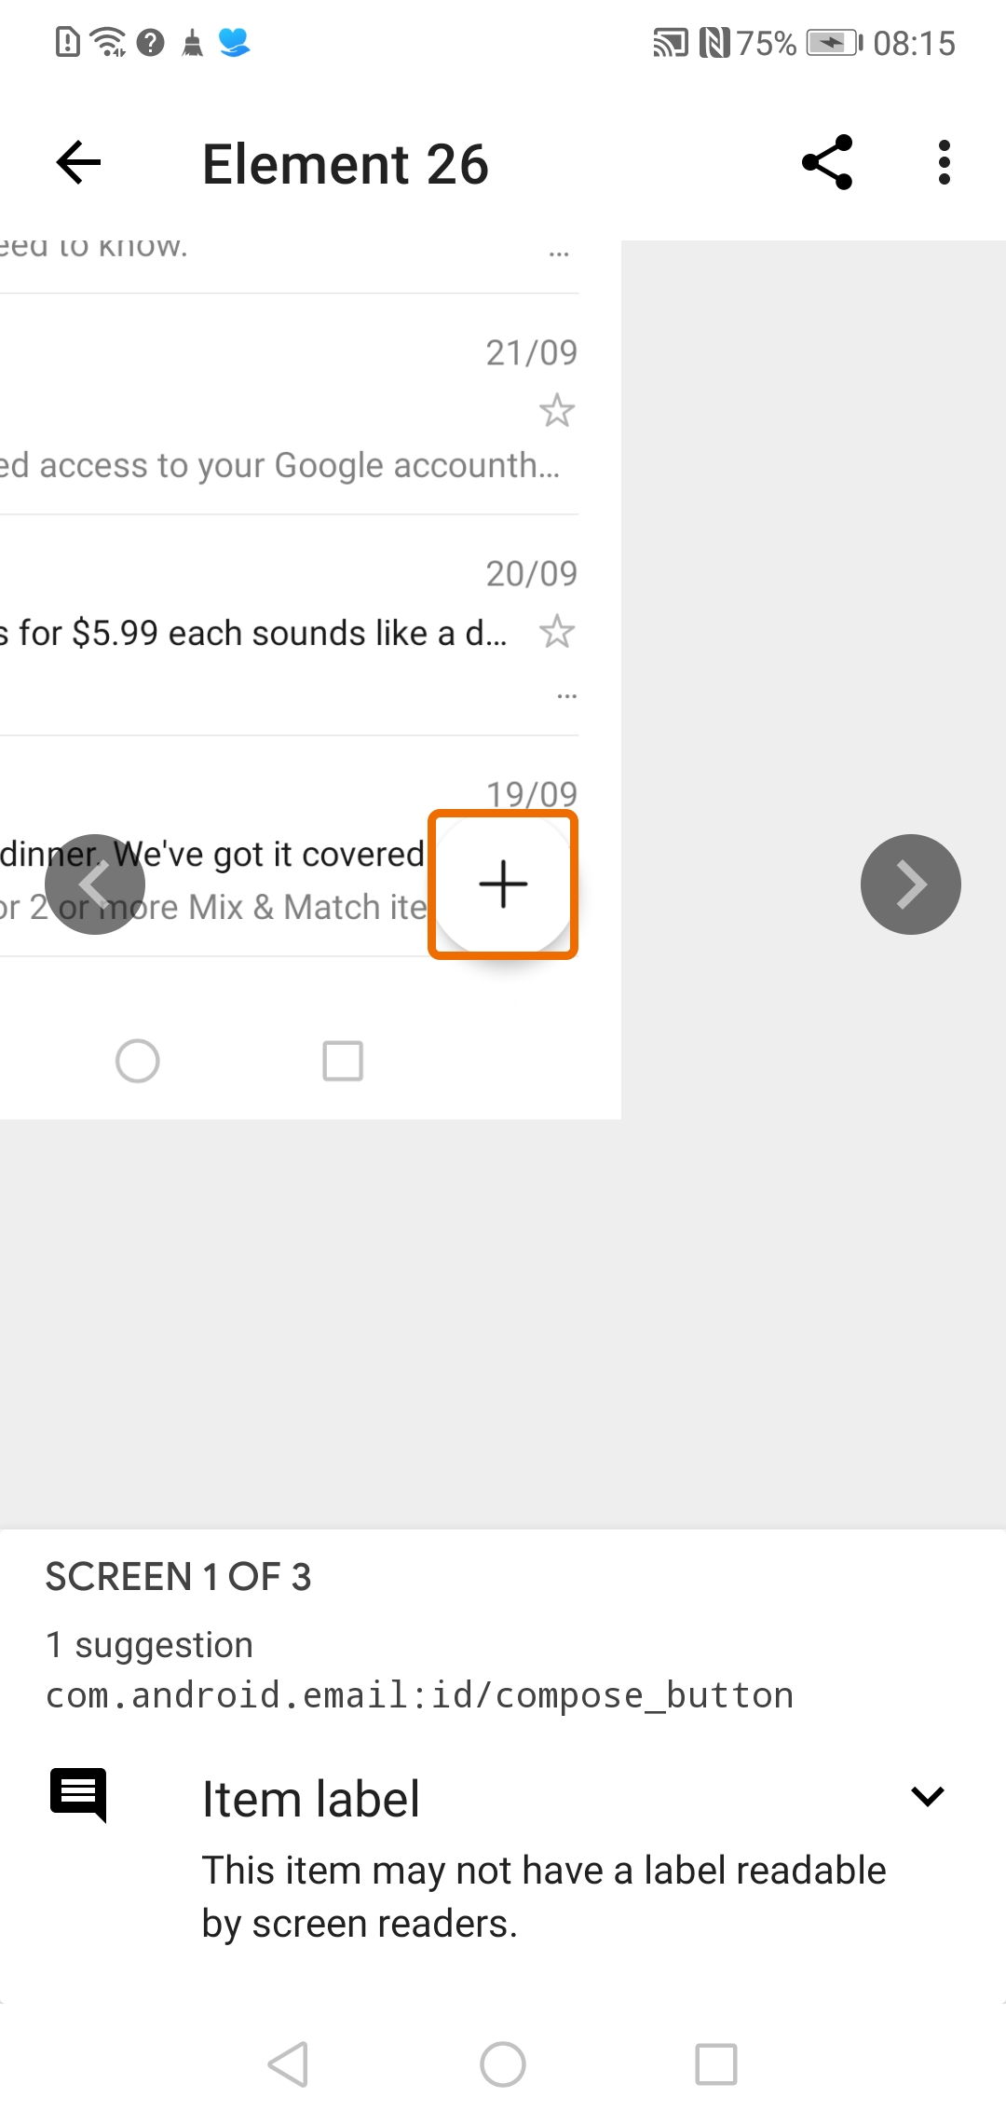
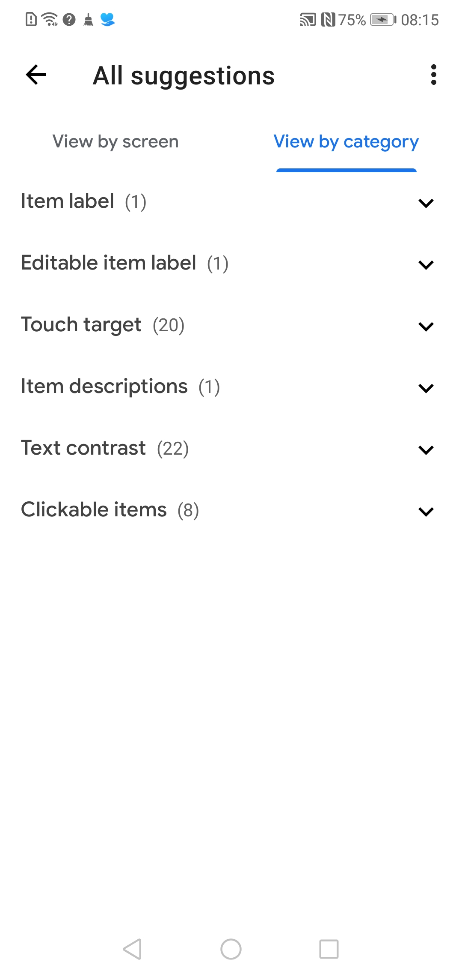
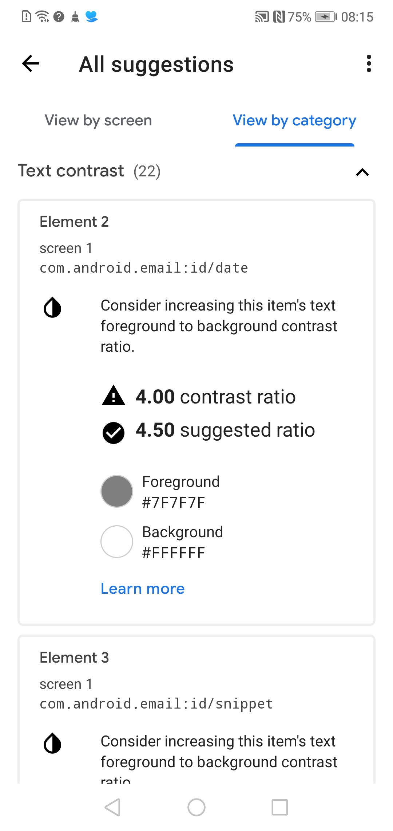
Google Accessibility Scanner Results
Notes:
Results show a screen with all issues highlighted, user can select a highlighted item to view the error, or view the errors by categories and drill down.

Slide 37
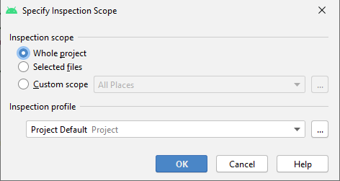
Android Automated Testing Tool Lint
Lint
Code scanning tool for apk files
Android Studio > Analyze > Inspect Code
Flags errors in the code
Test scope can be amended
Notes:
Lint is a tool provided in Android Studio that helps you identify problems with the structure of the code.
Helps identify cause of issues found in manual testing

Slide 38
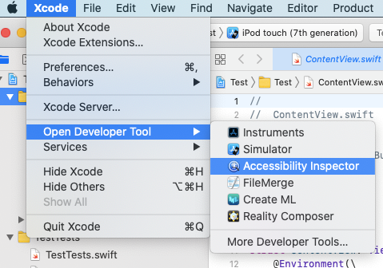
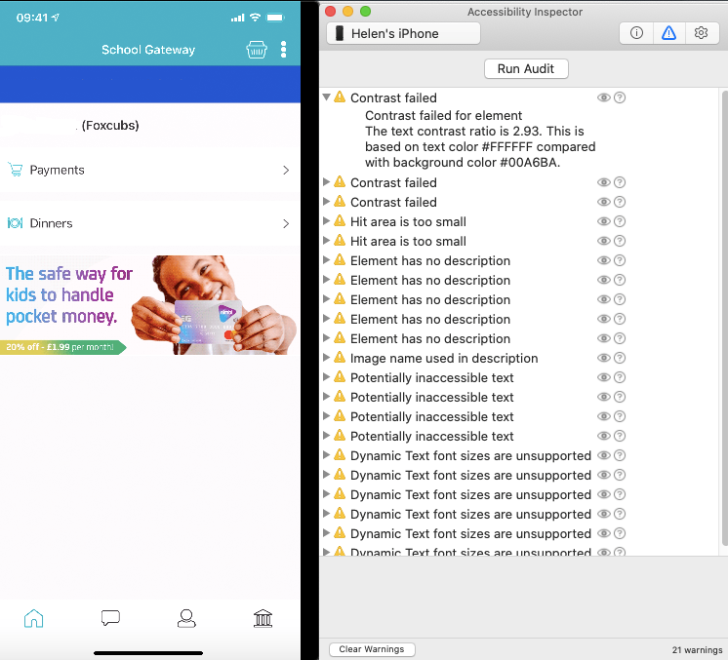
iOS Automated Testing Tools
Xcode > Open Developer Tool > Accessibility Inspector

Slide 39
Automation Results
Android Accessibility Scanner:
Content Labels
Implementation
Contrast Ratio
Touch Target Size
iOS Accessibility Inspector:
Accessible Name
Role verification
Contrast Ratio
Touch Target Size
Notes:
How to read Accessibility Scanner results
Content labelling
Accessibility Scanner looks for the following content labelling opportunities:
Item label missing Identify Views that a screen reader could focus and that have an empty spoken description, either for the View or relevant Views in its sub-hierarchy.
Item labelled with type or state Identify cases where a View has a redundant description.
Duplicate item descriptions Identify cases where a hierarchy contains Views with exactly duplicate descriptions. For example, two separately focusable buttons described as 'More options' could confuse a user.
Link purpose unclear Identify uninformative link text, such as 'click here’.
Implementation
Accessibility Scanner examines View hierarchies and identifies instances where users with motor impairments might have difficulty interacting with a layout.
Clickable links Identify uses of ClickableSpan that aren't UrlSpans.
Duplicate clickable Views Identify clickable Views that share the same on-screen location as other clickable Views.
Editable item label Identify EditTexts and editable TextViews that have a non-empty contentDescription.
Unsupported item type Identify item types that are not supported by accessibility services.
Traversal order Identify possible issues in the traversal ordering of items, which might affect users of screen readers or other accessibility services.
Low contrast
Accessibility Scanner suggests improvements to colour contrast ratios to make your app more accessible to visually impaired users.
Text and image contrast Identify text or images with a contrast ratio lower than 3.0 between the text colour and background colour (for non-empty TextViews) or between the foreground and background colour (for ImageViews). You can change the minimum ratio in your Accessibility Scanner settings.
Touch target size
Accessibility Scanner looks for small touch targets that could cause difficulty for users with motor impairments.
Touch target size Identify clickable and long-clickable Views that are smaller than 48x48dp in either dimension, or 32x32dp for Views within input method windows or against the display edge. You can change the minimum size in your Accessibility Scanner settings.
iOS results are similar to Android but the tests are as follows: Use Accessibility Verifier to perform any or all of the following tests (select the tests you want to run by clicking the Choose Tests button):
Parent/Child. This test checks the integrity of the accessibility hierarchy by making sure each parent-child pair forms a closed loop. For example, if a child listed in a parent object’s accessibilityChildren property does not refer to that object as its parent, this parent-child pair is invalid. Invalid parent-child pairs can prevent an accessibility client from correctly traversing an app’s accessibility hierarchy.
Window. This test checks that all objects contained in a window contain a reference to that window in their accessibilityWindow property. An object contained in a window is not necessarily the child of that window, but it should refer to its containing window as a convenience for accessibility clients.
Missing AXDescription. This test checks the element’s accessibilityLabel property. All accessible elements must provide some context-specific, descriptive label.
Role Verification. This test verifies that an accessibility object implements all the properties and methods required for its role.
When you click Verify, Accessibility Verifier runs the tests you selected and displays the results for each. The problems are reported as warnings or errors, depending on their severity (you can filter the results by selecting a severity level in the Report Level pop-up menu).
Eliminating all errors and warnings that Accessibility Verifier displays does not guarantee a perfectly accessible app. Always test your app with various accessibility clients, such as VoiceOver, to make sure there are no problems.

Slide 40
axe Auditor – Mobile Test Specifics
Can have one test case with multiple test runs
Mobile Web
Native Mobile Android
Native Mobile iOS
Removes HTML specific tests for Native type products
Removes Desktop specific checks for all mobile type test runs
Notes:
axe Auditor removes some WCAG checkpoints not relevant to mobile testing.
All Mobile:
1.4.10 – Reflow
1.4.13 – Content on Hover or Focus
Native Mobile:
Some 1.1.1 checks:
Alternative Text (CSS Images)
Alternative Text (Input Type Images)
Alternative Text (Captcha)
Some 1.3.1 checks:
Semantics
Group Related Form Elements
1.3.5 – Identify Input Purpose
1.4.3 – Color Contrast (large text)
1.4.12 – Text Spacing
2.1.1.b Shortcut Keys is replaced by 2.1.1.c Custom Gestures
2.1.4 – Character Key Shortcuts
Some 2.4.1 checks:
Skip Navigation, Headings or Landmarks
Titles on Frames
2.4.4 – Link Purpose (In Context)
2.4.5 – Multiple Ways
2.4.7 – Focus Visible
3.1 – Readable
4.1.1 – Parsing
Some 4.1.2 checks:
Custom Controls
Compatibility

Slide 41
Questions? Break 1

Slide 42
Design Considerations

Slide 43
Design Considerations
Colour Ratios – 4.5:1 minimum
Is content meaningful and concise?
Is the repeated content consistent?
How are buttons and links formatted on hover or on focus?
How will increasing text size be handled?
Will changing the orientation affect the screen layout?
Images: informative or decorative?

Slide 44
Questions? Break 1

Slide 45
Summary
Mobile Application Types
Assistive Technology for Mobiles
Using Mobile Screen Readers
Testing Considerations
Automated Testing
Design Considerations
Notes:
Here's an outline of what we will cover today.
* We will first look at application types and tips for how you can determine the type if you're not involved in developing the app itself

Slide 46
Useful Resources
Google – New Talkback Gestures
Accessibility Inspector (macOS)
Google Accessibility Scanner (Android)
Google – How to read Accessibility Scanner results
Android Developer – How to use Lint
Orange - How to run iOS automation
GOV UK - Public sector website and mobile application accessibility monitoring

Slide 47
Additional Resources
Additional resources mentioned during the webinar:
React Native Accessibility
W3C Audit Report Template
Virtual, Augmented & Mixed Reality accessibility

Slide 48
Thank you

