Slide 1
Welcome
Live captions during the online event – toggle on/off
Slides, a transcript and recording will be made available
Please use the Q&A window for questions
Please use the chat window for general conversation
Feedback form will be shared after the event

Slide 2
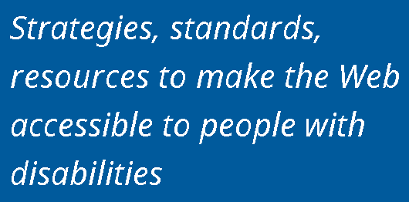
About AbilityNet
Notes:
- We are a technology charity providing a range of free and expert paid for products, services and resources. Our vision is a digital world that is accessible to all.
Products/Services include:
- Digital Accessibility Consultancy, Auditing and Training
- Accessibility Accreditation and Diverse User Testing

Slide 3
Ability Net Online Training Series
Thurs 29 July: Accessibility testing in mobile apps
Thurs 5 August: Accessible mobile development
Thurs 12 August: Accessibility for designers
Thurs 19 August: How to create accessible documents and presentations
Thurs 26 August: Creating accessible graphics and social content
10% off any future AbilityNet online training courses this year with discount code AbilityNetTraining10 abilitynet.org.uk/training

Slide 4
In this session you will…
Learn about how accessibility issues should be reported
Understand the factors that can influence prioritising accessibility issues
Discover how automated accessibility checkers report issues
Review some techniques for embedding accessibility in your organisation
Have an opportunity to ask questions

Slide 5
Poll 1 Have you commissioned or undertaken an accessibility audit on a current product?
Commissioned an audit from third party
Undertaken an audit internally
Not had an audit but have seen an audit report
Not commissioned or undertaken an audit or seen an audit report

Slide 6
Poll 2 If you’ve seen an audit report, what was your experience when reading it?
Easy to understand
Mostly easy to understand
Quite difficult to understand
Very difficult to understand

Slide 7
Understanding accessibility results
Why do we need to understand accessibility results?
Gauge compliance
Plan for accessibility improvements
View of impact & how to fix

Slide 8
Testing approaches
Automatic checkers
Manual checks
Site scanners

Slide 9
Template for reporting results
Recommended template for WCAG accessibility evaluations reports
Expect an accessibility evaluation to contain:
Summary – overview of findings, indication of severity of the issues
Scope of Review – what pages were tested and when; standards used
Review Process – what browsers & A.T. were used in the review
Results and Recommended Actions – reported by WCAG success criteria; additional issues may also be reported
Appendices – additional information about the process, resources, references

Slide 10
Agree approach:
Pages to be tested
Scope of testing
Readiness
Standard or guidelines to use in testing
WCAG 2.0 or 2.1; Level AA or AAA
EN 301 549
Other type of testing e.g. design/prototype review, accessibility review
What platforms, browsers and assistive technology to use in the review
Desktop only or also mobile site or app (additional testing)
Browser / screen reader combination
How it is reported

Slide 11
Measuring priority: impact on users
High – “can’t use”
specific user group(s) are excluded from using part of the site.
Medium – “causing problems”
specific user group(s) will experience significant problems but they are not prevented from using the site.
Low – “annoyance”
something is wrong which may slow some users down.
minor issues can be cumulative and lead to significant usability and accessibility barriers

Slide 12
Measuring priority: number affected
What is the size of the audiences that may experience difficulties due to an issue?
Does the issue affect multiple user groups?
How are the audience of your website specifically affected?

Slide 13
Measuring priority: incidences
Site-wide issue
Re-usable components
Individual page issue
e.g. header, navigation, branding
e.g. video player, in-page navigation
e.g. alt text, form field label

Slide 14
Measuring priority: cost of fix
Complexity of fix for issue
Number of instances to fix
May be no immediate fix possible!
Importance of avoiding retrospective fixes!!!
Considering accessibility earlier in development means fewer instances to fix and more flexibility in fixes available.

Slide 15
Example Audit
Accessible University
Page with known accessibility issues: https://www.washington.edu/accesscomputing/AU/before.html
List of issues:
https://www.washington.edu/accesscomputing/AU/issues.html

Slide 16
Using accessibility checkers
Automated tools can assist with finding some accessibility issues
GDS review: automated tools found up to 40% of issues
Issues can be harder to understand due to:
Multiple issues reporting the same problem e.g. missing alt text
Multiple tests for a single success criteria
Issues that need further, human review

Slide 17
Automated checker - visual
Looking at free, open-source checker Axe-core https://www.deque.com/axe/
Firefox and Chrome extension & Android app
Built into Google Lighthouse & Microsoft Accessibility Insights

Slide 18
Site scanners
Benefits
Potential coverage of entire web estate vs small sample in audits
A way to measure progress of accessibility efforts (up to a point)
Shareable results can help encourage content owners to prioritise accessibility
Potential drawbacks
Same limitations as all automated scans:
limited test coverage
need to sense check results
some results may be hard to interpret
Number of reported issues can seem overwhelming in aggregate
Cost
Potential false sense of security

Slide 19
Accessibility reports to include
What happened - a description of the accessibility problem
The impact on users
Where it happened
Page and location on page
What platform, device, browser or input method are affected
How to replicate the issue
Recommendations to fix it
Basic description
Code examples
Additional resources

Slide 20
Demonstrating conformance
Demonstrating conformance to accessibility principles and standards
WCAG 2.1.1: “All functionality of the content is operable through a keyboard interface without requiring specific timings for individual keystrokes, except where the underlying function requires input that depends on the path of the user's movement and not just the endpoints.”
Pass
Fail
Not applicable

Slide 21
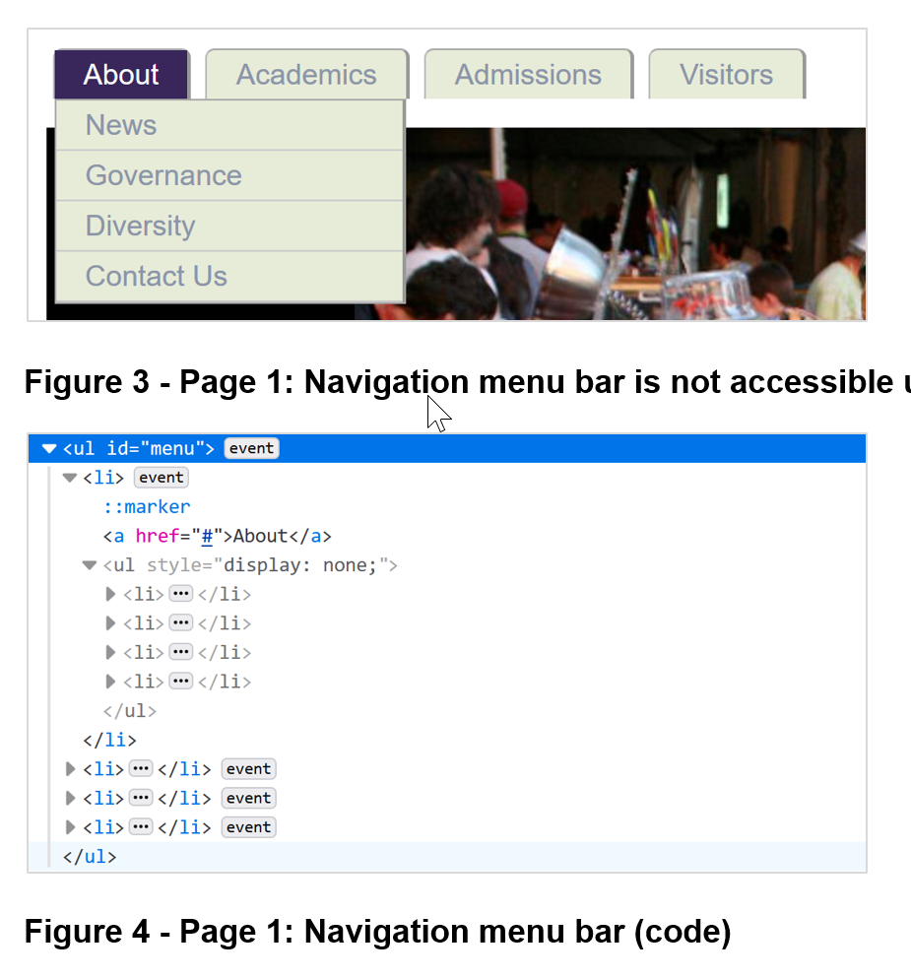
Reported issue: [Ref: 2.1.1] Keyboard
Issue (WCAG-002): Navigation menu bar is not accessible using keyboard [High priority] Pages affected: 1
On the top of the page, there is a dropdown menu. When hovering over each item of the menu bar using a mouse, it expands, showing the respective submenu with the list of pages which can be accessed on click.
Using a keyboard, although the focus indicator of the menu bar items is not visible, they are focusable. However, when receiving focus, it is not possible to activate them using keyboard-only or a screen reader. This issue affects all keyboard users, who cannot access other pages on the website using the navigation menu bar.

Slide 22
Issue (WCAG-002): Recommendation
Ensure the navigation menu bar is accessible to keyboard users. Both the navigation menu bar and submenus must be navigable as expected and correctly announced when using a screen reader.
Example of an accessible navigation menu bar, including full implementation: http://terrillthompson.com/tests/menus/accessible-mega-menu/test.html
Adobe Accessibility - Accessible Mega Menu provides an open source component fully usable with a keyboard and screen readers. See also their blog post.

Slide 23
3.1.1: Language of page
3.1.1: The default human language of each Web page can be programmatically determined.
Issue (WCAG-004) – Language of page is not specified [Medium priority]
Pages affected: All pages
The tested pages do not have an appropriate language setting, as no lang attribute is specified on the HTML tag. Knowing the language of a page enables assistive technology to correctly pronounce content. It is used by screen readers, Braille displays and other text-to-speech programs. Not having a language specified may cause some content to be mispronounced, causing confusion to screen reader users.
Recommendation: add <html lang=“en”> in the header element

Slide 24
Issues found through manual review
Can you spot them?:

Slide 25
3.1.2 Language of Parts (Level AA)
3.1.2: The human language of each passage or phrase in the content can be programmatically determined.
On the landing page, there is a paragraph in Spanish. Although the language of the page is not specified (please refer to issue WCAG-004), screen readers assume the page is in their default language. A screen reader with a default language of English will announce the Spanish text with English pronunciation, which may confuse screen reader users.

Slide 26
3.1.2 (Level AA) Recommendation
Ensure all text not written in the page main language has a lang attribute specified. e.g.
<h2 lang=”es”>Bienvenido!</h2>
<p lang=”es”>
Accessible Universidad (UA) es una Universidad ficticia, (…)
</p>
For a non-exhaustive list of 2 letter language codes, see http://reference.sitepoint.com/html/lang-codes
Notes:
POLL – What priority low, medium or high

Slide 27
1.4.1: Use of Colour (Level A)
1.4.1: Colour is not used as the only visual means of conveying information, indicating an action, prompting a response, or distinguishing a visual element.
Issue (WCAG-001): Links are identified by colour only
The “click here” links under “Can you spot the barriers?” are visually identified by colour only. While the paragraph text is black, these links have a grey tone.
What priority should this be?
This issue is likely to occur at a template / site-wide level as it affects all links.
Notes:
POLL – What priority low, medium or high

Slide 28
Additional issue
Issue (AI-001): Links have no descriptive text
The links under “Can you spot the barriers?” all have the same text, “click here”, which is not descriptive of their purpose. This does not strictly fail WCAG 2.4.4 (Link Purpose in Context) as the links are explained in the context of a surrounding paragraph, but ideally these should have more descriptive text. Additionally, this text describes an action which can only be performed using a mouse.
What priority should this be?
This issue has resulted from how the content has been written
Notes:
POLL – What priority low, medium or high

Slide 29
What makes a good report?
A clear indication of where to locate the issue within the page and code
Support for remediating the issue, aimed at the person responsible for resolving the issue
Assistance with prioritising issues
What does the person getting the report need? What do they want to get out of the process?

Slide 30
What’s next?
Embed accessibility across your organisation…
Top down
Bottom up

Slide 31
Embed a “Design for All” approach
Accessibility Outcomes:
Extend range of users who can access, understand & use.
Improved accessibility
Design for all approach considering:
Range of human abilities, needs & characteristics
Environmental factors & context of use
Leadership, commitment, policies & objectives
Monitoring, measuring & evaluating success
Planning for widest range of users
Digital Platforms & Services
Operations, service design & procurement
Objectives
Based on EN 17161 Design for All standard

Slide 32
Bottom up
The groundwork for accessibility success:
Develop accessibility champions to lead peer-to-peer training
Use the expertise you already have to understand & prioritise issues
Existing disabled users
Staff/internal disability groups
Formal user research
Ensure accessibility business cases & inclusive personas are available for anyone
{
Diverse user testing

Slide 33
Questions?

Slide 34
Resources
Tools:
Axe overview: https://www.deque.com/axe/
WAVE – links to the extensions are on the WAVE Webaim extension page.
Headings Map – extension for Chrome or Firefox
Text resize (Chrome) – A+ Font Size Changer Lite
Paciello Group Colour Contrast Analyser
Paul Adams accessibility bookmarklets
ANDI accessibility bookmarklet
Microsoft Accessibility Insights (includes axe)

Slide 35
Resources (2)
Useful links:
W3C: Template for Accessibility Evaluation Reports
W3C: The Business Case for Digital Accessibility
AbilityNet: How to build accessibility into your organisation – BBC Accessibility Champions
European Committee for Standardization: Design for All Standard
Government Digital Service: Using persona profiles to test accessibility

