Slide 1
Accessibility: The right choice - Inclusion, universal design and accessibility in online public services
Welcome! We will begin shortly…
Housekeeping
Attendee microphones and cameras are disabled
Closed captioning is provided
Please type your questions into the on-screen Q&A text box
Time will be put aside towards the end of this session to answer your questions
We would appreciate if you could complete a short survey after the event
A recording of this seminar will become available in the member resources section of ics.ie over the coming days
ICS - The voice of IT Professionals in Ireland – www.ics.ie​

Slide 2
Web Accessibility Directive Training Series
The Irish Computer Society (ICS), in partnership with the National Disability Authority (NDA), is holding a series of 2 information seminars and 2 up training webinars on EU Web Accessibility Directive.
Each information seminar is lead by experts in the field of accessibility and is followed by a more in-depth training webinar provided by AbilityNet on the same topic.
Further information and registration can be found on ics.ie/events
Become a member of ICS at ics.ie/member
ICS - The voice of IT Professionals in Ireland – www.ics.ie​

Slide 3
Accessibility: The right choice Inclusion, universal design and accessibility in online public services

Slide 4
Dónal Rice
Senior Standards and Monitoring Officer
djrice@nda.ie
@_donalrice
086 8567357
www.universaldesign.ie

Slide 5
Agenda ICS/NDA Web Accessibility Series The EU Web Accessibility Directive First Monitoring Report – 2021 Keynote: Gerry Ellis Questions and answers

Slide 6
Speakers - Dónal Rice, Centre for Excellence in Universal Design, NDA - Ben Adamson, Centre for Excellence in Universal Design, NDA - Gerry Ellis, Feel The BenefIT

Slide 7
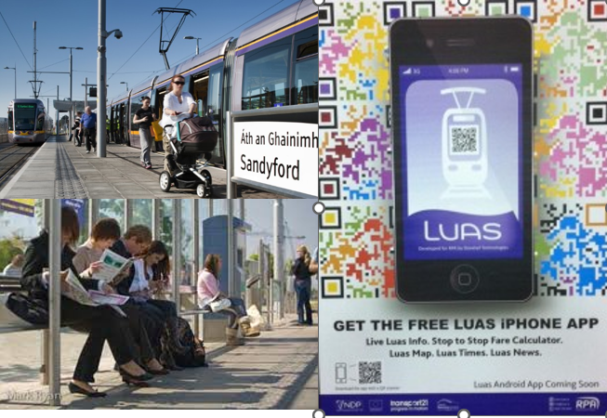
Centre for Excellence in Universal Design
Statutory body, part of NDA
Areas of work:
Standards
Awareness
Education and CPD
Monitoring
Built environment
Products & Services
ICT

Slide 8
ICS NDA Web Accessibility Directive Training Series
28 April: Information Seminar – Accessibility: The right choice - Inclusion, universal design and accessibility in online public services
12 May: Training Webinar - How to Create Accessible Documents and Presentations
26 May: Training Webinar - Accessibility Testing in Mobile Apps
2 June: Information Seminar – Organisational factors to improve accessibility
To register, please visit the ICS website.

Slide 9
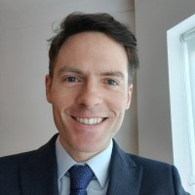
Ben Adamson
Standards and Monitoring Officer
btadamson@nda.ie
www.universaldesign.ie

Slide 10
EU Web Accessibility Directive
Directive (EU) 2016/2102 of the European Parliament and of the Council of 26 October 2016 on the accessibility of the websites and mobile applications of public sector bodies
Transposed into Irish Law on 23 September 2020, under S.I. No. 358/2020 - European Union (Accessibility of Websites and Mobile Applications of Public Sector Bodies) Regulations 2020
Sets a standard for public sector websites
Introduces monitoring of compliance
See overview on the NDA website

Slide 11
Web Accessibility Directive – What public bodies must do
Ensure all their websites and mobile apps comply with AA WCAG 2.1
Provide and maintain a detailed accessibility statement
Include a feedback mechanism and info on asking for support or making a complaint

Slide 12
The Accessibility Statement must contain
Compliance status
State if the website fully/partially/non-compliant
Must be based on a review
Non-accessible content
List non-accessible parts. State why (e.g. exempt under legislation, disproportionate burden - assessment)
Preparation of this accessibility statement
Method used e.g independent audit
Feedback and contact information
Notify public body of issues
Name person in charge of dealing with requests
Enforcement procedure
Equal Status Act 2000 (No. 8 of 2000) and the Disability Act 2005 (No. 14 of 2005) to the extent to which they apply to the body concerned.
Writing an Accessibility Statement (Article on universaldesign.ie)

Slide 13
Scope of content covered
What’s covered
What’s exempt
Office file formats e.g Word, PDF
Navigation
Content
Images
Videos
Embedded content
Forms
Search
Extranets/intranets
Archived content
Some office file formats and videos
Live media and maps
Items in heritage collections
3rd party content not under control of a public body
Extranets / intranets developed before 23 September 2019
Website & mobile apps
Covers ALL content – not just HTML pages
Internal intranet systems used by employees etc

Slide 14
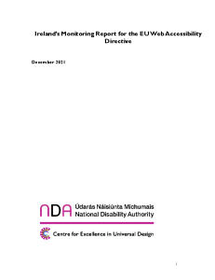
Monitoring and Reporting
Monitoring
Reporting
NDA national monitoring body
Conducted annually
Simplified Reviews
2021: 50 conducted
2022: 350 to be conducted
In-depth Reviews
2021: 5 conducted
2022: 35 to be conducted
Mobile app Reviews
2021: 4 conducted
2022: 13 to be conducted
First Monitoring Report EU WAD Ireland 2021

Slide 15
Findings - Simplified reviews by the numbers
 | Total pages | Total issues | Pages with issues | Pages with critical issues
50 sites | 40,373 | 517,348 | 31,880 | 19,241

Slide 16
Findings – In-depth reviews
Every site has considered accessibility - no website is fully compliant
Many issues are easy to fix – and occur on many pages
Accessibility Statements – inconsistent approach
In-depth reviews
Confusing/inconsistent navigation
Poorly designed forms, form feedback, widgets (cookie banners)
Poor description of images/graphs
PDFs
Mobile Apps
Newer apps have less issues

Slide 17
“Accessibility is not a specialism.
It’s a mindful way of working."
Alistair McNaught

Slide 18
Gerry Ellis
Feel the BenefIT
gerry.ellis@feelthebenefit.com

Slide 19
Populations
ROD Group (formerly 5th Quadrant Analytics)
1.3 Billion persons in the world experience disability
European Disability Forum
Over 100 Million persons with Disabilities in Europe
2016 Irish Census
640,000 persons with Disabilities in Ireland
ESRI
11.5% of working age population have disabilities

Slide 20
Spending Power
2.2 Billion including Friends and Families
ROD Group (formerly 5th Quadrant Analytics)
1.3 Billion persons in the world experience disability
Control $8 Trillion
Disposable Income Annually

Slide 21
Legislation and Standards
UN Convention on the Rights of Persons with Disabilities
European Disability Act
Digital Services Act
Web Accessibility Directive
CEN/Cenelec EN 301549
6 European standards to be reviewed, 2 new standards
Harmonised Standards support adherence to Directives

Slide 22
ESRI Report on Disability
"Identification Of Skills Gaps Among Persons With Disabilities And Their Employment Prospects"
Published September 2021
According to the Census, only a third of the working age people (16-64 years) with disabilities indicated that their main economic status in 2016 was employment. This compares with two-thirds of those without disabilities.
People with disabilities are around 3 times more likely to experience consistent poverty than people without
Education Gap
Employment Gap
Poverty Gap

Slide 23
DPI Group
Strong evidence supports the business case for employing people with disabilities. And that’s outside the traditional corporate social responsibility argument
87% of consumers agree or strongly agree that they prefer to give their business to companies that employ people with disabilities
Companies that have started to employ people with disabilities show that these hiring decisions positively impact the bottom line in the form of reduced costs, increased productivity, and reduced employee turnover.
Washington Mutual (now JP Morgan Chase Bank) found an 8% turnover rate among employees with disabilities, as compared to 45% in the general population.

Slide 24
Accenture
Getting to Equal: the Disability Inclusion Advantage Report
Published in December, 2018
59 percent) of accommodations cost absolutely nothing to make, while the rest typically cost only $500 per employee with a disability. (JAN Survey)
Work environments that are more inclusive of persons with disabilities often see improved productivity.
A Nielsen study in 2016 found that persons with disabilities tend to be more brand loyal and also make more shopping trips and spend more per trip than the average consumer.
Workers are consumers, too. The GDP could get a boost up to $25 billion if just 1 percent more of persons with disabilities joined the U.S. labor force.

Slide 25
What is a MOOC?
MOOC = Massive Open Online Course
Form of Distance Education
Free to unlimited number of participants
Uses web-based information and social media
Promotes interaction between presenters and participants

Slide 26
Who gains - Individual
Accessible web sites and online tools improve access to education, employment and society in general
Access to education is the best route to employment
Access to employment is the best route out of poverty
Ability to Retain employment and advance in employment if disabled during the working life
Improved self esteem and disposable income leading to contributions to family, friends and society

Slide 27
Who gains - Organisation
Reduced costs
Improved Productivity
Reduced staff turnover
Benefits of providing accommodations greatly outweigh the costs
Increase the number of potential customers
Protects company from legal challenges
Using standard processes eases employee recruitment and rotation as opposed to using non-standard ones

Slide 28
Who gains - Society
High unemployment means high social welfare costs and other supports
High employment means higher tax received and less social welfare and other costs
Higher disposable income amongst people with disabilities increases society's overall wealth
Contributions to pension protects society from costs as the person with a disability grows older
Increased standardised products, services and, particularly, new technology facilitates widespread sharing of staff skills and technical knowledge including across borders

Slide 29
Resources - Gerry Ellis
UN Convention on the rights of Persons with Disabilities
Universal Design
Web Content Accessibility Guidelines (WCAG)
Reports that demonstrate economic as well as social benefits
ROD Group (formerly 5th Quadrant Analytics)
European Disability Forum
ESRI report “Identification Of Skills Gaps Among Persons With Disabilities And Their Employment Prospects”
DPI Group
Accenture
JAN survey on Cost and Benefits of Workplace Accommodations
ESRI report “Identification Of Skills Gaps Among Persons With Disabilities And Their Employment Prospects”

Slide 30
Resources (continued)
Standards and Harmonisation
MOOCAP MOOC
Virginia Tech MOOC and Other Resource

Slide 31
Questions?

Slide 32
ICS NDA Web Accessibility Directive Training Series
28 April: Information Seminar – Accessibility: The right choice - Inclusion, universal design and accessibility in online public services
12 May: Training Webinar - How to Create Accessible Documents and Presentations
26 May: Training Webinar - Accessibility Testing in Mobile Apps
2 June: Information Seminar – Organisational factors to improve accessibility
To register, please visit the ICS website.

Slide 33
NDA Resources
EU Web Accessibility Directive
Writing an Accessibility Statement
Guidance and resources (including ICS/NDA training series)
Web Accessibility Techniques
Developers
Designers
Content providers
webaccessmonitor@nda.ie

Slide 34
Thank you
Dónal Rice
Senior Standards and Monitoring Officer
djrice@nda.ie
@_donalrice
086 8567357
www.universaldesign.ie

