Slide 1

EU Web Accessibility Directive – Creating accessible digital content
Housekeeping
Attendee microphones and cameras are disabled
Closed captioning is provided
Please type your questions into the on-screen Q&A text box
Time will be put aside towards the end of this session to answer your questions
We would appreciate if you could complete a short survey after the event
A recording of this seminar will become available in the member resources section of ics.ie over the coming days
Welcome! We will begin shortly…
Housekeeping
Attendee microphones and cameras are disabled
Closed captioning is provided
Please type your questions into the on-screen Q&A text box
Time will be put aside towards the end of this session to answer your questions
We would appreciate if you could complete a short survey after the event
A recording of this seminar will become available in the member resources section of ics.ie over the coming days
ICS - The voice of IT Professionals in Ireland – www.ics.ie​

Slide 2
Web Accessibility Directive Training Series
The Irish Computer Society (ICS), in partnership with the National Disability Authority (NDA), is holding a series of 3 information seminars and 3 follow up training webinars on EU Web Accessibility Directive.
Each information seminar is lead by experts in the field of accessibility and is then followed by a more in-depth training webinar provided by AbilityNet on the same topic.
Today’s seminar will give you an overview of the Directive, the obligations it places on public bodies and the standards public websites and mobile apps must comply with and the monitoring function of the National Disability Authority. Speakers will include Donal Rice from the NDA, Carine Marzin from the European Disability Forum (EDF) and Daniel Montalvo from World Wide Web Consortium (W3C).
Further information and registration can be found on ics.ie/events
Become a member of ICS at ics.ie/member
The Irish Computer Society (ICS), in partnership with the National Disability Authority (NDA), is holding a series of 3 information seminars and 3 follow up training webinars on EU Web Accessibility Directive.
Each information seminar is lead by experts in the field of accessibility and is then followed by a more in-depth training webinar provided by AbilityNet on the same topic.
Further information and registration can be found on ics.ie/events
Become a member of ICS at ics.ie/member
ICS - The voice of IT Professionals in Ireland – www.ics.ie​

Slide 3
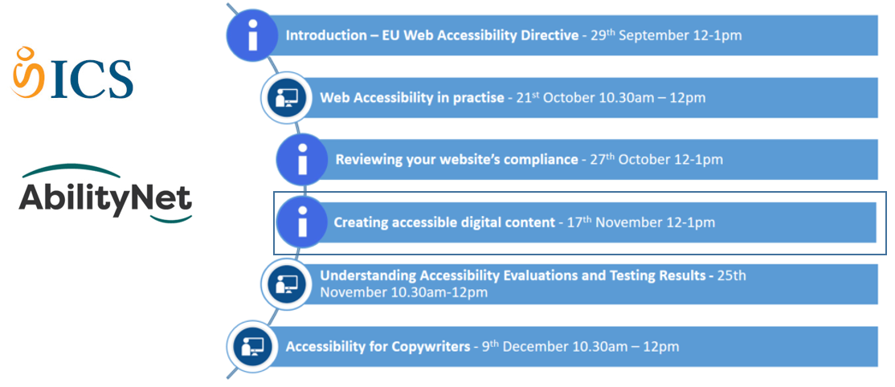
ICS NDA Web Accessibility Directive Training Series

Slide 4


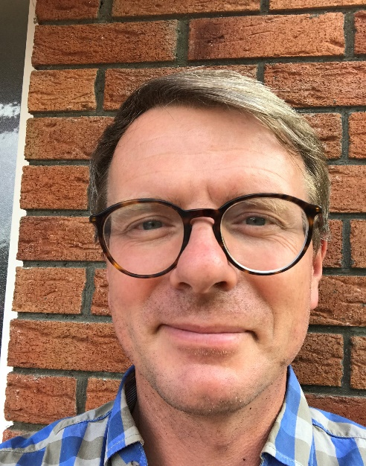





Creating accessible digital content
Dónal Rice
Senior Standards and Monitoring Officer
djrice@nda.ie
@_donalrice
086 8567357
www.universaldesign.ie

Slide 5
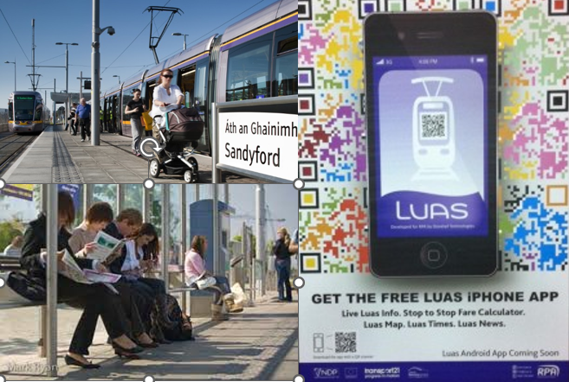
Centre for Excellence in Universal Design
Statutory body, part of NDA
Areas of work:
Standards
Awareness
Education and CPD
Monitoring
Built environment
Products & Services
ICT

Slide 6


Speakers
Dónal Rice, Centre for Excellence in Universal
Design , NDA
Jacinta Byrne, Centre for Excellence in Universal
Design , NDA
Kyran O’Mahoney, NCBI
Sean Doran, NCBI

Slide 7
EU Web Accessibility Directive
“Directive (EU) 2016/2102 of the European Parliament and of the Council of 26 October 2016 on the accessibility of the websites and mobile applications of public sector bodies
Transposed into Irish Law on 23 September 2020, under S.I. No. 358/2020 - European Union (Accessibility of Websites and Mobile Applications of Public Sector Bodies) Regulations 2020
Sets a standard for public sector websites
Introduces monitoring of compliance
See overview on the NDA website

Slide 8



Web Accessibility Directive – What public bodies must do
Ensure all their websites and mobile apps comply with AA WCAG 2.1
Provide and maintain a detailed accessibility statement
Include a feedback mechanism and info on asking for support or making a complaint

Slide 9

The Accessibility Statement must contain:
Compliance status
  State if the website fully/partially/non-compliant
  Most be based on a review
Non-accessible content
  List non-accessible parts. State why (e.g. exempt under legislation, disproportionate burden - assessment)
Preparation of this accessibility statement
  Method used e.g independent audit
Feedback and contact information
  Notify public body of issues
  Name person in charge of dealing with requests
Enforcement procedure
  Equal Status Act 2000 (No. 8 of 2000) and the Disability Act 2005 (No. 14 of 2005) to the extent to which they apply to the body concerned.
Writing an Accessibility Statement

Slide 10




Monitoring
Monitoring
Reporting
NDA national monitoring body
Conducted annually
Register of websites
When: October/November 2021
Numbers to increase by 400% in 2022
Report to European Commission by 23 December 2021
Evaluation results, methodology used,
Support capacity building and competence in public sector and web design community
Notes:
Office file formats published before 23 Sept 2018– unless of particular relevance
Videos before 23 September 2018
Live media
Maps – alternative for navigational maps
Reproductions of items in heritage collections
3rd party content not under control of a public body
Extranets / intranets developed before 23 September 2019

Slide 11



Monitoring underway - EU Web Accessibility Directive
50 Simplified
5 In-depth
2 mobile
webaccessmonitor@nda.ie

Slide 12


Scope of content covered
What’s covered
What’s exempt
Office file formats e.g Word, PDF
Navigation
Content
Images
Videos
Embedded content
Forms
Search
Extranets/intranets
Archived content
Some office file formats and videos
Live media and maps
Items in heritage collections
3rd party content not under control of a public body
Extranets / intranets developed before 23 September 2019
Website & mobile apps
Covers ALL content – not just HTML pages
Internal intranet systems used by employees etc
Notes:
Office file formats published before 23 Sept 2018– unless of particular relevance
Videos before 23 September 2018
Live media
Maps – alternative for navigational maps
Reproductions of items in heritage collections
3rd party content not under control of a public body
Extranets / intranets developed before 23 September 2019

Slide 13

Accessibility is not a specialism
It’s a mindful way of working
Alistair McNaught

Slide 14
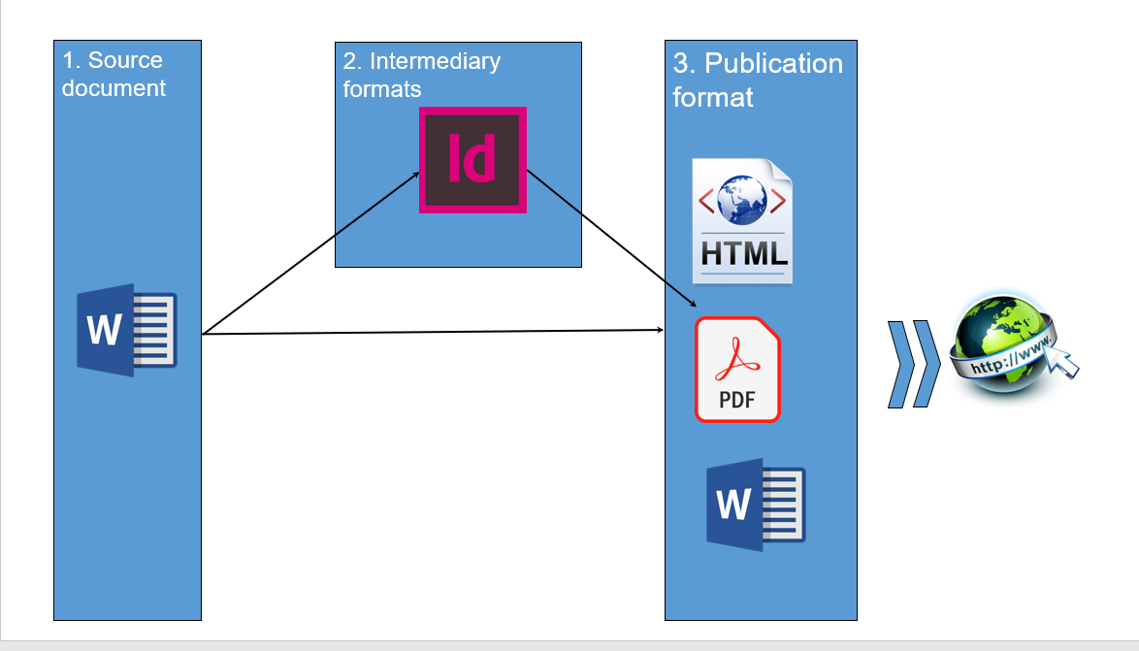
Steps

Slide 15
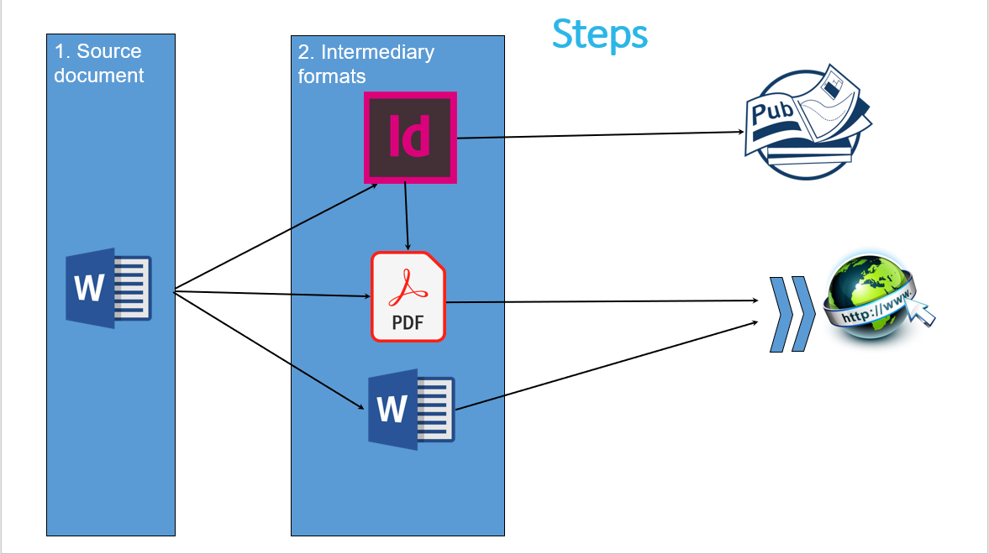
Steps

Slide 16
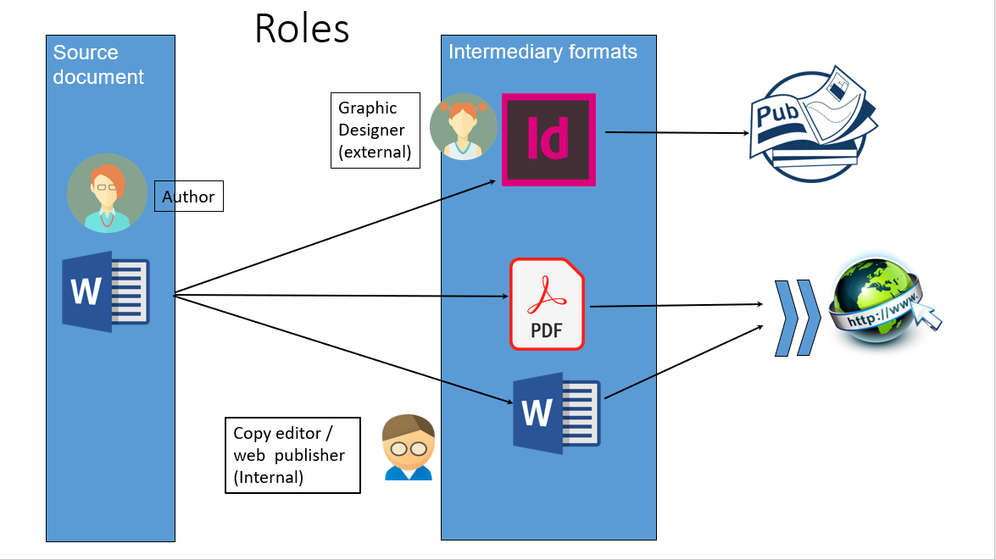
Roles

Slide 17
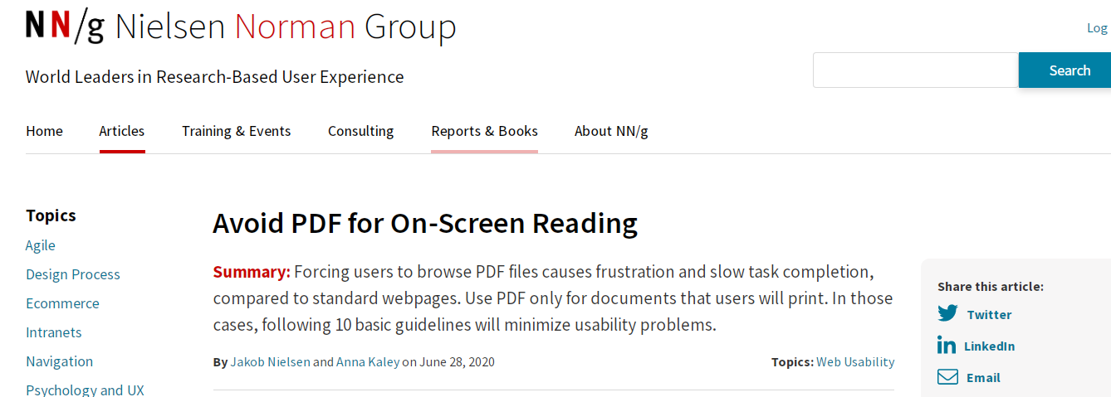
WCAG 2.1 - AA
Avoid PDF for On-Screen Reading

Slide 18
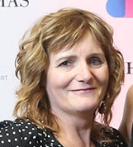
Creating accessible digital content – what I have learned
Jacinta Byrne
jgbyrne@nda.ie
www.universaldesign.ie

Slide 19
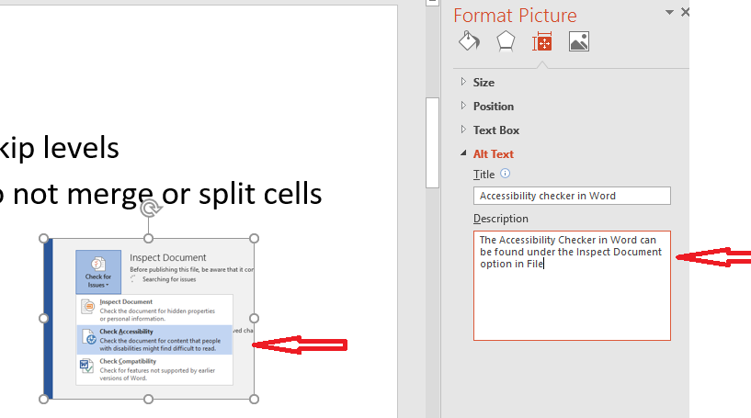
Main steps in creating accessible documents - Word and Powerpoint
Use the formatting toolbar!
Headings
Tables
Images – alternative text
The Accessibility checker
Notes:
Some errors that constantly crop up. This is what you need to watch out for. Do not assume that authors are familiar with the formatting ribbon in Word. Authors may know just enough in Word to do what they have to do. It is important to use the buttons on the formatting toolbar. Some examples – do not manually enter numbers for a numbered list and do not use bold and increased font size for headings. Tables – do not use for formatting text and one header row, no merged split cells. Heading hierarchy – do not skip levels
Images – alternative text – images are not just pictures, images are also charts, diagrams and infographics. If you present text or information in the graphic, you must include it in the accompanying text or in the alt text. Be careful if using Word Art or shapes. Remember images in PPT also need alt text! PPT slides with graphics - consider saving as one image with alt text
Image in slide showing location of accessibility checker and has alt text
Use the Accessibility checkers in Word and PPT under File
In NDA we have an in house Style Guide and a Word Template. Very useful. We also have an NDA Word Toolbar which gives shortcuts to all the main accessibility features.

Slide 20
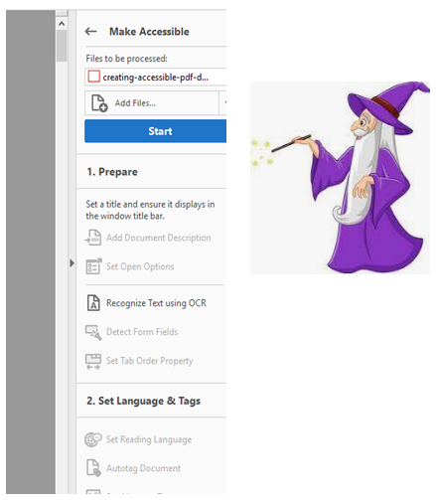
Main steps in creating accessible documents - PDFs
Source document – Word?
Converting to PDF
Use the Action Wizard!
Run the Accessibility checker
Notes:
Source document – if in Word easier to fix issues in the source document than in a PDF. Just because one version of your document is accessible does not mean when converted to another format that it will still be accessible!
Converting to PDF – do not use the Print to option or scan to PDF option. Use the Save As Adobe PDF. More work to be done – use the Make Accessible Action Wizard. Set the title, the reading language etc. if not intended to be an editable form – skip. Then run the accessibility checker. PDFS are portable, emailable and useful for printing but for accessibility PDFs are tricky, even with a fully accessible source document, issues can crop up in the PDF – need advanced level of training in Adobe. We aren’t print design experts. The other option is to provide the content in html pages – useful to have source Word doc for this. An example in this slide of multiple images saved as one with one alt text.

Slide 21
Working with external bodies.
Contractors will need help and guidance. Check document accessibility at early stage!
Ensure that the publisher/graphic designer will provide you with a fully accessible end document. Check document accessibility at early stage!
Notes:
Ensure you have a final in house version of the source word doc! If text is changed when proofing drafts ensure it is changed in the source doc.
External contractors – they will need guidance. Not really knowing what NDA means when we ask for an accessible document. Check accessibility at first draft level, not at the final doc when up against the deadline. A version of the Style Guide for external contractors would be useful.
You have a fully accessible document which goes to the external publisher or graphic designer and often they will tell you that they know about accessibility but they don’t. You need to ensure they know what standards they have to comply with. You will need to check the accessibility of the document at an early stage - first draft so you can go back to them and there is time to fix any issues. Really important to have the in-house knowledge to do this.
May need to plan to have someone in house who can do this. Do not leave the checking until the final draft!

Slide 22
Resources
Customer Communications Toolkit for the Public Service – a Universal Design Approach
Guidance on Written, Spoken & Signed and Digital Communication. Contains checklists, tips and links to learn more
Web accessibility techniques – Content Providers
Techniques designed to help you present digital content in a way that allows users to access, understand and use it.
Guidance and resources – Specific topics in digital accessibility
Links to guidance on creating accessible Word, Powerpoint and PDFs
Notes:
s

Slide 23
Creating Accessible Documents
Kyran O’Mahoney (CTO)
Sean Doran
NCBI.ie

Slide 24
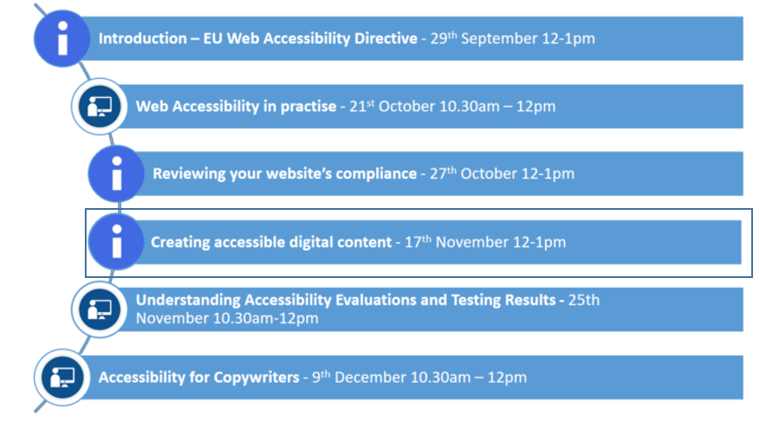

ICS NDA Web Accessibility Directive Training Series

Slide 25

One last thing…
We’re hiring!
2 posts
  HEO
  EO
  Full-time permanent
Closing date is 11am on Monday 22nd November!
More details available on the NDA website

Slide 26

Thank you
Dónal Rice
Senior Standards and Monitoring Officer
djrice@nda.ie
@_donalrice
086 8567357
www.universaldesign.ie

