Slide 1
EU Web Accessibility Directive- Reviewing your website’s Compliance
Housekeeping
Attendee microphones and cameras are disabled
Closed captioning is provided
Please type your questions into the on-screen Q&A text box
Time will be put aside towards the end of this session to answer your questions
We would appreciate if you could complete a short survey after the event
A recording of this seminar will become available in the member resources section of ics.ie over the coming days
Welcome! We will begin shortly…
Housekeeping
Attendee microphones and cameras are disabled
Closed captioning is provided
Please type your questions into the on-screen Q&A text box
Time will be put aside towards the end of this session to answer your questions
We would appreciate if you could complete a short survey after the event
A recording of this seminar will become available in the member resources section of ics.ie over the coming days
ICS - The voice of IT Professionals in Ireland – www.ics.ie​

Slide 2
Web Accessibility Directive Training Series
The Irish Computer Society (ICS), in partnership with the National Disability Authority (NDA), is holding a series of 3 information seminars and 3 follow up training webinars on EU Web Accessibility Directive.
Each information seminar is lead by experts in the field of accessibility and is then followed by a more in-depth training webinar provided by AbilityNet on the same topic.
Today’s seminar will give you an overview of the Directive, the obligations it places on public bodies and the standards public websites and mobile apps must comply with and the monitoring function of the National Disability Authority. Speakers will include Donal Rice from the NDA, Carine Marzin from the European Disability Forum (EDF) and Daniel Montalvo from World Wide Web Consortium (W3C).
Further information and registration can be found on ics.ie/events
Become a member of ICS at ics.ie/member
The Irish Computer Society (ICS), in partnership with the National Disability Authority (NDA), is holding a series of 3 information seminars and 3 follow up training webinars on EU Web Accessibility Directive.
Each information seminar is lead by experts in the field of accessibility and is then followed by a more in-depth training webinar provided by AbilityNet on the same topic.
Further information and registration can be found on ics.ie/events
Become a member of ICS at ics.ie/member
ICS - The voice of IT Professionals in Ireland – www.ics.ie​

Slide 3
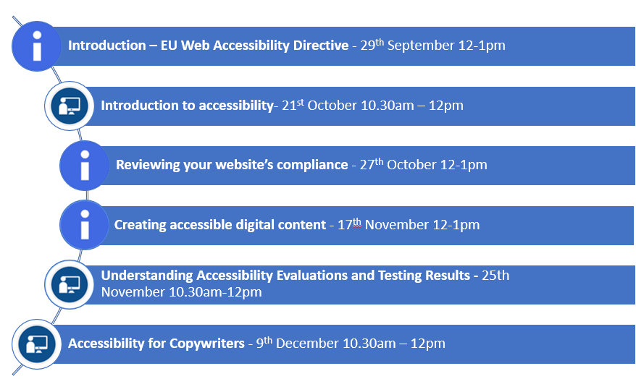
ICS NDA Web Accessibility Directive Training Series

Slide 4
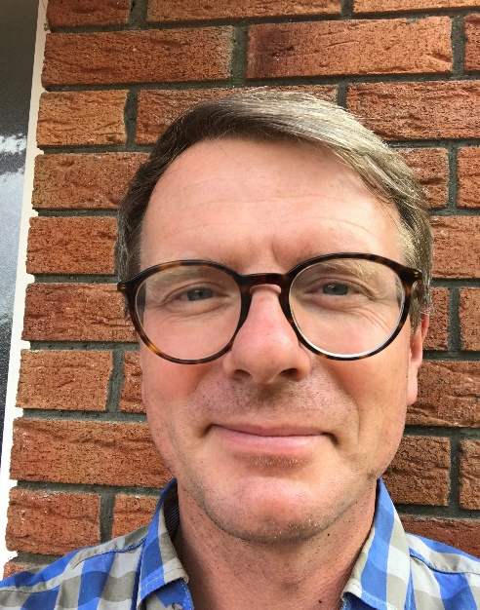
Reviewing your website’s compliance
Dónal Rice
Senior Standards and Monitoring Officer
djrice@nda.ie
@_donalrice
086 8567357
www.universaldesign.ie

Slide 5
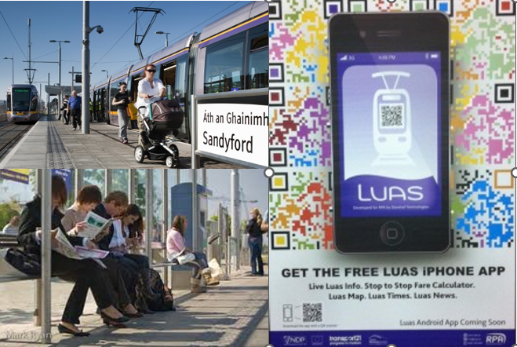
Centre for Excellence in Universal Design
Statutory body, part of NDA
Areas of work:
Standards
Awareness
Education and CPD
Monitoring
Built environment
Products & Services
ICT

Slide 6
Speakers
Dónal Rice, Centre for Excellence in Universal
Design , NDA
Dr Donal Fitzpatrick, Centre for Excellence in Universal
Design , NDA
Pat Cullen, InterAccess

Slide 7
Accessibility is not a specialism It's a mindful way of working
Alistair McNaught

Slide 8
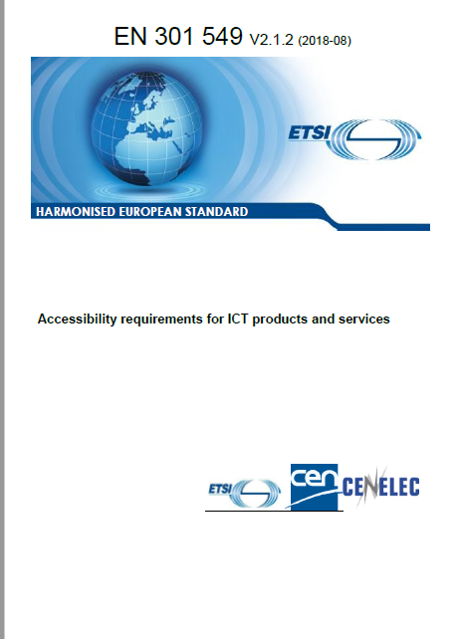
Recap of first information seminar of the EU Web Accessibility Directive
An EU Directive in support of both human rights and single market objectives
Requires the use of internationally accepted web accessibility standards: WCAG 2.1, EN 301 549
Transposed into Irish Law: European Union (Accessibility of Websites and Mobile Applications of Public Sector Bodies) Regulations 2020

Slide 9
Web Accessibility Directive – What public bodies must do
Ensure all their websites and mobile apps comply with AA WCAG 2.1
Provide and maintain a detailed accessibility statement
Include a feedback mechanism and info on asking for support or making a complaint

Slide 10
Core Aspects
“Essential requirements” - what must be done
defined in Article 4 of the Directive
Perceivable, operable, understandable, robust
“Presumption of conformity” - prove it!
EN 301 549 “Accessibility requirements for ICT products and services” – harmonised standard – referenced in the OJEU
“Implementing Decisions” set out details for accessibility statement, and monitoring scope and methodology

Slide 11
Update on monitoring
Register of websites for review finalised
50 simplified
5 in-depth
2 mobile apps
webaccessmonitor@nda.ie

Slide 12
WCAG 2.1 – AA
Perceivable, operable, understandable, robust
“I need to Perceive the content, then I need to Understand it. Once
I’ve Understood it, I need to Operate it, using a device of my choice,
in a Robust way that won’t break it. ”
Anne-Marie McCullagh -Houghton Mifflin Harcourt

Slide 13
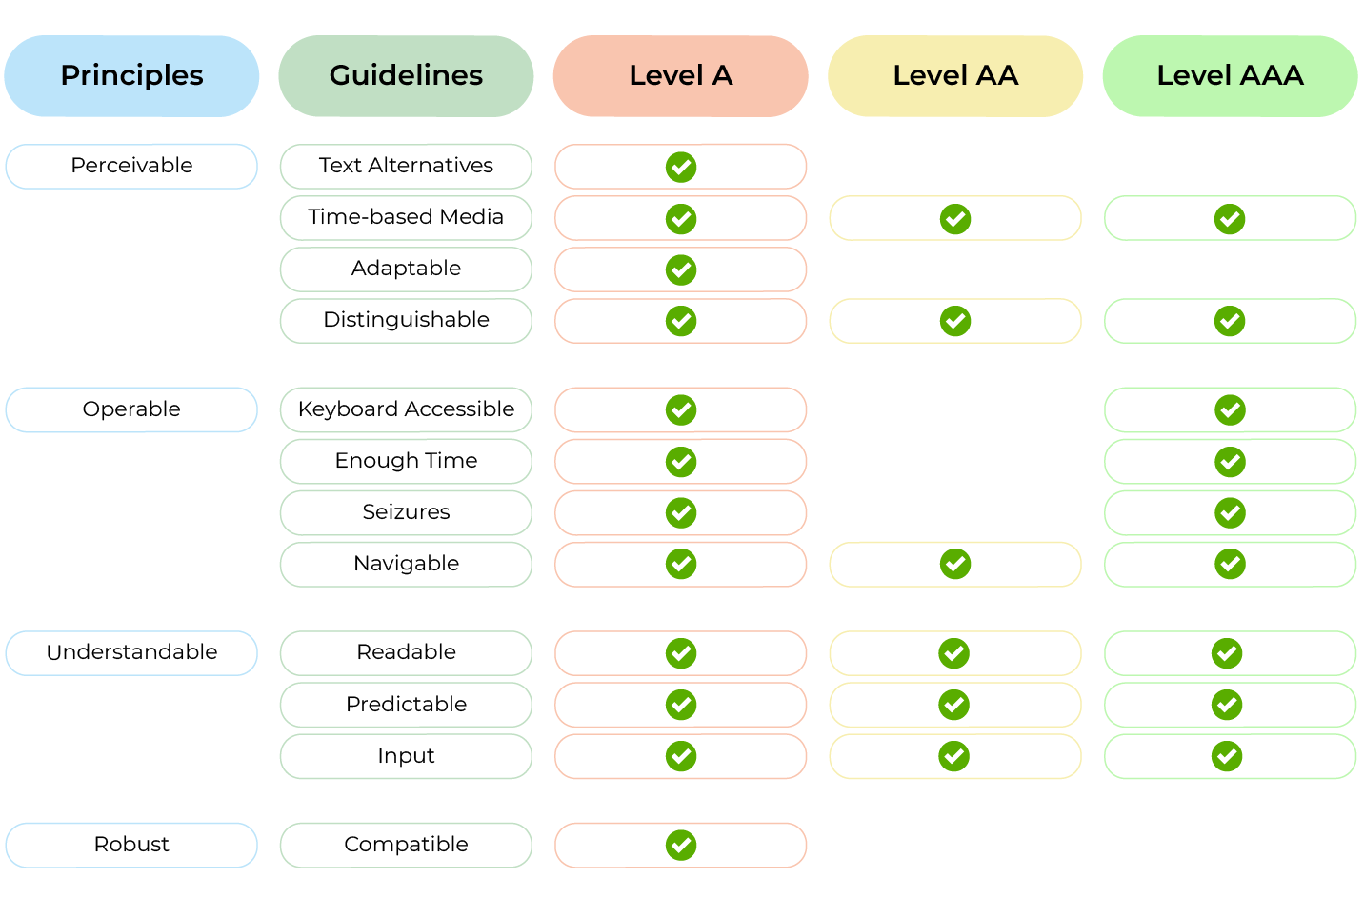
Structure of WCAG 2.1

Slide 14
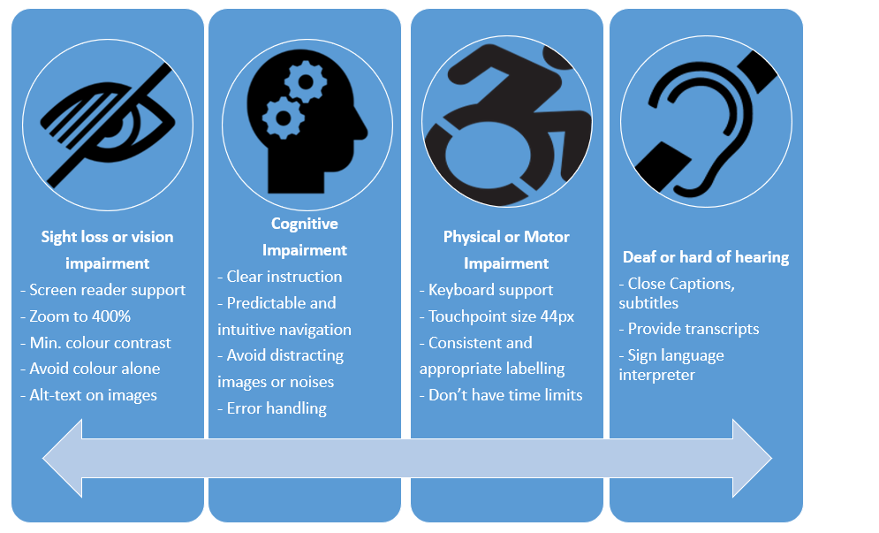
Accessibility Guidelines

Slide 15
The Accessibility Statement must contain:
Compliance status
State if the website fully/partially/non-compliant
Most be based on a review
Non-accessible content
List non-accessible parts. State why (e.g. exempt under legislation, disproportionate burden - assessment)
Preparation of this accessibility statement
Method used e.g independent audit
Feedback and contact information
Notify public body of issues
Name person in charge of dealing with requests
Enforcement procedure
Equal Status Act 2000 (No. 8 of 2000) and the Disability Act 2005 (No. 14 of 2005) to the extent to which they apply to the body concerned.
Writing an Accessibility Statement

Slide 16
Conducting your own review
How to know if your website is compliant
We’ve received no complaints ××
My contractor told me ✓
I used an automated tool ✓
I conducted a review ✓✓
I commissioned a detailed audit ✓✓✓

Slide 17
Tools
Automated checkers:
WAVE from Webaim
Catches about 35% of issues
HTML parsing errors, heading structure, colour contrast, lack of labels on forms etc
Colour checkers
Colour Contrast Analyser
Screen reader
E.g JAWS, VoiceOver, NVDA
Office file formats: checker in Word, Adobe Acrobat Pro

Slide 18
What to test
Select a sample of pages:
Homepage, main template pages, contact us, accessibility statement, search results, forms, all steps in a process, pages with PDFs, videos, carousels, add-on such as twitter feeds
Before you test:
For newbies, choose a test plan, e.g. Webaim: Quick Reference Testing Web Content for Accessibility
Define a texting matrix
E.g NVDA on Chrome in Windows 10, VoiceOver in Safari on iOS

Slide 19
How to test – today!
Run an automated checker – try understand the results
Look out for key elements:
Heading list structure, images, contrast, forms, links and buttons, etc
Use a keyboard to see can you access all content and perform all tasks
Don’t forget the cookie banner!
Try using a screen reader e.g. NVDA. (don’t be afraid!)

Slide 20
Resources
WAVE Chrome plugin
Webaim Screen Reader Survey
NVDA screen reader
Colour Contrast Checker
Using NVDA to test for web accessibility
Web Accessibility Techniques

Slide 21
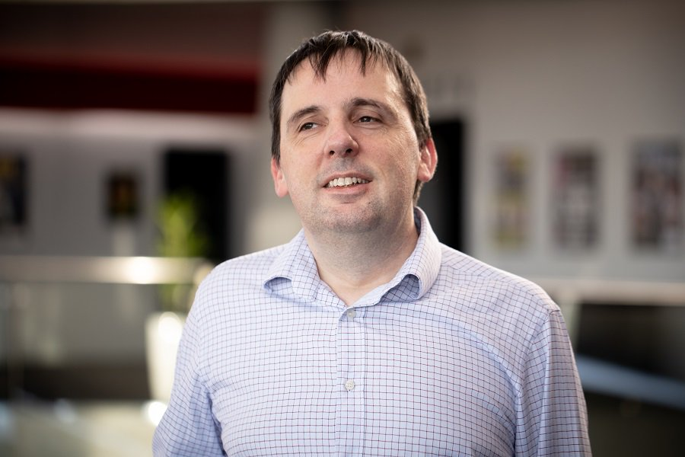
Reviewing your website’s compliance
Dr Donal Fitzpatrick
Senior Design Advisor, ICT
djfitzpatrick@nda.ie
www.universaldesign.ie

Slide 22
Reviewing your website’s compliance
Pat Cullen
Senior Accessibility Consultant
InterAccess
pat@interaccess.ie
www.interaccess.ie

Slide 23
What do we do about the audit?
If the skills are not currently available in-house, you can have the audit performed for you by an external company
External expertise can be used to train the teams involved
An audit will find the issues, detail them, and suggest how to fix them
Do not expect to be fully compliant, especially after the first audit
Keep stakeholders informed and involved
The aim is to continuously produce accessible content, not just to perform an audit and make an accessibility statement
Notes:
Compliance is a moving target, content is forever changing and we must ensure accessibility is considered for each step

Slide 24
We have done the audit, are we finished?
The accessibility audit is just the start of the journey
All of the issues should be fixed. Prioritize the bugs, but plan to address them all
Verify that the issues have been fixed
Identify the origin of the issues and train the team accordingly
Bake accessibility into the team and organization
Don’t rely on “quick-fix” software; it can lead to more problems
Map and track improvements over time; there will be more audits
Notes:
An audit is just a snapshot of a particular point in time, things can get better (or worse!)

Slide 25
Resources
https://www.w3.org/WAI/test-evaluate/
https://www.gov.uk/service-manual/helping-people-to-use-your-service/testing-for-accessibility
https://www.a11yproject.com/checklist/
https://webaim.org/resources/evalquickref/

Slide 26
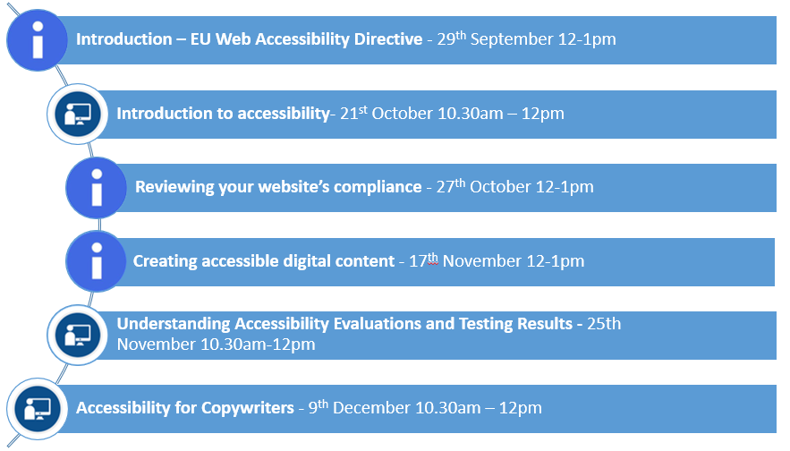
ICS NDA Web Accessibility Directive Training Series

Slide 27
One last thing…
NDA Research Promotion Scheme
The focus of research topics for this year is: Assistive Products and Consumer Products that support choice and control for Persons with Disabilities.
Closing date for receipt of applications is: 12 noon on 9th November 2021.
More details available on the NDA website

Slide 28
Thank you
Dónal Rice
Senior Standards and Monitoring Officer
djrice@nda.ie
@_donalrice
086 8567357
www.universaldesign.ie

