Slide 1

An Introduction to the EU Web Accessibility Directive
Welcome! We will begin shortly…
Housekeeping
Attendee microphones and cameras are disabled
Closed captioning is provided
Please type your questions into the on-screen Q&A text box
Time will be put aside towards the end of this session to answer your questions
We would appreciate if you could complete a short survey after the event
A recording of this seminar will become available in the member resources section of ics.ie over the coming days
ICS - The voice of IT Professionals in Ireland – www.ics.ie​

Slide 2

Web Accessibility Directive Training Series
The Irish Computer Society (ICS), in partnership with the National Disability Authority (NDA), is holding a series of 3 information seminars and 3 follow up training webinars on EU Web Accessibility Directive.
Each information seminar is lead by experts in the field of accessibility and is then followed by a more in-depth training webinar provided by AbilityNet on the same topic.
Today’s seminar will give you an overview of the Directive, the obligations it places on public bodies and the standards public websites and mobile apps must comply with and the monitoring function of the National Disability Authority. Speakers will include Donal Rice from the NDA, Carine Marzin from the European Disability Forum (EDF) and Daniel Montalvo from World Wide Web Consortium (W3C).
Further information and registration can be found on ics.ie/events
Become a member of ICS at ics.ie/member
Mary Cleary
Secretary General, ICS
ICS - The voice of IT Professionals in Ireland – www.ics.ie​

Slide 3








EU Web Accessibility Directive
Dónal Rice
Senior Standards and Monitoring Officer
djrice@nda.ie
@_donalrice
086 8567357
www.universaldesign.ie

Slide 4
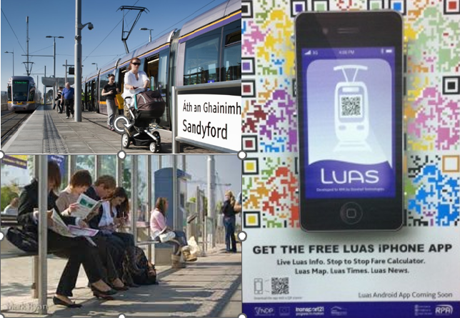
Centre for Excellence in Universal Design
Statutory body, part of NDA
Areas of work:
Standards
Awareness
Education and CPD
Monitoring
Built environment
Products & Services
ICT

Slide 5



Speakers
Dónal Rice, National Disability Authority
Carine Marzin, European Disability Forum
Daniel Montalvo, W3C/WAI

Slide 6

EU Web Accessibility Directive
Carine Marzin, WAI-CooP Project Manager
European Disability Forum
Notes:
EU Web Accessibility Directive
Carine Marzin, WAI-CooP Project Manager
European Disability Forum

Slide 7
About the European Disability Forum
Umbrella organisation of persons with disabilities
100 million persons with disabilities in Europe
Influencing EU law
Focused on implementing United Nations Convention on Rights of Persons with Disabilities (UN CRPD)
Notes:
About the European Disability Forum
Umbrella organisation of persons with disabilities
100 million persons with disabilities in Europe
Influencing EU law
Focused on implementing United Nations Convention on Rights of Persons with Disabilities (UN CRPD)

Slide 8
What is the UN CRPD?
Binding international human rights treaty, ratified by the EU in 2010 and all Member States
Clarifies the rights of persons with disabilities
Establishes accessibility as a general principle
Article 9 on accessibility
Notes:
What is the UN CRPD?
Binding international human rights treaty, ratified by the EU in 2010 and all Member States
Clarifies the rights of persons with disabilities
Establishes accessibility as a general principle
Article 9 on accessibility

Slide 9
Web Accessibility: a priority for EDF
Millions of people impacted
EU Web Accessibility Directive: a unique lever
Accessibility: a ‘must-have’, on a par with privacy and security
Meaningful involvement of persons with disabilities
Notes:
Web Accessibility: a priority for EDF
Millions of people impacted
EU Web Accessibility Directive: a unique lever
Accessibility: a ‘must-have’, on a par with privacy and security
Meaningful involvement of persons with disabilities

Slide 10
Resources
European Disability Forum: https://www.edf-feph.org/
UN Convention on Rights of Persons with Disabilities: https://www.un.org/development/desa/disabilities/convention-on-the-rights-of-persons-with-disabilities.html
Web Accessibility Perspectives Videos (W3C WAI): https://www.w3.org/WAI/perspective-videos/
Notes:
Resources
European Disability Forum: https://www.edf-feph.org/
UN Convention on Rights of Persons with Disabilities: https://www.un.org/development/desa/disabilities/convention-on-the-rights-of-persons-with-disabilities.html
Web Accessibility Perspectives Videos (W3C WAI): https://www.w3.org/WAI/perspective-videos/

Slide 11
What is W3C/WAI
World Wide Web Consortium Web Accessibility Initiative
Develops
  International Standards
  Complementary Resources
Involvement from international organizations and bodies
Open process

Slide 12
WCAG 2 (Current)
2.0 – published 2008
2.1 – published 2018
2.2 – scheduled for 2021
Conformance based on testable statements (SCs)
Notes:
WCAG 2
Focus Visible now level A
Authentication
Dragging Movement
Consistent Help

Slide 13
WCAG 3 (Future)
Web, apps, tools
Change in conformance model
Notes:
WCAG 2
Focus Visible now level A
Authentication
Dragging Movement
Consistent Help

Slide 14
Useful Links
https://www.w3.org/WAI/standards-guidelines/wcag/
https://www.w3.org/WAI/standards-guidelines/wcag/docs/
http://www.w3.org/WAI/WCAG21/quickref/

Slide 15

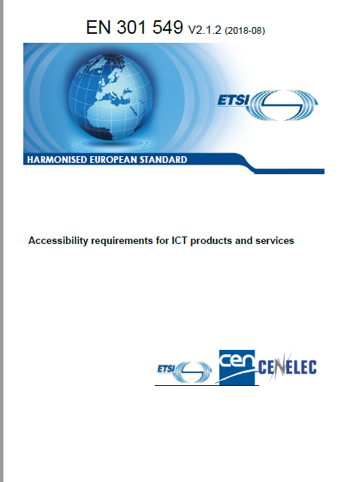


Overview of the EU Web Accessibility Directive
An EU Directive in support of both human rights and single market objectives
Requires the use of internationally accepted web accessibility standards: WCAG 2.1, EN 301 549
Who, what, how and when for public bodies in Ireland

Slide 16
EU Web Accessibility Directive
“Directive (EU) 2016/2102 of the European Parliament and of the Council of 26 October 2016 on the accessibility of the websites and mobile applications of public sector bodies
Transposed into Irish Law on 23 September 2020, under S.I. No. 358/2020 - European Union (Accessibility of Websites and Mobile Applications of Public Sector Bodies) Regulations 2020
Sets a standard for public sector websites
Introduces monitoring of compliance
See overview on the NDA website

Slide 17


Web Accessibility Directive – What public bodies must do
Ensure all their websites and mobile apps comply with AA WCAG 2.1
Provide and maintain a detailed accessibility statement
Include a feedback mechanism and info on asking for support or making a complaint

Slide 18





Scope of content covered
What’s covered
What’s exempt
Office file formats e.g Word, PDF
Navigation
Content
Images
Videos
Embedded content
Forms
Search
Extranets/intranets
Archived content
Some office file formats and videos
Live media and maps
Items in heritage collections
3rd party content not under control of a public body
Extranets / intranets developed before 23 September 2019
Website & mobile apps
Covers ALL content – not just HTML pages
Internal intranet systems used by employees etc
Notes:
Office file formats published before 23 Sept 2018– unless of particular relevance
Videos before 23 September 2018
Live media
Maps – alternative for navigational maps
Reproductions of items in heritage collections
3rd party content not under control of a public body
Extranets / intranets developed before 23 September 2019

Slide 19

The Accessibility Statement must contain:
Compliance status
  State if the website fully/partially/non-compliant
Non-accessible content
  List non-accessible parts. State why (e.g. exempt under legislation, disproportionate burden - assessment)
Preparation of this accessibility statement
  Method used e.g independent audit
Feedback and contact information
  Notify public body of issues
  Name person in charge of dealing with requests
Enforcement procedure
  Equal Status Act 2000 (No. 8 of 2000) and the Disability Act 2005 (No. 14 of 2005) to the extent to which they apply to the body concerned.
Writing an Accessibility Statement

Slide 20




Monitoring
Monitoring
Reporting
NDA national monitoring body
Conducted annually
Register of websites
Reviews:
  In-depth – 5 in 2021
  Mobile app – 2 in 2021
  Simplified – 50 in 2021
When: October 2021
Numbers to increase by 400% in 2022
Report to European Commission by 23 December 2021
Evaluation results, methodology used,
Support capacity building and competence in public sector and web design community
Notes:
Office file formats published before 23 Sept 2018– unless of particular relevance
Videos before 23 September 2018
Live media
Maps – alternative for navigational maps
Reproductions of items in heritage collections
3rd party content not under control of a public body
Extranets / intranets developed before 23 September 2019

Slide 21

ICS NDA Web Accessibility Directive Training Series
28 April: Information Seminar – Accessibility: The right choice - Inclusion, universal design and accessibility in online public services
12 May: Training Webinar - How to Create Accessible Documents and Presentations
26 May: Training Webinar - Accessibility Testing in Mobile Apps
2 June: Information Seminar – Organisational factors to improve accessibility

Slide 22

Resources
EU Web Accessibility Directive
Web Accessibility Techniques
Writing an Accessibility Statement
Guidance and resources

Slide 23

One more thing…
Web Accessibility Techniques

Slide 24
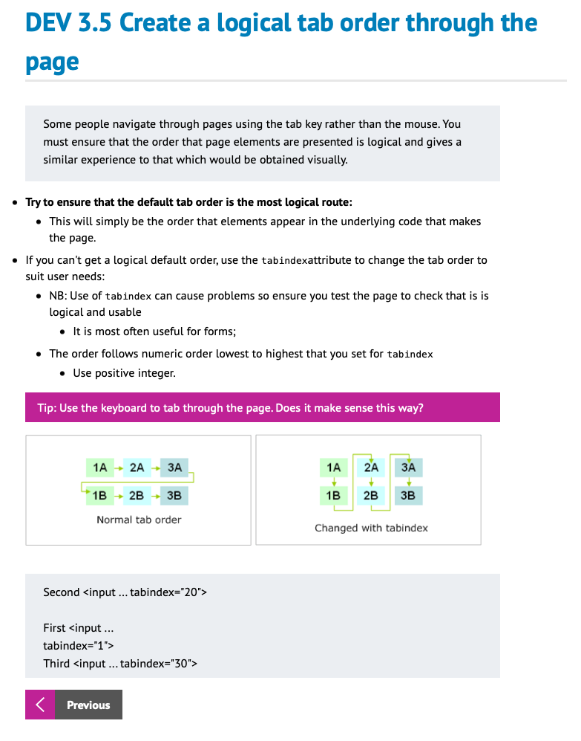



Web Accessibility Techniques
Developers
Designers
Content providers
Each section contains
  Introduction
  50+ Topics and sub-topics
  Examples, code snippets, do’s/don’ts
Web Accessibility Techniques
Notes:
A clear intro
Techniques
Tips
Good and bad examples
Reference to WCAG/EN 301 549 (new)
Updated reference to other resources (new)

Slide 25
Peer reviewersStakeholders

Slide 26

Thank you
Dónal Rice
Senior Design and Policy Advisor
djrice@nda.ie
@_donalrice
086 8567357
www.universaldesign.ie

