Slide 1
The successful implementation of web accessibility standards factors of resistance and support Webinar 2 June 2022 Eric Velleman Based on phd study results 2018
Notes:
© 2022 Copyrights Accessibility Foundation, HAN UAS and Eric Velleman

Slide 2
Introduction
Eric Velleman
Professor Inclusive Digital Design & Engineering (HAN University of Applied Sciences, Arnhem, NL)
Innovation expert at Bartiméus
Scientific advisor Accessibility Foundation

Slide 3
Goal of this ‘lunch’ webinar
Factors determining successful implementation of digital accessibility in your organization
Insight into the different roles in your organization
How to make digital accessibility sustainable

Slide 4
Mentimeter
Mentimeter | menti.com
And use the code that is on the top of the page

Slide 5
MENTI: Where do you work
Government department 13
Stage agency 13
Local authority 2
Publicly funded org 3
Digital agency 4
Disabled persons org 0
Other 5

Slide 6
MENTI: What is your role in the organization
Managerial 9
Administrative 11
Webmaster 4
Content specialist 4
Product owner 0
Developer 6
Designer 3
UX researcher 1
Other 4

Slide 7
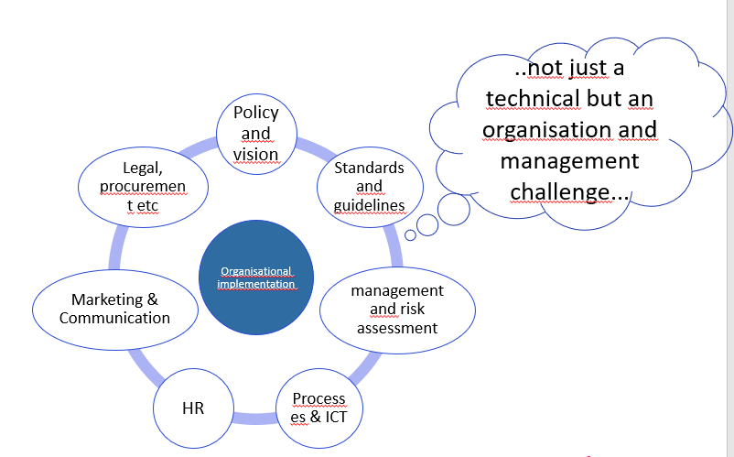
Digital Accessibility Implementation
Research question:
Conclusion:
Roles
Processes
Tools
Knowledge and awareness
End-user involvement

Slide 8
Roles
Managerial
Policy officer
Content specialist
Legal or compliance manager
Initiator / Product owner
Document maker / administrator
ICT advisor
Developer
Tester
HR advisor
Designer
Purchasing IT
Notes:
https://www.digitoegankelijk.nl/sites/default/files/2020-04/Digitale-Toegankelijkheid-In-Jouw-Organisatie.pdf

Slide 9
Processes determining success or failure
Statistical correlations:
Knowledge and awareness
Involvement of (top) management
Organizational embedding (documents, rules,.)
Continuous monitoring information
procurement and tooling
And just important (Involvement of end-users)
The implementation of web accessibility standards by Dutch Municipalities – Factors of resistance and support (2018)

Slide 10
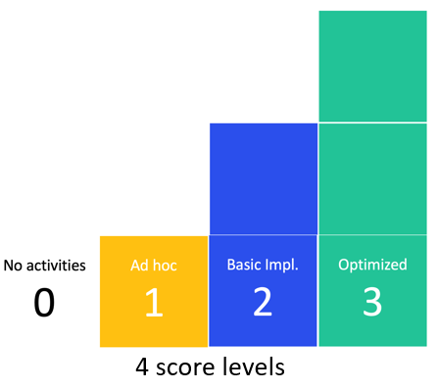
From research to model to maturity tool (ongoing work)
Dimensions:
Knowledge and awareness
Responsibility / governance
Organisation and strategy
Monitoring / prod. lifecycle
Accountability / compliance
Communication
Procurement and tooling
Human Resources
Artefacts
Documents
Measures
Tools
Budget
Etc.
Notes:
Related to the Capability Maturity Model (CMM)

Slide 11
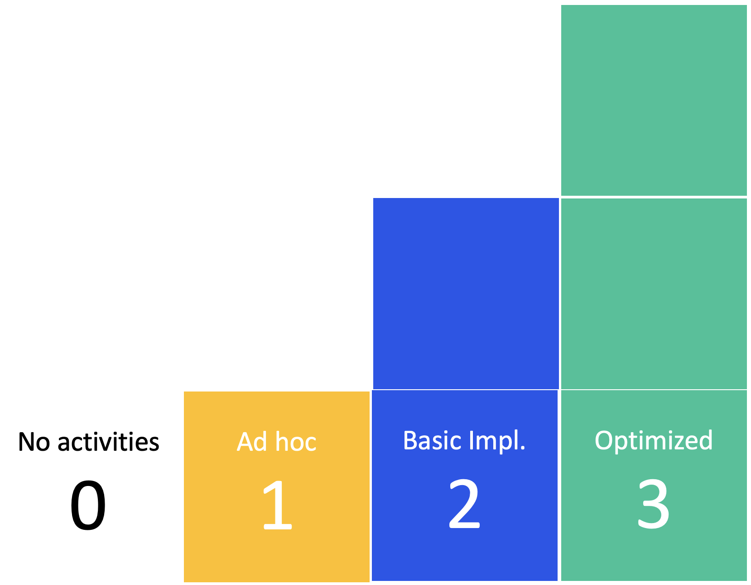
Level 1: ad hoc (example)
“If we hear about an accessibility problem, we fix it”

Slide 12
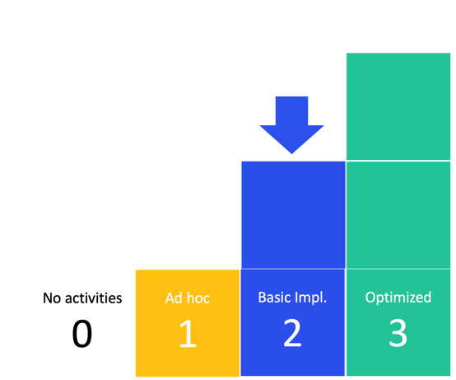
Level 2: implemented (example)
There is a plan for the implementation and monitoring of digital accessibility that has been approved by management

Slide 13
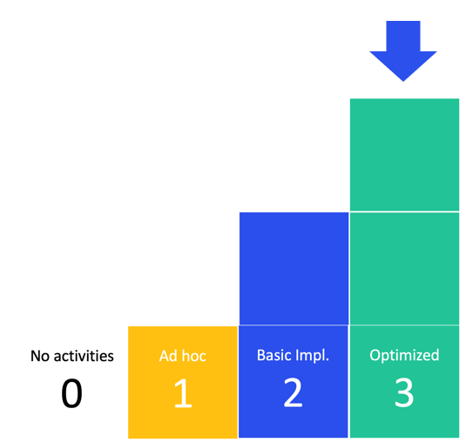
Level 3: optimized (example)
The plan is periodically evaluated and updated if necessary.

Slide 14
Dimension 1: Knowledge and awareness
Examples of artefacts:
EN 301 549, standard for digital accessibility, including WCAG
Current status of digital accessibility
Use of tools for monitoring and repair

Slide 15
MENTI: Knowledge of digital accessibility guidelines standard EN 301 549 including the Web Content Accessibility Guidelines (WCAG)
Level 0 No activities (6)
Level 1 Ad hoc (17)
Level 2 Implemented (13)
Level 3 Optimized (1)

Slide 16
MENTI: Up-to-date information about the accessibility status of your digital products and services
Level 0 No activities (4)
Level 1 Ad hoc (17)
Level 2 Implemented (8)
Level 3 Optimized (3)

Slide 17
Dimension 2: Responsibility / governance
Examples of artefacts:
For all digital products, it has been documented who is responsible for the accessibility of the content
Ownership of digital products/services is clearly documented

Slide 18
MENTI: For all digital products, it has been documented who is responsible for the accessibility of the content
Level 0 No activities (11)
Level 1 Ad hoc (11)
Level 2 Implemented (7)
Level 3 Optimized (1)

Slide 19
Dimension 3: Organisation and strategy
Examples of artefacts:
Digital accessibility is part of our organizational strategy
We include external stakeholders when we design and develop new products and services. This includes persons with disabilities
Digital accessibility accessibility is taken up broadly

Slide 20
MENTI: Digital accessibility is part of our organizational strategy
Level 0 No activities (8)
Level 1 Ad hoc (10)
Level 2 Implemented (9)
Level 3 Optimized (1)

Slide 21
MENTI: We include external stakeholders when we design and develop new products and services. This includes persons with disabilities
Level 0 No activities (12)
Level 1 Ad hoc (9)
Level 2 Implemented (1)
Level 3 Optimized (4)

Slide 22
Dimension 4: Monitoring
Examples of artefacts:
The technical standard is included in acceptance criteria
New features/updates are tested for accessibility before going live
There is a person appointed who is responsible for monitoring

Slide 23
MENTI: The technical standard is included in acceptance criteria
Level 0 No activities (8)
Level 1 Ad hoc (9)
Level 2 Implemented (9)
Level 3 Optimized (0)

Slide 24
MENTI: New features/updates are tested for accessibility before going live
Level 0 No activities (5)
Level 1 Ad hoc (7)
Level 2 Implemented (14)
Level 3 Optimized (0)

Slide 25
Dimension 5: Accountability / compliance
Examples of artefacts:
There is an inventory of the risks involved with non-compliance with accessibility regulations
Responsibilities regarding digital accessibility are documented

Slide 26
MENTI: There is an inventory of the risks involved with non-compliance with accessibility regulations
Level 0 No activities (9)
Level 1 Ad hoc (15)
Level 2 Implemented (1)
Level 3 Optimized (0)

Slide 27
Dimension 6: Communication
Examples of artefacts:
CMS supports digital accessibility
Accessibility is part of our social media policy
We have accessible document templates

Slide 28
MENTI: CMS supports digital accessibility
Level 0 No activities (5)
Level 1 Ad hoc (3)
Level 2 Implemented (15)
Level 3 Optimized (1)

Slide 29
MENTI: Accessibility is part of our social media policy
Level 0 No activities (10)
Level 1 Ad hoc (7)
Level 2 Implemented (9)
Level 3 Optimized (0)

Slide 30
Dimension 7: Procurement and tooling
Examples of artefacts:
Digital accessibility is part of purchasing/procurement conditions
Skills of contractors/suppliers in the field of digital accessibility are checked

Slide 31
MENTI: Digital accessibility is part of purchasing / procurement conditions
Level 0 No activities (12)
Level 1 Ad hoc (4)
Level 2 Implemented (9)
Level 3 Optimized (1)

Slide 32
Dimension 8: Human Resources
Examples of artefacts:
Digital accessibility is part of job requirements
Employees are held accountable

Slide 33
MENTI: Digital accessibility is part of job requirements
Level 0 No activities (15)
Level 1 Ad hoc (5)
Level 2 Implemented (3)
Level 3 Optimized (0)

Slide 34
Organizational processes questionnaire
..not just a technical but an organisation and management challenge...
Based on the research, Accessibility Foundation NL
made a questionnaire to help organizations see where they stand
(www.accessibility.nl)

Slide 35
Questions (and thank you) More information: www.accessibility.nl and HAN Research Group Inclusive Digital Design & Engineering Eric Velleman Seminar 2 June 2022

